Slide 1
boosting
David Kauchak
CS451 – Fall 2013

Slide 2
Admin
Final project

Slide 3
Ensemble learning
Basic idea: if one classifier works well, why not use multiple classifiers!

Slide 4
Ensemble learning
Basic idea: if one classifier works well, why not use multiple classifiers!
Training
learning alg
model 1
learning alg
model 2
Training
Data
…
learning alg
model m

Slide 5
Ensemble learning
Basic idea: if one classifier works well, why not use multiple classifiers!
Testing
model 1
prediction 1
example to label
model 2
prediction 2
…
model m
prediction m

Slide 6
Idea 4: boosting
training data
“training” data 2
“training” data 3
Data
Label
Weight
Data
Label
Weight
Data
Label
Weight
0
0.2
0
0.1
0
0.05
0
0.2
0
0.1
0
0.2
1
0.2
1
0.4
1
0.2
1
0.2
1
0.1
1
0.05
0
0.2
0
0.3
0
0.5

Slide 7
“Strong” learner
Given
a reasonable amount of training data
a target error rate ε
a failure probability p
A strong learning algorithm will produce a classifier with error rate <ε with probability 1-p

Slide 8
“Weak” learner
Given
a reasonable amount of training data
a failure probability p
A weak learning algorithm will produce a classifier with error rate < 0.5 with probability 1-p
Weak learners are much easier to create!

Slide 9
weak learners for boosting
Data
Label
Weight
0
0.2
0
0.2
weak learning algorithm
weak classifier
1
0.2
1
0.2
Which of our algorithms can handle weights?
0
0.2
Need a weak learning algorithm that can handle weighted examples

Slide 10
boosting: basic algorithm
Training:
start with equal example weights
for some number of iterations:
learn a weak classifier and save
change the example weights
Classify:
get prediction from all learned weak classifiers
weighted vote based on how well the weak classifier did when it was trained

Slide 11
boosting basics
Start with equal weighted examples
Weights:
Examples:
E1
E2
E3
E4
E5
Learn a weak classifier:
weak 1

Slide 12
Boosting
classified correct
classified incorrect
Weights:
Examples:
E1
E2
E3
E4
E5
We want to reweight the examples and then learn another weak classifier
How should we change the example weights?
weak 1

Slide 13
Boosting
Weights:
Examples:
E1
E2
E3
E4
E5
decrease the weight for those we’re getting correct
increase the weight for those we’re getting incorrect

Slide 14
Boosting
Weights:
Examples:
E1
E2
E3
E4
E5
Learn another weak classifier:
weak 2

Slide 15
Boosting
Weights:
Examples:
E1
E2
E3
E4
E5
weak 2

Slide 16
Boosting
Weights:
Examples:
E1
E2
E3
E4
E5
decrease the weight for those we’re getting correct
increase the weight for those we’re getting incorrect

Slide 17
Classifying
weak 1
prediction 1
weighted vote based on how well they classify the training data
weak 2
prediction 2
weak_2_vote > weak_1_vote since it got more right
…

Slide 18
Notation
x_{i} example i in the training data
w_{i} weight for example i, we will enforce:
classifier_{k}(x_{i}) +1/-1 prediction of classifier k example i

Slide 19
AdaBoost: train
for k = 1 to iterations:
classifier_{k} = learn a weak classifier based on weights
calculate weighted error for this classifier
calculate “score” for this classifier:
change the example weights

Slide 20
AdaBoost: train
classifier_{k} = learn a weak classifier based on weights
weighted error for this classifier is:
What does this say?

Slide 21
AdaBoost: train
classifier_{k} = learn a weak classifier based on weights
weighted error for this classifier is:
What is the range of possible values?
prediction
did we get the example wrong
weighted sum of the errors/mistakes

Slide 22
AdaBoost: train
classifier_{k} = learn a weak classifier based on weights
weighted error for this classifier is:
Between 0, if we get all examples right, and 1, if we get them all wrong
prediction
did we get the example wrong
weighted sum of the errors/mistakes

Slide 23
AdaBoost: train
classifier_{k} = learn a weak classifier based on weights
“score” or weight for this classifier is:
What does this look like (specifically for errors between 0 and 1)?

Slide 24
AdaBoost: train
ranges from 1 to -1
errors of 50% = 0

Slide 25
AdaBoost: classify
What does this do?

Slide 26
AdaBoost: classify
The weighted vote of the learned classifiers weighted by α(remember αvaries from 1 to -1 training error)
What happens if a classifier has error >50%

Slide 27
AdaBoost: classify
The weighted vote of the learned classifiers weighted by α(remember αvaries from 1 to -1 training error)
We actually vote the opposite!

Slide 28
AdaBoost: train, updating the weights
update the example weights
Remember, we want to enforce:
Z is called the normalizing constant. It is used to make sure that the weights sum to 1
What should it be?

Slide 29
AdaBoost: train
update the example weights
Remember, we want to enforce:
normalizing constant (i.e. the sum of the “new” w_{i}):

Slide 30
AdaBoost: train
update the example weights
What does this do?

Slide 31
AdaBoost: train
update the example weights
correct positive
incorrect negative
correct
incorrect
?

Slide 32
AdaBoost: train
update the example weights
correct positive
incorrect negative
correct small value
incorrect large value
Note: only change weights based on current classifier (not all previous classifiers)

Slide 33
AdaBoost: train
update the example weights
What does the αdo?

Slide 34
AdaBoost: train
update the example weights
What does the αdo?
If the classifier was good (<50% error)αis positive:
trust classifier output and move as normal
If the classifier was back (>50% error)αis negative
classifier is so bad, consider opposite prediction of classifier

Slide 35
AdaBoost: train
update the example weights
correct positive
incorrect negative
correct small value
incorrect large value
If the classifier was good (<50% error)αis positive
If the classifier was back (>50% error)αis negative

Slide 36
AdaBoost justification
update the example weights
Does this look like anything we’ve seen before?

Slide 37
AdaBoost justification
update the example weights
Exponential loss!
AdaBoost turns out to be another approach for minimizing the exponential loss!

Slide 38
Other boosting variants
Adaboost =
Logitboost
Loss
Brownboost
0-1 loss
loss
Mistakes
Correct
Notes:
- many other “boosting” variants besides AdaBoost that can all be equated to different surrogate loss functions

Slide 39
Boosting example
Start with equal weighted data set

Slide 40
Boosting example
weak learner = line
What would be the best line learned on this data set?
h => p(error) = 0.5 it is at chance

Slide 41
Boosting example
How should we reweight examples?
This one seems to be the best
This is a ‘weak classifier’: It performs slightly better than chance.

Slide 42
Boosting example
What would be the best line learned on this data set?
reds on this side get less weight
blues on this side get more weight
reds on this side get more weight
blues on this side get less weight

Slide 43
Boosting example
How should we reweight examples?

Slide 44
Boosting example
What would be the best line learned on this data set?

Slide 45
Boosting example

Slide 46
Boosting example
f₁
f₂
f₄
f₃
The strong (non- linear) classifier is built as the combination of all the weak (linear) classifiers.

Slide 47
AdaBoost: train
for k = 1 to iterations:
classifier_{k} = learn a weak classifier based on weights
weighted error for this classifier is:
“score” or weight for this classifier is:
change the example weights
What can we use as a classifier?
Notes:
- what can we use as a classifier?

Slide 48
AdaBoost: train
for k = 1 to iterations:
classifier_{k} = learn a weak classifier based on weights
weighted error for this classifier is:
“score” or weight for this classifier is:
change the example weights
Anything that can train on weighted examples
For most applications, must be fast!
Why?
Notes:
- what can we use as a classifier?

Slide 49
AdaBoost: train
for k = 1 to iterations:
classifier_{k} = learn a weak classifier based on weights
weighted error for this classifier is:
“score” or weight for this classifier is:
change the example weights
Anything that can train on weighted examples
For most applications, must be fast!
Each iteration we have to train a new classifier
Notes:
- what can we use as a classifier?

Slide 50
Boosted decision stumps
One of the most common classifiers to use is a decision tree:
can use a shallow (2-3 level tree)
even more common is a 1-level tree
called a decision stump ☺
asks a question about a single feature
What does the decision boundary look like for a decision stump?

Slide 51
Boosted decision stumps
One of the most common classifiers to use is a decision tree:
can use a shallow (2-3 level tree)
even more common is a 1-level tree
called a decision stump ☺
asks a question about a single feature
What does the decision boundary look like for boosted decision stumps?

Slide 52
Boosted decision stumps
One of the most common classifiers to use is a decision tree:
can use a shallow (2-3 level tree)
even more common is a 1-level tree
called a decision stump ☺
asks a question about a single feature
Linear classifier!
Each stump defines the weight for that dimension
If you learn multiple stumps for that dimension then it’s the weighted average

Slide 53
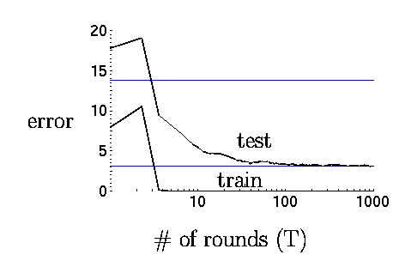
Boosting in practice
Very successful on a wide range of problems
One of the keys is that boosting tends not to overfit, even for a large number of iterations
Using <10,000 training examples can fit >2,000,000 parameters!

Slide 54
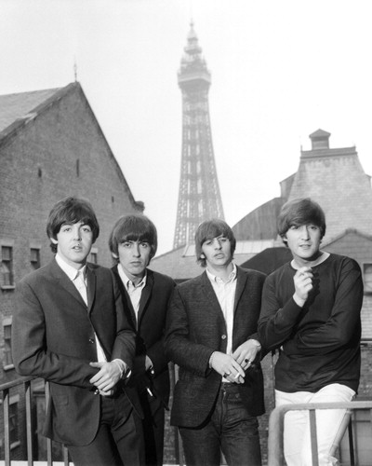
Adaboost application example: face detection

Slide 55
Adaboost application example: face detection

Slide 57
To give you some context of importance:
or:

Slide 58
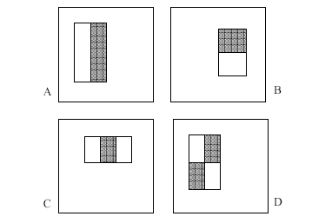
“weak” learners
4 Types of “Rectangle filters” (Similar to Haar wavelets
Papageorgiou, et al. )
Based on 24x24 grid: 160,000 features to choose from
g(x) =
sum(WhiteArea) - sum(BlackArea)

Slide 59
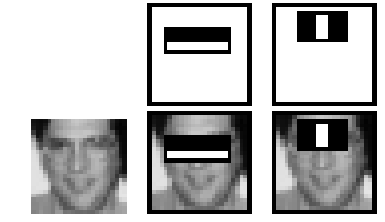
“weak” learners
F(x) = α₁ f₁(x) + α₂ f₂(x) + ...
1 if g_{i}(x) > θ_{i}
-1 otherwise
f_{i}(x) =

Slide 60
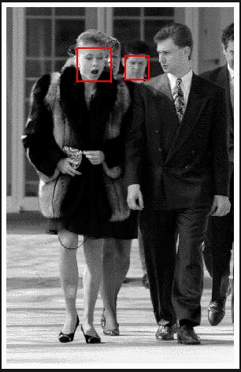
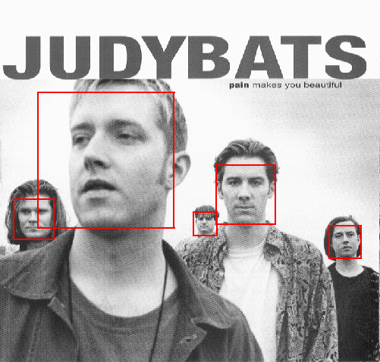
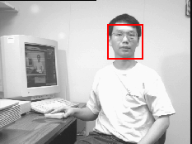
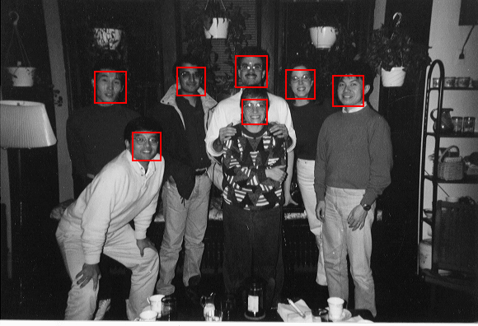
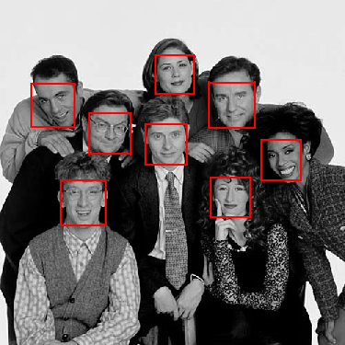
Example output

Slide 61
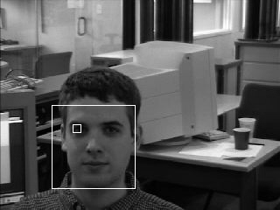
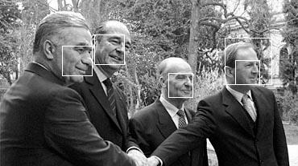
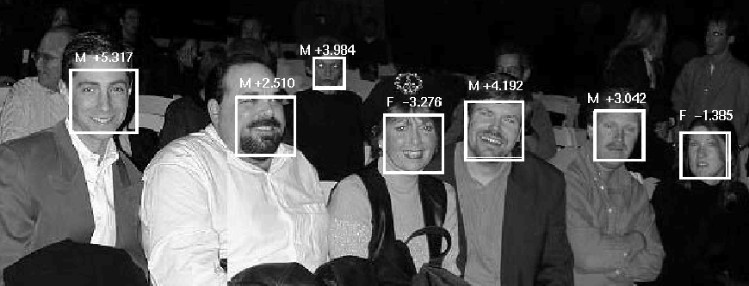
Solving other “Face” Tasks
Facial Feature Localization
Profile Detection
Demographic
Analysis

Slide 62
“weak” classifiers learned

Slide 63
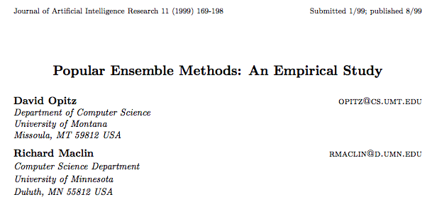
Bagging vs Boosting
http://arxiv.org/pdf/1106.0257.pdf

Slide 64
Boosting Neural Networks
Change in error rate over standard classifier
Ada-Boosting
Arcing
Bagging
White bar represents 1
standard deviation

Slide 65
Boosting Decision Trees

