Slide 1
Features
David Kauchak CS 451 – Fall 2013

Slide 2
Admin
Assignment 2
This class will make you a better programmer!
How did it go?
How much time did you spend?
Assignment 3 out
Implement perceptron variants
See how they differ in performance
Take a break from implementing algorithms after this (for 1-2 weeks)

Slide 3
Features
Terrain | Unicycle-type | Weather | Go-For-Ride?
Trail | Normal | Rainy | NO
Road | Normal | Sunny | YES
Trail | Mountain | Sunny | YES
Road | Mountain | Rainy | YES
Trail | Normal | Snowy | NO
Road | Normal | Rainy | YES
Road | Mountain | Snowy | YES
Trail | Normal | Sunny | NO
Road | Normal | Snowy | NO
Trail | Mountain | Snowy | YES
Where do they come from?

Slide 4
UCI Machine Learning Repository
http://archive.ics.uci.edu/ml/datasets.html

Slide 5
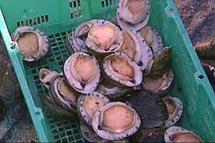
Provided features
Predicting the age of abalone from physical measurements
Name / Data Type / Measurement Unit / Description
-----------------------------
Sex / nominal / -- / M, F, and I (infant)
Length / continuous / mm / Longest shell measurement
Diameter / continuous / mm / perpendicular to length
Height / continuous / mm / with meat in shell
Whole weight / continuous / grams / whole abalone
Shucked weight / continuous / grams / weight of meat
Viscera weight / continuous / grams / gut weight (after bleeding)
Shell weight / continuous / grams / after being dried
Rings / integer / -- / +1.5 gives the age in years

Slide 6
Provided features
Predicting breast cancer recurrence
1. Class: no-recurrence-events, recurrence-events
2. age: 10-19, 20-29, 30-39, 40-49, 50-59, 60-69, 70-79, 80-89, 90-99.
3. menopause: lt40, ge40, premeno.
4. tumor-size: 0-4, 5-9, 10-14, 15-19, 20-24, 25-29, 30-34, 35-39, 40-44, 45-49, 50-54, 55-59.
5. inv-nodes: 0-2, 3-5, 6-8, 9-11, 12-14, 15-17, 18-20, 21-23, 24-26, 27-29, 30-32, 33-35, 36-39.
6. node-caps: yes, no.
7. deg-malig: 1, 2, 3.
8. breast: left, right.
9. breast-quad: left-up, left-low, right-up, right-low, central.
10. irradiated: yes, no.

Slide 7
Provided features
In many physical domains (e.g. biology, medicine, chemistry, engineering, etc.)
the data has been collected and the relevant features identified
we cannot collect more features from the examples (at least “core” features)
In these domains, we can often just use the provided features

Slide 8
Raw data vs. features
In many other domains, we are provided with the raw data, but must extract/identify features
For example
image data
text data
audio data
log data
…

Slide 9
Text: raw data
Raw data
Features?

Slide 10
Feature examples
Raw data
Features
Clinton said banana repeatedly last week on tv, “banana, banana, banana”
(1, 1, 1, 0, 0, 1, 0, 0, …)
clinton
said
california
across
tv
wrong
banana
capital
Occurrence of words

Slide 11
Feature examples
Raw data
Features
Clinton said banana repeatedly last week on tv, “banana, banana, banana”
(4, 1, 1, 0, 0, 1, 0, 0, …)
clinton
said
california
across
tv
wrong
banana
capital
Frequency of word occurrence
Do we retain all the information in the original document?

Slide 12
Feature examples
Raw data
Features
Clinton said banana repeatedly last week on tv, “banana, banana, banana”
(1, 1, 1, 0, 0, 1, 0, 0, …)
clinton said
said banana
across the
tv banana
wrong way
capital city
california schools
banana repeatedly
Occurrence of bigrams

Slide 13
Feature examples
Raw data
Features
Clinton said banana repeatedly last week on tv, “banana, banana, banana”
(1, 1, 1, 0, 0, 1, 0, 0, …)
clinton said
said banana
across the
tv banana
wrong way
capital city
california schools
banana repeatedly
Other features?

Slide 14
Lots of other features
POS: occurrence, counts, sequence
Constituents
Whether ‘V1agra’ occurred 15 times
Whether ‘banana’ occurred more times than ‘apple’
If the document has a number in it
…
Features are very important, but we’re going to focus on the models today

Slide 15
How is an image represented?

Slide 16
How is an image represented?
images are made up of pixels
for a color image, each pixel corresponds to an RGB value (i.e. three numbers)

Slide 17
Image features
for each pixel: R[0-255] G[0-255] B[0-255]
Do we retain all the information in the original document?

Slide 18
Image features
for each pixel: R[0-255] G[0-255] B[0-255]
Other features for images?

Slide 19
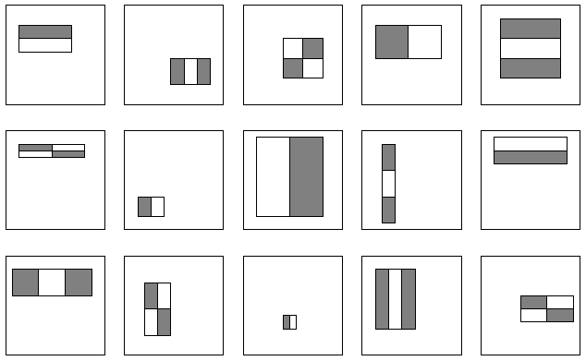
Lots of image features
Use “patches” rather than pixels (sort of like “bigrams” for text)
Different color representations (i.e. L*A*B*)
Texture features, i.e. responses to filters
Shape features
…

Slide 20
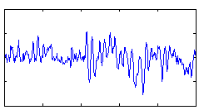
Audio: raw data
How is audio data stored?

Slide 21
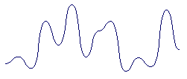
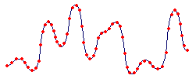
Audio: raw data
Many different file formats, but some notion of the frequency over time
Audio features?

Slide 22
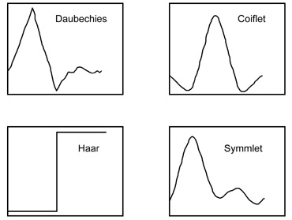
Audio features
frequencies represented in the data (FFT)
frequencies over time (STFT)/responses to wave patterns (wavelets)
beat
timber
energy
zero crossings
…

Slide 23
Obtaining features
Very often requires some domain knowledge
As ML algorithm developers, we often have to trust the “experts” to identify and extract reasonable features
That said, it can be helpful to understand where the features are coming from

Slide 24
Current learning model
training data
(labeled examples)
learn
Terrain | Unicycle-type | Weather | Go-For-Ride?
Trail | Normal | Rainy | NO
Road | Normal | Sunny | YES
Trail | Mountain | Sunny | YES
Road | Mountain | Rainy | YES
Trail | Normal | Snowy | NO
Road | Normal | Rainy | YES
Road | Mountain | Snowy | YES
Trail | Normal | Sunny | NO
Road | Normal | Snowy | NO
Trail | Mountain | Snowy | YES
model/
classifier

Slide 25
Pre-process training data
training data
(labeled examples)
pre-process data
Terrain | Unicycle-type | Weather | Go-For-Ride?
Trail | Normal | Rainy | NO
Road | Normal | Sunny | YES
Trail | Mountain | Sunny | YES
Road | Mountain | Rainy | YES
Trail | Normal | Snowy | NO
Road | Normal | Rainy | YES
Road | Mountain | Snowy | YES
Trail | Normal | Sunny | NO
Road | Normal | Snowy | NO
Trail | Mountain | Snowy | YES
Terrain | Unicycle-type | Weather | Go-For-Ride?
Trail | Normal | Rainy | NO
Road | Normal | Sunny | YES
Trail | Mountain | Sunny | YES
Road | Mountain | Rainy | YES
Trail | Normal | Snowy | NO
Road | Normal | Rainy | YES
Road | Mountain | Snowy | YES
Trail | Normal | Sunny | NO
Road | Normal | Snowy | NO
Trail | Mountain | Snowy | YES
learn
model/
classifier
“better” training data
What types of preprocessing might we want to do?

Slide 26
Outlier detection
What is an outlier?

Slide 27
Outlier detection
An example that is inconsistent with the other examples
What types of inconsistencies?

Slide 28
Outlier detection
An example that is inconsistent with the other examples
extreme feature values in one or more dimensions
examples with the same feature values but different labels

Slide 29
Outlier detection
An example that is inconsistent with the other examples
extreme feature values in one or more dimensions
examples with the same feature values but different labels
Fix?

Slide 30
Removing conflicting examples
Identify examples that have the same features, but differing values
For some learning algorithms, this can cause issues (for example, not converging)
In general, unsatisfying from a learning perspective
Can be a bit expensive computationally (examining all pairs), though faster approaches are available

Slide 31
Outlier detection
An example that is inconsistent with the other examples
extreme feature values in one or more dimensions
examples with the same feature values but different labels
How do we identify these?

Slide 32
Removing extreme outliers
Throw out examples that have extreme values in one dimension
Throw out examples that are very far away from any other example
Train a probabilistic model on the data and throw out “very unlikely” examples
This is an entire field of study by itself! Often called outlier or anomaly detection.

Slide 33
Quick statistics recap
What are the mean, standard deviation, and variance of data?

Slide 34
Quick statistics recap
mean: average value, often written as μ
variance: a measure of how much variation there is in the data. Calculated as:
standard deviation: square root of the variance (written as σ)
How can these help us with outliers?
Notes:
Do you expect the max temp values for each day to have higher variance here or in San Diego?

Slide 35
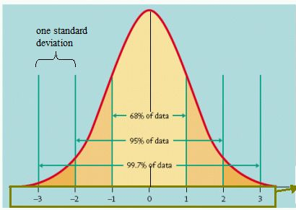
Outlier detection
If we know the data is distributed normally (i.e. via a normal/gaussian distribution)

Slide 36
Outliers in a single dimension
Examples in a single dimension that have values greater than |kσ| can be discarded (for k >>3)
Even if the data isn’t actually distributed normally, this is still often reasonable

Slide 37
Outliers in general
Calculate the centroid/center of the data
Calculate the average distance from center for all data
Calculate standard deviation and discard points too far away
Again, many, many other techniques for doing this

Slide 38
Outliers for machine learning
Some good practices:
Throw out conflicting examples
Throw out any examples with obviously extreme feature values (i.e. many, many standard deviations away)
Check for erroneous feature values (e.g. negative values for a feature that can only be positive)
Let the learning algorithm/other pre-processing handle the rest

Slide 39
Feature pruning
Good features provide us information that helps us distinguish between labels
However, not all features are good
What makes a bad feature and why would we have them in our data?

Slide 40
Bad features
Each of you are going to generate a feature for our data set: pick 5 random binary numbers
f₁
f₂
…
label
I’ve already labeled these examples and I have two features

Slide 41
Bad features
Each of you are going to generate some a feature for our data set: pick 5 random binary numbers
f₁
f₂
…
label
1
0
1
1
0
Is there any problem with using your feature in addition to my two real features?

