Slide 1
xkcd.com/208
Regex comic
  http://xkcd.com/208
Cleverbot video
  http://www.youtube.com/watch?v=WnzlbyTZsQY

Slide 2
CORpus analysis
David Kauchak
NLP – Fall 2014

Slide 3
Administrivia
Assignment 0
Assignment 1 out
  due Thursday 11th
  no code submitted, but will require coding
  Will require some command-line work
Reading
CS lab accounts
Send videos…

Slide 4
NLP models
How do people learn/acquire language?

Slide 5
NLP models
A lot of debate about how human’s learn language
  Rationalist (e.g. Chomsky)
  Empiricist
From my perspective (and many people who study NLP)…
  I don’t care :)
Strong AI vs. weak AI: don’t need to accomplish the task the same way people do, just the same task
  Machine learning
  Statistical NLP

Slide 6
Vocabulary
Word
  a unit of language that native speakers can identify
  words are the blocks from which sentences are made
Sentence
  a string of words satisfying the grammatical rules of a language
Document
  A collection of sentences
Corpus
  A collection of related texts

Slide 7
Corpus examples
Any you’ve seen or played with before?

Slide 8
Corpus characteristics
What are some defining characteristics of corpora?

Slide 9
Corpus characteristics
monolingual vs. parallel
language
annotated (e.g. parts of speech, classifications, etc.)
source (where it came from)
size

Slide 10
Corpus examples
Linguistic Data Consortium
  http://www.ldc.upenn.edu/Catalog/byType.jsp
Dictionaries
  WordNet – 206K English words
  CELEX2 – 365K German words
Monolingual text
  Gigaword corpus
    4M documents (mostly news articles)
    1.7 trillion words
    11GB of data (4GB compressed)
  Enron e-mails
    517K e-mails

Slide 11
Corpus examples
Monolingual text continued
  Twitter
  Chatroom
  Many non-English resources
Parallel data
  ~10M sentences of Chinese-English and Arabic-English
  Europarl
    ~1.5M sentences English with 10 different languages
  200K sentences of English Wikipedia—Simple English Wikipedia

Slide 12
Corpus examples
Annotated
  Brown Corpus
    1M words with part of speech tag
  Penn Treebank
    1M words with full parse trees annotated
  Other treebanks
    Treebank refers to a corpus annotated with trees (usually syntactic)
    Chinese: 51K sentences
    Arabic: 145K words
    many other languages…
    BLIPP: 300M words (automatically annotated)
Notes:
Many other data

Slide 13
Corpora examples
Many others…
  Spam and other text classification
  Google n-grams
    2006 (24GB compressed!)
    13M unigrams
    300M bigrams
    ~1B 3,4 and 5-grams
  Speech
  Video (with transcripts)

Slide 14
Corpus analysis
Corpora are important resources
Often give examples of an NLP task we’d like to accomplish
Much of NLP is data-driven!
A common and important first step to tackling many problems is analyzing the data you’ll be processing

Slide 15
Corpus analysis
What types of questions might we want to ask?
How many…
  documents, sentences, words
On average, how long are the:
  documents, sentences, words
What are the most frequent words? pairs of words?
How many different words are used?
Data set specifics, e.g. proportion of different classes?
…

Slide 16
Corpora issues
Somebody gives you a file and says there’s text in it
Issues with obtaining the text?
  text encoding
  language recognition
  formatting (e.g. web, xml, …)
  misc. information to be removed
    header information
    tables, figures
    footnotes

Slide 17
A rose by any other name…
Word
  a unit of language that native speakers can identify
  words are the blocks from which sentences are made
Concretely:
  We have a stream of characters
  We need to break into words
  What is a word?
  Issues/problem cases?
  Word segmentation/tokenization?

Slide 18
Tokenization issues: ‘
Finland’s capital…
?

Slide 19
Tokenization issues: ‘
Finland’s capital…
Finland
Finland ‘ s
Finland ‘s
Finlands
Finland s
Finland’s
What are the benefits/drawbacks?

Slide 20
Tokenization issues: ‘
Aren’t we …
?

Slide 21
Tokenization issues: ‘
Aren’t we …
Aren’t
Arent
Are n’t
Aren t
Are not

Slide 22
Tokenization issues: hyphens
Hewlett-Packard
state-of-the-art
co-education
lower-case
take-it-or-leave-it
26-year-old
?

Slide 23
Tokenization issues: hyphens
Hewlett-Packard
state-of-the-art
co-education
lower-case
Keep as is
merge together
  HewlettPackard
  stateoftheart
Split on hyphen
  lower case
  co education
What are the benefits/drawbacks?

Slide 24
More tokenization issues
Compound nouns: San Francisco, Los Angelos, …
  One token or two?
Numbers
  Examples
    Dates: 3/12/91
    Model numbers: B-52
    Domain specific numbers: PGP key - 324a3df234cb23e
    Phone numbers: (800) 234-2333
    Scientific notation: 1.456 e-10

Slide 25
Tokenization: language issues
Lebensversicherungsgesellschaftsangestellter
‘life insurance company employee’
Opposite problem we saw with English (San Francisco)
German compound nouns are not segmented
German retrieval systems frequently use a compound splitter module

Slide 26
Tokenization: language issues
莎拉波娃现在居住在美国东南部的佛罗里达。
Where are the words?
thisissue
Many character based languages (e.g. Chinese) have no spaces between words
  A word can be made up of one or more characters
  There is ambiguity about the tokenization, i.e. more than one way to break the characters into words
  Word segmentation problem
  can also come up in speech recognition

Slide 27
Word counts: Tom Sawyer
How many words?
  71,370 total
  8,018 unique
Is this a lot or a little? How might we find this out?
  Random sample of news articles: 11K unique words
What does this say about Tom Sawyer?
  Simpler vocabulary (colloquial, audience target, etc.)

Slide 28
Word counts
Word | Frequency
the and a to of was it in that he I his you Tom with | 3332 2972 1775 1725 1440 1161 1027 906 877 877 783 772 686 679 642
What are the most frequent words?
What types of words are most frequent?

Slide 29
Word counts
Word Frequency | Frequency of frequency
1 2 3 4 5 6 7 8 9 10 11-50 51-100 > 100 | 3993 1292 664 410 243 199 172 131 82 91 540 99 102
8K words in vocab
71K total occurrences
how many occur once? twice?

Slide 30
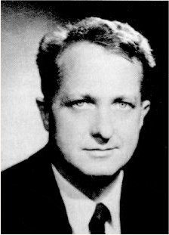
Zipf’s “Law”
The frequency of the occurrence of a word is inversely proportional to its frequency of occurrence ranking
Their relationship is log-linear, i.e. when both are plotted on a log scale, the graph is a straight line
George Kingsley Zipf
1902-1950

Slide 31
Zipf’s law
At a high level:
  a few words occur very frequently
  a medium number of elements have medium frequency
  many words occur very infrequently

Slide 32
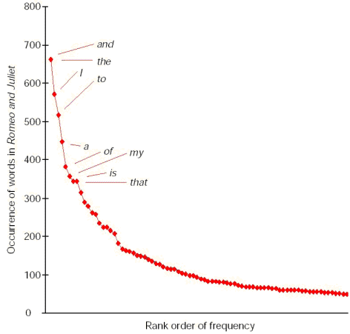
Zipf’s law
The product of the frequency of words (f) and their rank (r) is approximately constant
Constant is corpus dependent, but generally grows roughly linearly with the amount of data

Slide 33
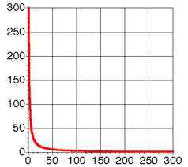
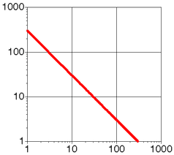
Zipf Distribution

Slide 34
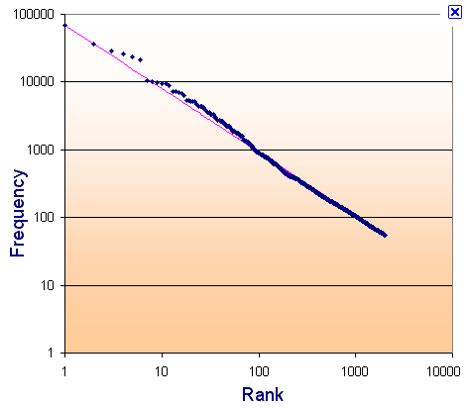
Zipf’s law: Brown corpus
log
log

Slide 35
Zipf’s law: Tom Sawyer
Word | Frequency | Rank
the and | 3332 ? | 1 2

Slide 36
Zipf’s law: Tom Sawyer
Word | Frequency | Rank
the and | 3332 2972 | 1 2

Slide 37
Zipf’s law: Tom Sawyer
Word | Frequency | Rank
the and a | ***** 2972 ? | 1 2 3

Slide 38
Zipf’s law: Tom Sawyer
Word | Frequency | Rank
the and a | ***** 2972 1775 | 1 2 3

Slide 39
Zipf’s law: Tom Sawyer
Word | Frequency | Rank
he friends | 877 ? | 10 800

Slide 40
Zipf’s law: Tom Sawyer
Word | Frequency | Rank
he friends | 877 10 | 10 800

Slide 41
Zipf’s law: Tom Sawyer
Word | Frequency | Rank | C = f * r
the and a he but be Oh two name group friends family sins Applausive | 3332 2972 1775 877 410 294 116 104 21 13 10 8 2 1 | 1 2 3 10 20 30 90 100 400 600 800 1000 3000 8000 | 3332 5944 5235 8770 8400 8820 10440 10400 8400 7800 8000 8000 6000 8000
What does this imply about C/zipf’s law? How would you pick C?
Notes:
It’s more of a “rule of thumb”, than a “law”
Often, estimate C using linear regression (fit a line to the data)

Slide 42
Sentences
Sentence
  a string of words satisfying the grammatical rules of a language
Sentence segmentation
  How do we identify a sentence?
  Issues/problem cases?
  Approach?

Slide 43
Sentence segmentation: issues
A first answer:
  something ending in a: . ? !
  gets 90% accuracy
Dr. Dave gives us just the right amount of homework.
Abbreviations can cause problems

Slide 44
Sentence segmentation: issues
A first answer:
  something ending in a: . ? !
  gets 90% accuracy
The scene is written with a combination of unbridled passion and sure-handed control: In the exchanges of the three characters and the rise and fall of emotions, Mr. Weller has captured the heartbreaking inexorability of separation.
sometimes: : ; and – might also denote a sentence split

Slide 45
Sentence segmentation: issues
A first answer:
  something ending in a: . ? !
  gets 90% accuracy
“You remind me,” she remarked, “of your mother.”
Quotes often appear outside the ending marks

Slide 46
Sentence segmentation
Place initial boundaries after: . ? !
Move the boundaries after the quotation marks, if they follow a break
Remove a boundary following a period if:
  it is a known abbreviation that doesn’t tend to occur at the end of a sentence (Prof., vs.)
  it is preceded by a known abbreviation and not followed by an uppercase word

Slide 47
Sentence length
What is the average sentence length, say for news text?
23
Length | percent | cumul. percent
1-5 6-10 11-15 16-20 21-25 26-30 31-35 36-40 41-45 46-50 51-100 101+ | 3 8 14 17 17 15 11 7 4 2 1 0.01 | 3 11 25 42 59 74 86 92 96 98 99.99 100

Slide 48
Regular expressions
Regular expressions are a very powerful tool to do string matching and processing
Allows you to do things like:
  Tell me if a string starts with a lowercase letter, then is followed by 2 numbers and ends with “ing” or “ion”
  Replace all occurrences of one or more spaces with a single space
  Split up a string based on whitespace or periods or commas or …
  Give me all parts of the string where a digit is proceeded by a letter and then the ‘#’ sign

Slide 49
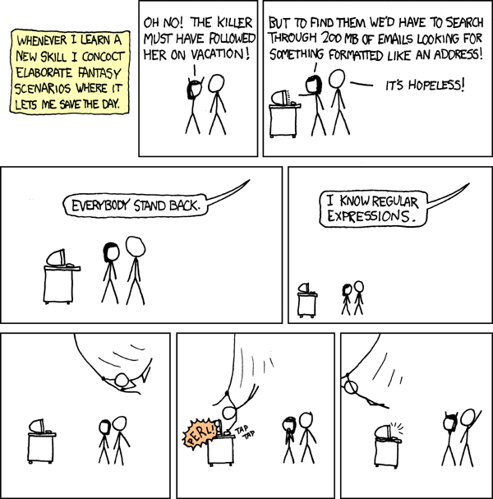
http://xkcd.com/208/

Slide 50
Regular expressions: literals
We can put any string in a regular expression
  /test/
    matches any string that has “test” in it
  /this class/
    matches any string that has “this class” in it
  /Test/
    case sensitive: matches any string that has “Test” in it

Slide 51
Regular expressions: character classes
A set of characters to match:
  put in brackets: []
  [abc] matches a single character a or b or c
For example:
  /[Tt]est/
    matches any string with “Test” or “test” in it
Can use – to represent ranges
    [a-z] is equivalent to [abcdefghijklmnopqrstuvwxyz]
    [A-D] is equivalent to [ABCD]
    [0-9] is equivalent to [0123456789]

Slide 52
Regular expressions: character classes
For example:
  /[0-9][0-9][0-9][0-9]/
    matches any four digits, e.g. a year
Can also specify a set NOT to match
  ^ means all character EXCEPT those specified
  [^a] all characters except ‘a’
  [^0-9] all characters except numbers
  [^A-Z] not an upper case letter

Slide 53
Regular expressions: character classes
Meta-characters (not always available)
  \w - word character (a-zA-Z_0-9)
  \W - non word-character (i.e. everything else)
  \d - digit (0-9)
  \s - whitespace character (space, tab, endline, …)
  \S - non-whitespace
  \b matches a word boundary (whitespace, beginning or end of line)
  . - matches any character

Slide 54
For example
/19\d\d/
  would match any 4 digits starting with 19
/\s/
  matches anything with a whitespace (space, tab, etc)
/\s[aeiou]..\s/
  any three letter word that starts with a vowel

Slide 55
Regular expressions: repetition
* matches zero or more of the preceding character
  /ba*d/
    matches any string with:
      bd
      bad
      baad
      baaad
  /A.*A/
    matches any string starts and ends with A
+ matches one or more of the preceding character
  /ba+d/
    matches any string with
      bad
      baad
      baaad
      baaaad

Slide 56
Regular expressions: repetition
? zero or 1 occurrence of the preceding
  /fights?/
    matches any string with “fight” or “fights” in it
{n,m} matches n to m inclusive
  /ba{3,4}d/
  matches any string with
    baaad
    baaaad

Slide 57
Regular expressions: beginning and end
^ marks the beginning of the line
$ marks the end of the line
/test/
  test can occur anywhere
/^test/
  must start with test
/test$/
  must end with test
/^test$/
  must be exactly test

Slide 58
Regular expressions: repetition revisited
What if we wanted to match:
  This is very interesting
  This is very very interesting
  This is very very very interesting
Would /This is very+ interesting/ work?
  No… + only corresponds to the ‘y’
  /This is (very )+interesting/

Slide 59
Regular expressions: disjunction
| has the lowest precedence and can be used
  /cats|dogs/
    matches:
      cats
      dogs
    does NOT match:
      catsogs

Slide 60
Regular expressions: disjunction
We want to match:
  I like cats
  I like dogs
Does /^I like cats|dogs$/ work?
    No! Matches:
      I like cats
      dogs
    Solution?

Slide 61
Regular expressions: disjunction
We want to match:
  I like cats
  I like dogs
/^I like (cats|dogs)$/
    matches:
      I like cats
      I like dogs

Slide 62
Some examples
All strings that start with a capital letter
IP addresses
  255.255.122.122
Matching a decimal number
All strings that end in ing
All strings that end in ing or ed
All strings that begin and end with the same character

Slide 63
Some examples
All strings that start with a capital letter
  /^[A-Z]/
IP addresses
  /\b\d{1,3}\.\d{1,3}\.\d{1,3}\.\d{1,3}\b/
Matching a decimal number
  /[-+]?[0-9]*\.?[0-9]+/
All strings that end in ing
  /ing$/
All strings that end in ing or ed
  /ing|ed$/

Slide 64
Regular expressions: memory
All strings that begin and end with the same character
Requires us to know what we matched already
()
  used for precedence
  also records a matched grouping, which can be referenced later
/^(.).*\1$/
  all strings that begin and end with the same character

Slide 65
Regular expression: memory
/She likes (\w+) and he likes \1/
We can use multiple matches
  /She likes (\w+) and (\w+) and he also likes \1 and \2/

Slide 66
Regular expressions: substitution
Most languages also allow for substitution
  s/banana/apple/
    substitute first occurrence banana for apple
  s/banana/apple/g
    substitute all occurrences (globally)
  s/^(.*)$/\1 \1/
    duplicate the string, separated by a space
  s/\s+/ /g
    substitute multiple spaces to a space

Slide 67
Regular expressions by language
Java: as part of the String class
  String s = “this is a test”
  s.matches(“test”)
  s.matches(“.*test.*”)
  s.matches(“this\\sis .* test”)
  s.split(“\\s+”)
  s.replaceAll(“\\s+”, “ “);
  Be careful, matches must match the whole string (i.e. an implicit ^ and $)

Slide 68
Regular expressions by language
Java: java.util.regex
  Full regular expression capabilities
  Matcher class: create a matcher and then can use it
  String s = “this is a test”
  Pattern pattern = Pattern.compile(“is\\s+”)
  Matcher matcher = pattern.matcher(s)
  matcher.matches()
  matcher.find()
  matcher.replaceAll(“blah”)
  matcher.group()

Slide 69
Regular expressions by language
Python:
  import re
  s = “this is a test”
  p = re.compile(“test”)
  p.match(s)
  p = re.compile(“.*test.*”)
  re.split(‘\s+’, s)
  re.sub(‘\s+’, ‘ ‘, s)

Slide 70
Regular expressions by language
perl:
  $s = “this is a test”
  $s =~ /test/
  $s =~ /^test$/
  $s =~ /this\sis .* test/
  split /\s+/, $s
  $s =~ s/\s+/ /g

Slide 71
Regular expression by language
grep
  command-line tool for regular expressions (general regular expression print/parser)
  returns all lines that match a regular expression
  grep “@” twitter.posts
  grep “http:” twiter.posts
  can’t used metacharacters (\d, \w), use [] instead
  Often want to use “grep –E” (for extended syntax)

Slide 72
Regular expression by language
sed
  another command-line tool that uses regexs to print and manipulate strings
  very powerful, though we’ll just play with it
  Most common is substitution:
    sed “s/ is a / is not a /g” twitter.posts
    sed “s/ */ /g” twitter.posts
      sed doesn’t have +, but does have *
  Can also do things like delete all that match, etc.

Slide 73
Regular expression resources
General regular expressions:
  Ch 2.1 of the book
  http://www.regular-expressions.info/
    good general tutorials
    many language specific examples as well
Java
  http://download.oracle.com/javase/tutorial/essential/regex/
  See also the documentation for java.util.regex
Python
  http://docs.python.org/howto/regex.html
  http://docs.python.org/library/re.html

Slide 74
Regular expression resources
Perl
  http://perldoc.perl.org/perlretut.html
  http://perldoc.perl.org/perlre.html
grep
  See the write-up at the end of Assignment 1
  http://www.panix.com/~elflord/unix/grep.html
sed
  See the write-up at the end of Assignment 1
  http://www.grymoire.com/Unix/Sed.html
  http://www.panix.com/~elflord/unix/sed.html

