Slide 1
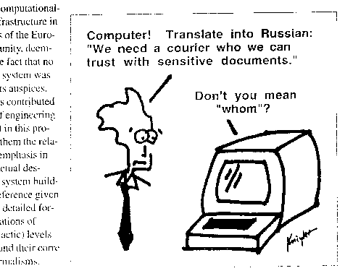
Kevin Knight, http://www.isi.edu/natural-language/people/pictures/ieee-expert-1.gif

Slide 2
Modeling Natural Text
David Kauchak
CS159 – Fall 2014

Slide 3
Admin
Projects
  Status report due today (before class)
  12/10 5pm paper draft
  12/16 2pm final paper, code and presentation
Schedule for the rest of the semester
  Thurday: text simplification
  Tuesday: 1 hr quiz + presentation info

Slide 4

Document Modeling
http://whatshaute.com/index.php/2011/05/win-this-limited-edition-silk-scarf-and-inside-book-by-best-selling-author-brenda-novak/brenda-novak-scarf-inside-book-giveaway-model-front/

Slide 5
Modeling natural text
You’re goal is to create a probabilistic model of natural (human) text.
What are some of the questions you might want to ask about a text?
What are some of the phenomena that occur in natural text that you might need to consider/model?

Slide 6
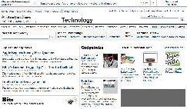
Modeling natural text
Questions
what are the key topics in the text?
what is the sentiment of the text?
who/what does the article refer to?
what are the key phrases?
…
Phenomena
synonymy
sarcasm/hyperbole
variety of language (slang), mispellings
coreference (e.g. pronouns like he/she)
…
Notes:
We want to try and create computer/mathematical models that can handle questions about these text documents.
What questions do we want to ask about these texts?

Slide 7
Document modeling: learn a probabilistic model of documents
Predict the likelihood that an unseen document belongs to a set of documents
?
Model should capture text characteristics
Notes:
“Let’s transition…”
Use the term “document” to represent any body of text, e.g. web page, e-mail, tweet
A document model, is one component to tackling some of these applications

Slide 8
Training a document model
training
documents
model parameter estimation
document model

Slide 9
Applying a document model
Document model: what is the probability the new document is in the same “set” as the training documents?
probability
new document
document model

Slide 10
Document model applications
?

Slide 11





Applications
search engines
search
advertising
corporate databases
language generation
I think, therefore I am
I am
speech recognition
machine translation
text simplification
text classification and clustering
☺
☹
SPAM
sentiment analysis
document hierarchies
Notes:
Just to name a few…

Slide 12
Application: text classification
Category
sports
politics
entertainment
business
…
?
Spam
spam
not-spam
Sentiment
positive
negative

Slide 13
Text classification: Training
SPAM
model parameter estimation
non-SPAM

Slide 14
Text classification: Applying
probability of document being SPAM
Is it SPAM or non-SPAM?
which is larger?
probability of document being non-SPAM

Slide 15
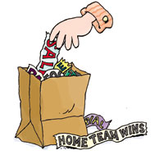
Representation and Notation
Standard representation: bag of words
  Fixed vocabulary ~50K words
  Documents represented by a count vector, where each dimension represents the frequency of a word
(4, 1, 1, 0, 0, 1, 0, 0, …)
Clinton said banana repeatedly last week on tv, “banana, banana, banana”
clinton
said
california
across
tv
wrong
banana
capital
Representation allows us to generalize across documents
Downside?
Notes:
aka vector space model

Slide 16
Representation and Notation
Standard representation: bag of words
  Fixed vocabulary ~50K words
  Documents represented by a count vector, where each dimension represents the frequency of a word
(4, 1, 1, 0, 0, 1, 0, 0, …)
Clinton said banana repeatedly last week on tv, “banana, banana, banana”
clinton
said
california
across
tv
wrong
banana
capital
Representation allows us to generalize across documents
Downside: lose word ordering information

Slide 17
Word burstiness
What is the probability that a political document contains the word “Clinton” exactly once?
The Stacy Koon-Lawrence Powell defense! The decisions of Janet Reno and Bill Clinton in this affair are essentially the moral equivalents of Stacy Koon's. …
p(“Clinton”=1|political)= 0.12
Notes:
- I mentioned many phenomena that occur in natural text. Today, I’d like to focus on one in particular… burstiness

Slide 18
Word burstiness
What is the probability that a political document contains the word “Clinton” exactly twice?
The Stacy Koon-Lawrence Powell defense! The decisions of Janet Reno and Bill Clinton in this affair are essentially the moral equivalents of Stacy Koon's. Reno and Clinton have the advantage in that they investigate themselves.
p(“Clinton”=2|political)= 0.05

Slide 19
Word burstiness in models
p(“Clinton”=1|political)= 0.12
Under the multinomial model, how likely is p(“Clinton” = 2 | political)?

Slide 20
Word burstiness in models
p(“Clinton”=2|political)= 0.05
Many models incorrectly predict:
p(“Clinton”=2|political) ≈ p(“Clinton”=1|political)²
0.05 ≠ 0.0144 (0.12²)
And in general, predict:
p(“Clinton”=i|political) ≈ p(“Clinton”=1|political)^{i}

Slide 21
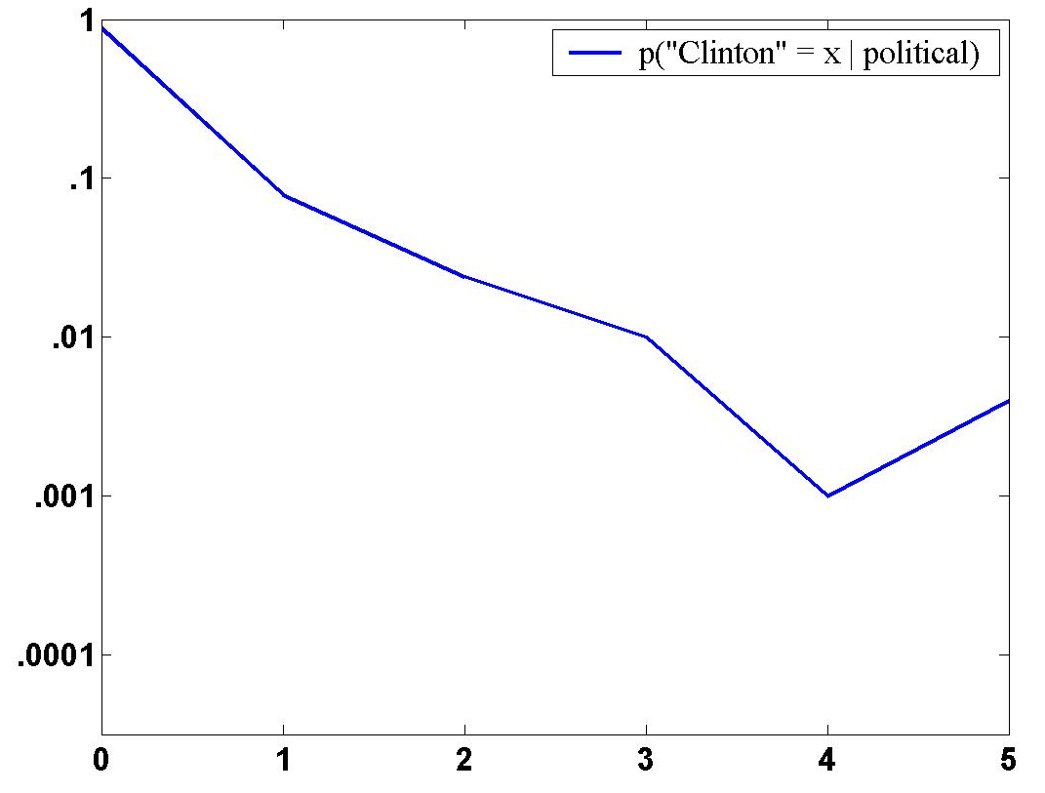
p(“Clinton” = x | political)
probability
“Clinton” occurs exactly x times in document
Notes:
even having Clinton occur 5 times in an article is still fairly probable (once in a few hundred articles)
exponential y-axis
predicted is something more like 1 in 10,000 articles (orders of magnitude off)

Slide 22
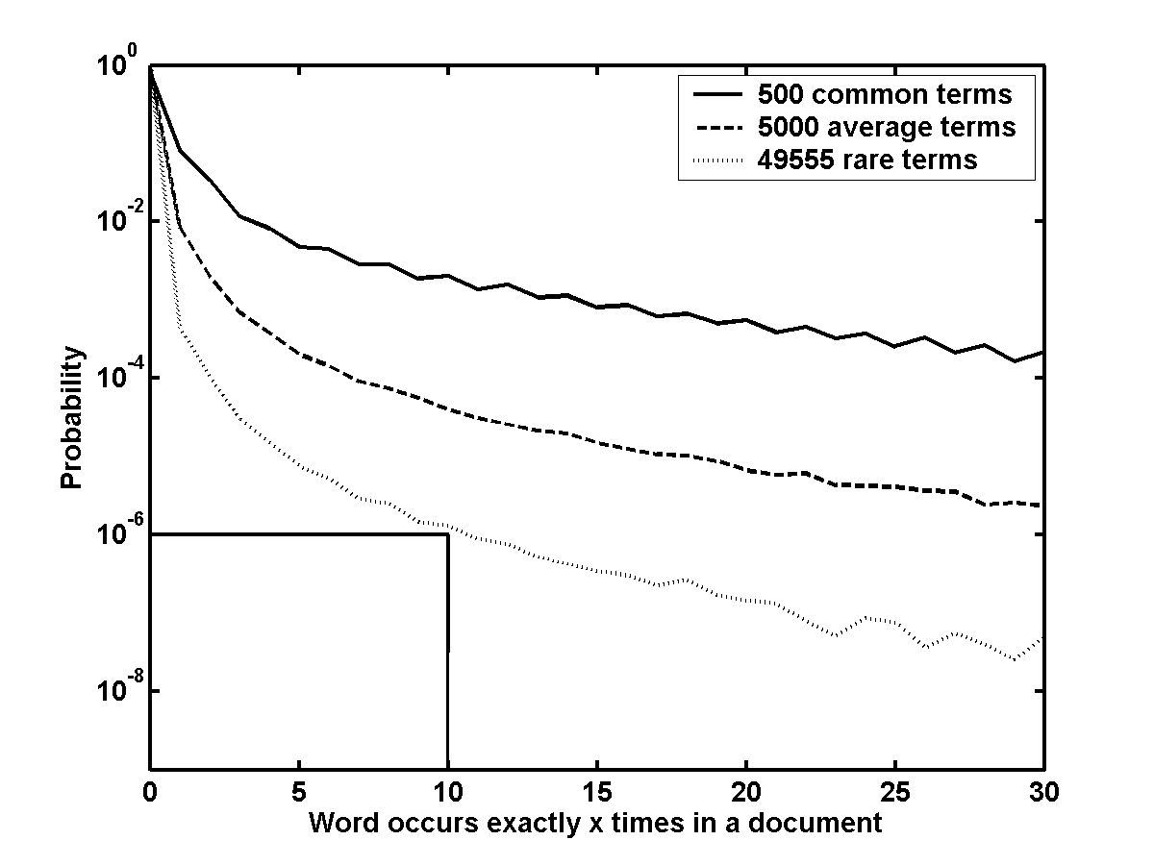
Word count probabilities
common words – 71% of word occurrences and 1% of the vocabulary
average words – 21% of word occurrences and 10% of the vocabulary
rare words – 8% or word occurrences and 89% of the vocabulary
Notes:
- decreasing probability on an exponential scale

Slide 23
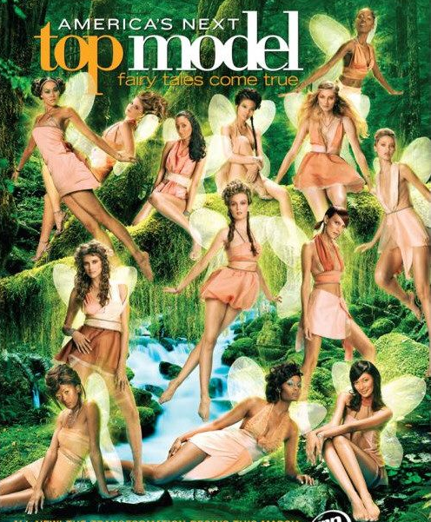
The models…

Slide 24
Multinomial model
20 rolls of a fair, 6-side die –
each number is equally probable
(1, 10, 5, 1, 2, 1)
(3, 3, 3, 3, 4, 4)
ones
twos
threes
fives
fours
sixes
ones
twos
threes
fives
fours
sixes
Which is more probable?

Slide 25
Multinomial model
20 rolls of a fair, 6-side die –
each number is equally probable
(1, 10, 5, 1, 2, 1)
(3, 3, 3, 3, 4, 4)
ones
twos
threes
fives
fours
sixes
ones
twos
threes
fives
fours
sixes
How much more probable?

Slide 26
Multinomial model
20 rolls of a fair, 6-side die –
each number is equally probable
(1, 10, 5, 1, 2, 1)
(3, 3, 3, 3, 4, 4)
0.000000764
0.000891
1000 times more likely

Slide 27
Multinomial model for text
Many more “sides” on the die than 6, but the same concept…
(4, 1, 1, 0, 0, 1, 0, 0, …)
banana
multinomial
document model
clinton
said
california
across
tv
wrong
capital
probability
Notes:
- for the multinomial, the “learned” parameters are the probabilities of a word occurring (i.e. the probability of a die side coming up)

Slide 28

Generative Story
To apply a model, we’re given a document and we obtain the probability
We can also ask how a given model would generate a document
This is the “generative story” for a model
Notes:
- although we don’t generally “generate” a document from a model, it’s often useful to look at the generative story of a model (i.e. how the model says a document was generate) to help us understand why the model assigns certain probabilities

Slide 29
Multinomial Urn:
Drawing words from a multinomial
Selected:
w₁
w₃
w₂
w₁
w₁
w₁
w₃
Notes:
- model defines the proportion of words in the urn

Slide 30
Drawing words from a multinomial
Selected:
w₁
w₃
w₂
w₁
w₁
w₁
w₃

Slide 31
Drawing words from a multinomial
Selected:
w₁
Put a copy of w₁ back
w₁
w₃
sampling with replacement
w₂
w₁
w₁
w₁
w₃

Slide 32
Drawing words from a multinomial
Selected:
w₁
w₁
w₁
w₃
w₂
w₁
w₁
w₃

Slide 33
Drawing words from a multinomial
Selected:
w₁
w₁
Put a copy of w₁ back
w₁
w₃
sampling with replacement
w₂
w₁
w₁
w₁
w₃

Slide 34
Drawing words from a multinomial
Selected:
w₁
w₁
w₂
w₁
w₃
w₁
w₁
w₁
w₃

Slide 35
Drawing words from a multinomial
Selected:
w₁
w₁
w₂
Put a copy of w₂ back
w₁
w₃
sampling with replacement
w₂
w₁
w₁
w₁
w₃

Slide 36
Drawing words from a multinomial
Selected:
w₁
w₁
w₂
…
w₁
w₃
w₂
w₁
w₁
w₁
w₃

Slide 37
Drawing words from a multinomial
Does the multinomial model capture burstiness?

Slide 38
Drawing words from a multinomial
p(word) remains constant, independent of which words have already been drawn (in particular, how many of this particular word have been drawn)
burstiness

Slide 39
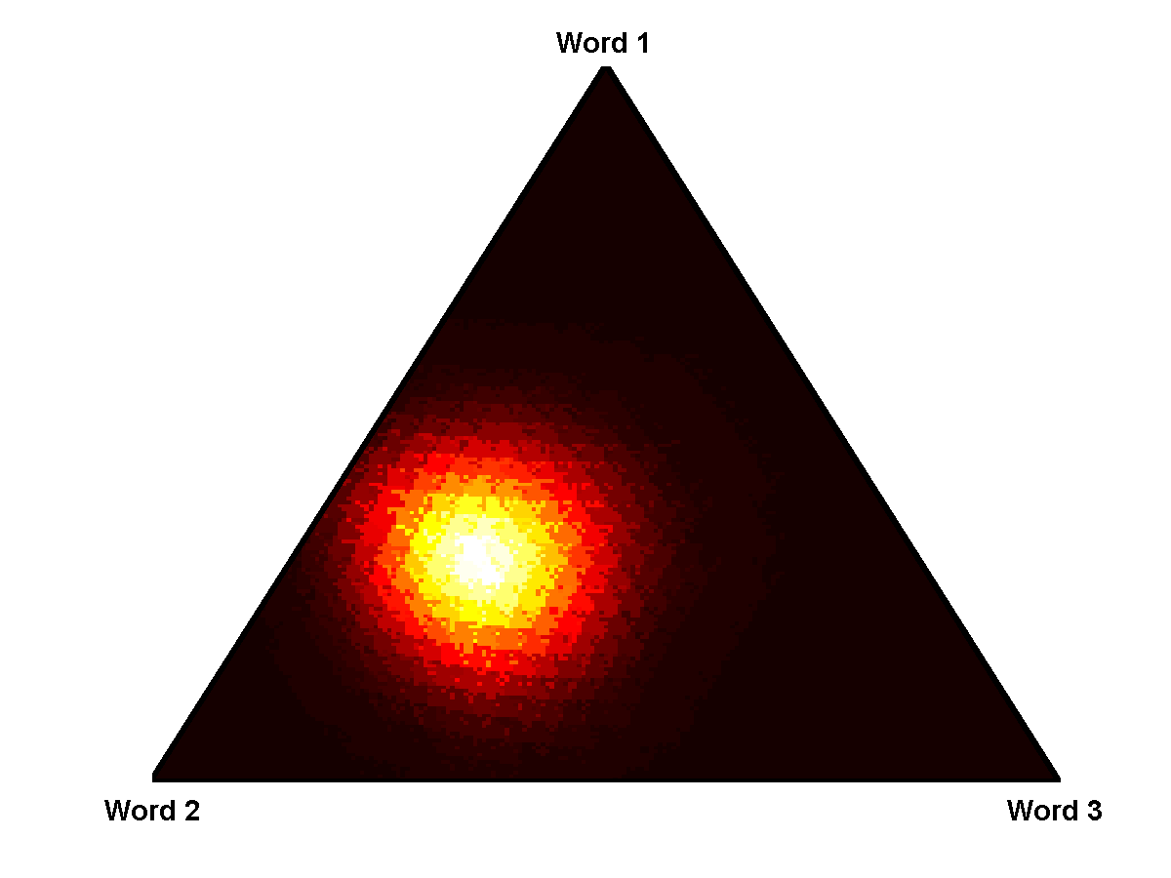
Multinomial probability simplex
Generate documents containing 100 words from a multinomial with just 3 possible words
word 1
word 2
word 3
{0.31, 0.44, 0.25}

Slide 40
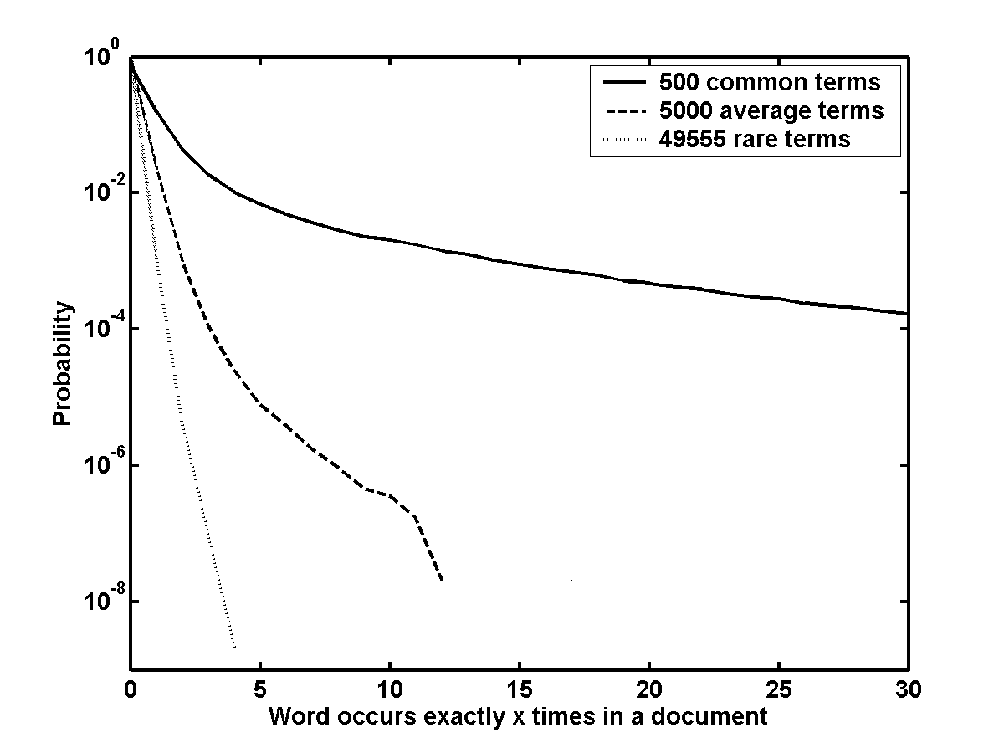
Multinomial word count probabilities

Slide 41

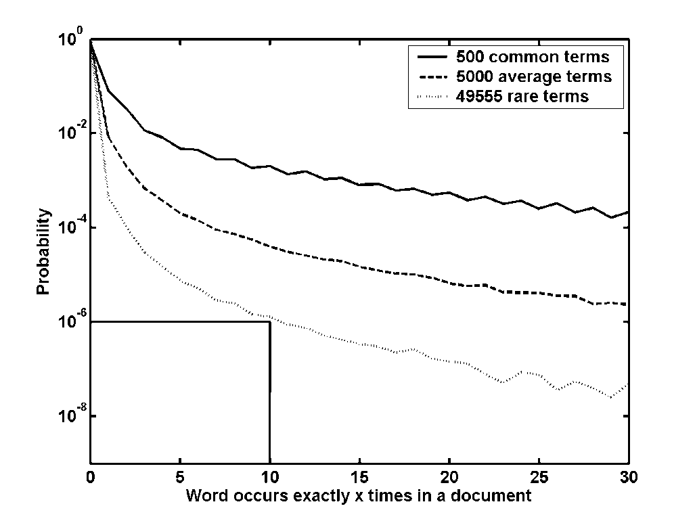
Multinomial does not model burstiness of average and rare words

Slide 42
Better model of burstiness: DCM
Dirichlet Compound Multinomial
Polya Urn process
  KEY: Urn distribution changes based on previous words drawn
  Generative story:
    Repeat until document length hit
      Randomly draw a word from urn – call it w_{i}
      Put 2 copies of w_{i} back in urn

Slide 43
Drawing words from a Polya urn
Selected:
w₁
w₃
w₂
w₁
w₁
w₁
w₃

Slide 44
Drawing words from a Polya urn
Selected:
w₁
w₃
w₂
w₁
w₁
w₁
w₃

Slide 45
Drawing words from a Polya urn
Selected:
w₁
Put 2 copies of w₁ back
w₁
w₃
Adjust parameters
w₂
w₁
w₁
w₁
w₁
w₃

Slide 46
Drawing words from a Polya urn
Selected:
w₁
w₁
w₁
w₃
w₂
w₁
w₁
w₁
w₃

Slide 47
Drawing words from a Polya urn
Selected:
w₁
w₁
Put 2 copies of w₁ back
w₁
w₁
w₃
Adjust parameters
w₂
w₁
w₁
w₁
w₁
w₃

Slide 48
Drawing words from a Polya urn
Selected:
w₁
w₁
w₂
w₁
w₁
w₃
w₁
w₁
w₁
w₁
w₃

Slide 49
Drawing words from a Polya urn
Selected:
w₁
w₁
w₂
Put 2 copies of w₂ back
w₁
w₁
w₃
Adjust parameters
w₂
w₂
w₁
w₁
w₁
w₁
w₃

Slide 50
Drawing words from a Polya urn
Selected:
w₁
w₁
w₂
…
w₁
w₁
w₃
w₂
w₂
w₁
w₁
w₁
w₁
w₃

Slide 51

Polya urn
Words already drawn are more likely to be seen again
Results in the Dirichlet Compound Multinomial (DCM) distribution

Slide 52
Controlling burstiness
Same distribution of words
Which is more bursty?
more bursty
less bursty

Slide 53
Polya urn
Words already drawn are more likely to be seen again
Results in the DCM distribution
We can modulate burstiness by increasing/decreasing the number of words in the urn while keeping distribution the same

Slide 54
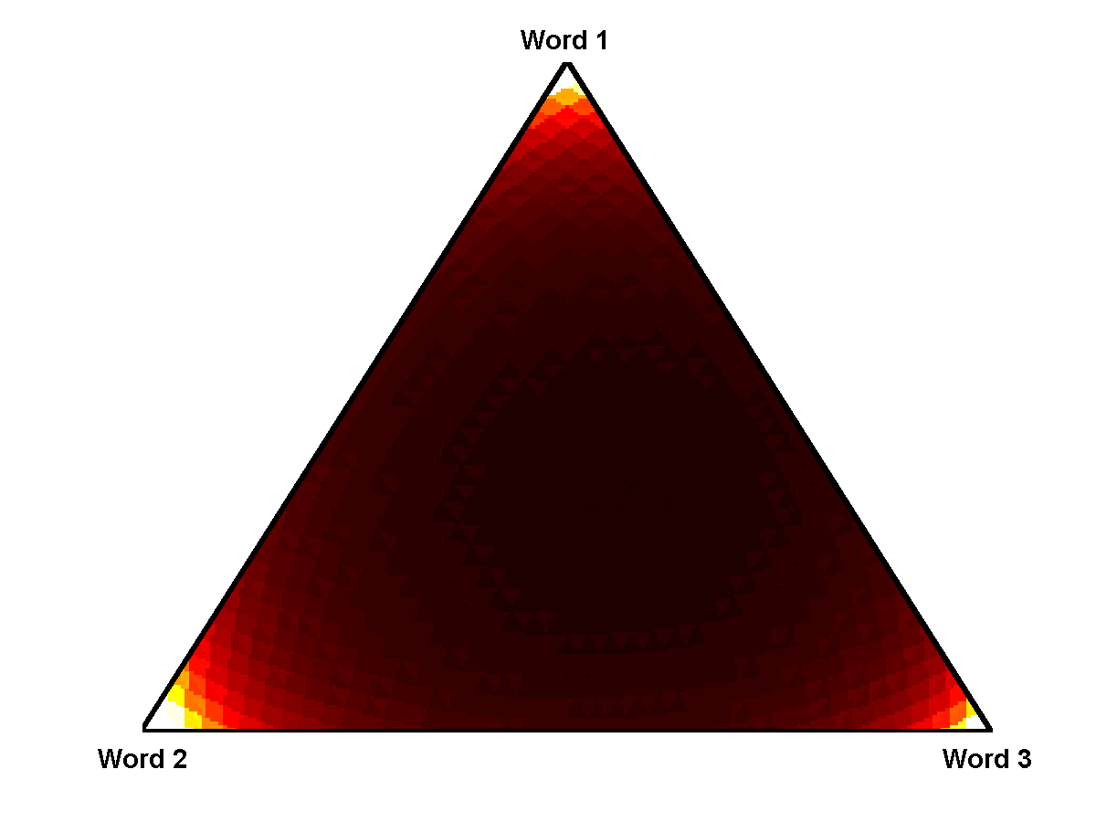
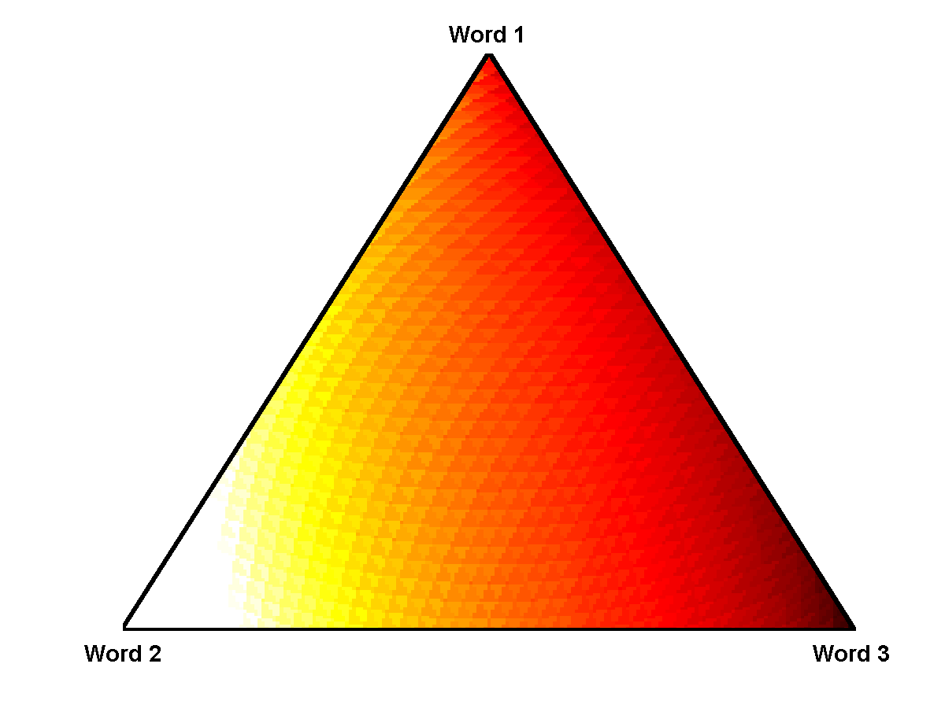
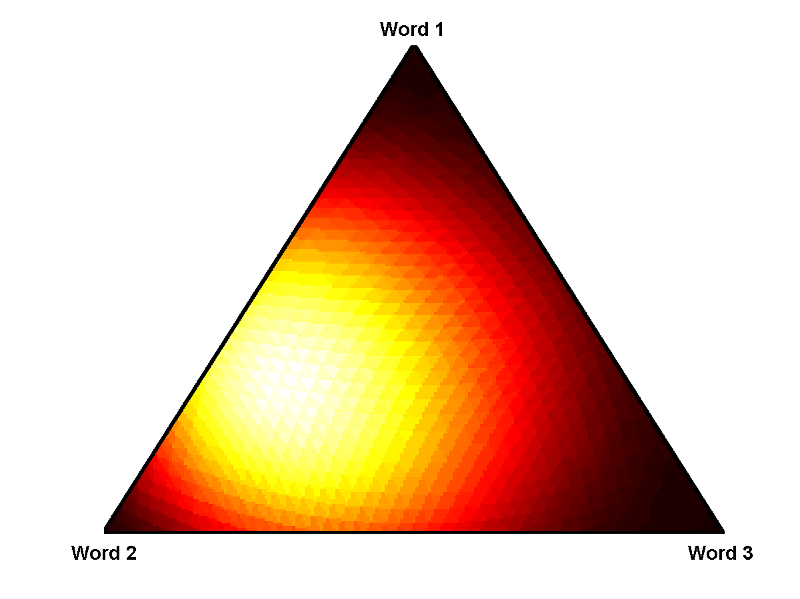
Burstiness with DCM
Multinomial
DCM
Down scaled
{.31, .44, .25}
Medium scaled
{.93, 1.32, .75}
Up scaled
{2.81,3.94, 2.25}

Slide 55
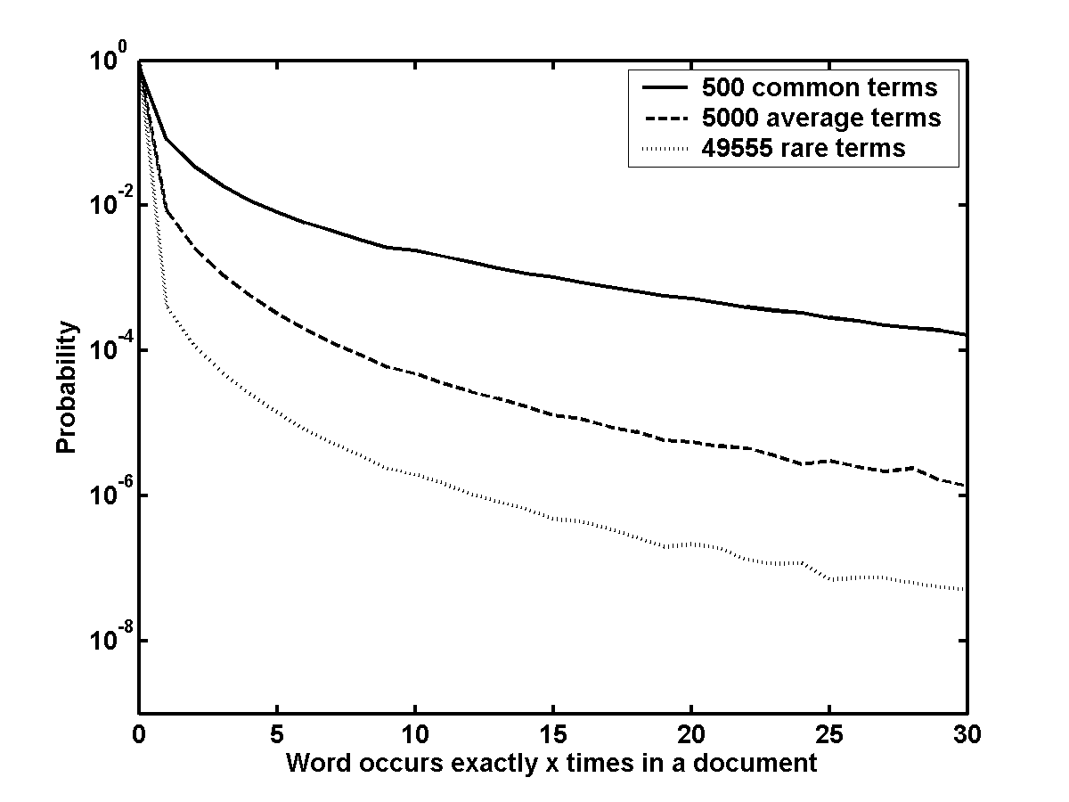
DCM word count probabilities

Slide 56
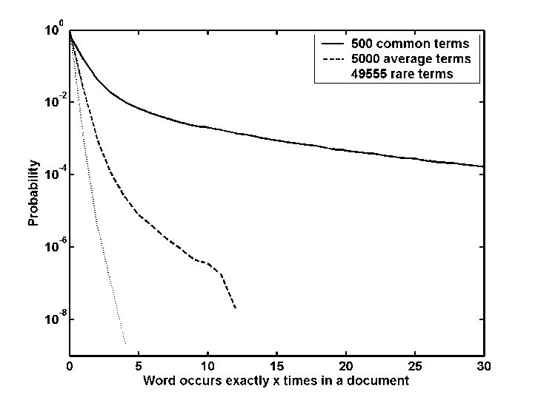


Reminder…
Multinomial
DCM
Data

Slide 57
DCM Model: another view
Multinomial
DCM

Slide 58
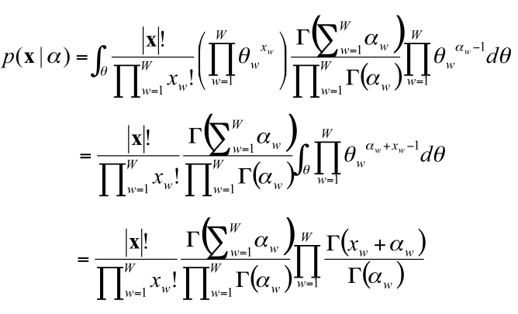
DCM model: another view
Notes:
just so you don’t think it’s too easy… ☺
there is another nice motivation for why the model handles burstiness based on how the model is derived

Slide 59
DCM Model: another view
p(x|θ) ~ multinomial
p(θ|α) ~ Dirichlet
Generative story for a single class
  A class is represented by a Dirichlet distribution
  Draw a multinomial based on class distribution
  Draw a document based on the drawn multinomial distribution

Slide 60
Dirichlet Compound Multinomial
p(x|θ) ~ multinomial
p(θ|α) ~ Dirichlet

Slide 61
Dirichlet Compound Multinomial

Slide 62
Modeling burstiness in other applications
Which model would be better: multinomial, DCM, other?
  User movie watching data
  Bags of M&Ms
  Daily Flight delays
…
horror
action
romance
comedy
…
green
blue
brown
red
…
SFO
LAX
ONT
SLC

Slide 63
DCM model
Notes:
just so you don’t think it’s too easy… ☺
there is another nice motivation for why the model handles burstiness based on how the model is derived

Slide 64
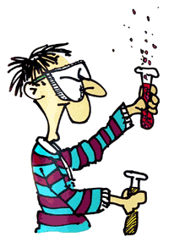
Experiments
Modeling one class: document modeling
Modeling alternative classes: classification

Slide 65
Two standard data sets
Industry sector (web pages)
  More classes
  Less documents per class
  Longer documents
20 newsgroups (newsgroup posts)
  Fewer classes
  More documents per class
  Shorter documents

Slide 66
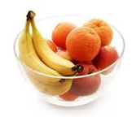

Modeling a single class: the fruit bowl
Mon
Tue
Wed
Th
Fri
Sat
Sun
Student 1
Goal: predict what the fruit mix will be for the following Monday (assign probabilities to options)
Student 2

Slide 67
Modeling a single class/group
How well does a model predict unseen data?
Monday
(3 2 0)
Model 1
apple
apple
orange
orange
banana
banana
Which model is better?
How would you quantify how much better?
Model 2
apple
orange
banana

Slide 68
Modeling evaluation: perplexity
Perplexity is the average of the negative log of the model probabilities (likelihood) on test data
test example
(3 2 0)
Model 1
apple
apple
orange
orange
banana
banana
Use the same idea to measure the performance of the different models for modeling one set of documents
Model 2
apple
orange
banana

Slide 69
Perplexity results
20 newsgroups data set
Multinomial 92.1
DCM 58.7
Lower is better
  ideally the model would have a perplexity of 0!
Significant increase in modeling performance!

Slide 70
Classification results
Accuracy = number correct/ number of documents
 | Industry | 20 Newsgroups
Multinomial | 0.600 | 0.853
DCM | 0.806 | 0.890
(results are on par with state of
the art discriminative approaches!)

Slide 71
Next steps in text modeling
Modeling textual phenomena like burstiness in text is important
Better grounded models like DCM ALSO perform better in applications (e.g. classification)
Better models
Applications of models
text substitutability
multi-class data modeling
(e.g. clustering)
relax bag of words constraint
(model co-occurrence)
text similarity
hierarchical models
handling short phrases
(tweets, search queries)
language generation applications
(speech recognition,
translation, summarization)

Slide 72
Questions?
?

