Slide 1
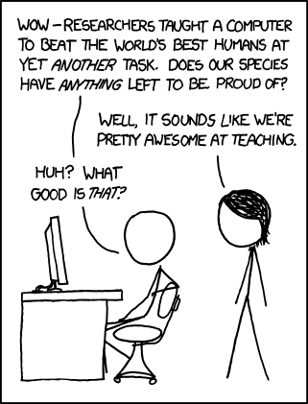
https://xkcd.com/894/

Slide 2
Introduction to Machine Learning
David Kauchak CS 158 – Fall 2016

Slide 3
Why are you here?
What is Machine Learning?
Why are you taking this course?
What topics would you like to see covered?

Slide 4
Machine Learning is…
Machine learning is a subfield of computer science that evolved from the study of pattern recognition and computational learning theory in artificial intelligence.

Slide 5
Machine Learning is…
Machine learning is programming computers to optimize a performance criterion using example data or past experience.
-- Ethem Alpaydin
The goal of machine learning is to develop methods that can automatically detect patterns in data, and then to use the uncovered patterns to predict future data or other outcomes of interest.
-- Kevin P. Murphy
The field of pattern recognition is concerned with the automatic discovery of regularities in data through the use of computer algorithms and with the use of these regularities to take actions.
-- Christopher M. Bishop

Slide 6
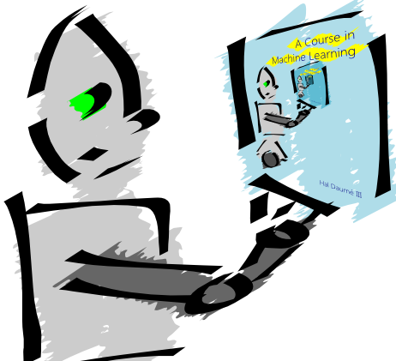
Machine Learning is…
Machine learning is about predicting the future based on the past.
-- Hal Daume III

Slide 7
Machine Learning is…
Machine learning is about predicting the future based on the past.
-- Hal Daume III
past
future
predict
learn
Training
Data
model/
predictor
Testing
Data
model/
predictor

Slide 8
Machine Learning, aka
data mining: data analysis, not prediction, though often involves some shared techniques
inference and/or estimation in statistics
pattern recognition in engineering
signal processing in electrical engineering
induction
optimization

Slide 9
Goals of the course: learn about…
Different machine learning problems
Common techniques/tools used
theoretical understanding
practical implementation
Proper experimentation and evaluation
Dealing with large (huge) data sets
Parallelization frameworks
Programming tools

Slide 10
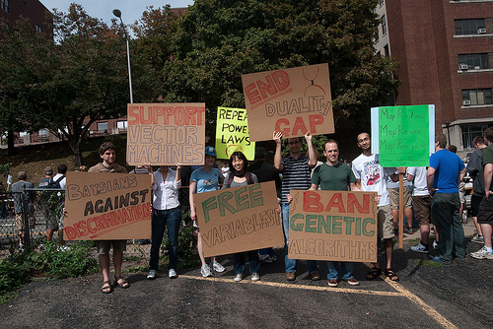
Goals of the course
Be able to laugh at these signs
(or at least know why one might…)

Slide 11
Administrative
Course page:
http://www.cs.pomona.edu/~dkauchak/classes/cs158/
Assignments
Weekly
Mostly programming (Java, mostly)
Some written/write-up
Generally due Sunday evenings
Two “midterm” exams and one final
Late Policy
Collaboration

Slide 12
Course expectations
Plan to stay busy!
Applied class, so lots of programming
Machine learning involves math

Slide 13
Other things to note
Videos before class
Lots of class participation!
Read the book (it’s good)

Slide 14
Machine learning problems
What high-level machine learning problems have you seen or heard of before?

Slide 15
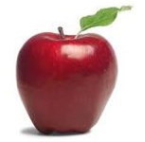
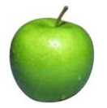
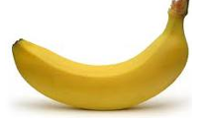
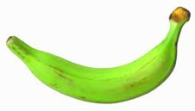
Data
examples
Data

Slide 16
Data
examples
Data

Slide 17
Data
examples
Data

Slide 18
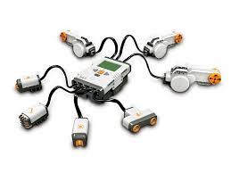
Data
examples
Data

Slide 19
Supervised learning
examples
label
label₁
label₃
labeled examples
label₄
label₅
Supervised learning: given labeled examples

Slide 20
Supervised learning
label
label₁
model/
predictor
label₃
label₄
label₅
Supervised learning: given labeled examples

Slide 21
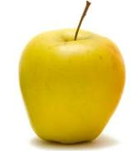
Supervised learning
model/
predictor
predicted label
Supervised learning: learn to predict new example

Slide 22
Supervised learning: classification
label
apple
Classification: a finite set of labels
apple
banana
banana
Supervised learning: given labeled examples

Slide 23
Classification Example
Differentiate between low-risk and high-risk customers from their income and savings

Slide 24
Classification Applications
Face recognition
Character recognition
Spam detection
Medical diagnosis: From symptoms to illnesses
Biometrics: Recognition/authentication using physical and/or behavioral characteristics: Face, iris, signature, etc
...

Slide 25
Supervised learning: regression
label
-4.5
Regression: label is real-valued
10.1
3.2
4.3
Supervised learning: given labeled examples

Slide 26
Regression Example
Price of a used car
x : car attributes (e.g. mileage)
y : price
y = wx+w₀

Slide 27
Regression Applications
Economics/Finance: predict the value of a stock
Epidemiology
Car/plane navigation: angle of the steering wheel, acceleration, …
Temporal trends: weather over time
…

Slide 28
Supervised learning: ranking
label
1
Ranking: label is a ranking
4
2
3
Supervised learning: given labeled examples

Slide 29
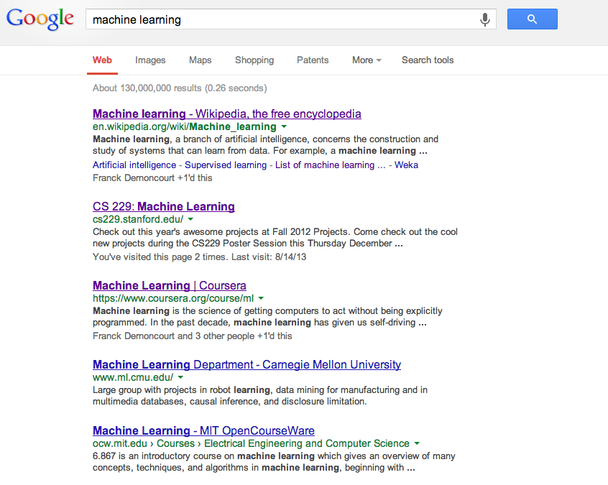
Ranking example
Given a query and
a set of web pages,
rank them according
to relevance

Slide 30
Ranking Applications
User preference, e.g. Netflix “My List” -- movie queue ranking
iTunes
flight search (search in general)
reranking N-best output lists
…

Slide 31
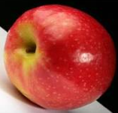
Unsupervised learning
Unupervised learning: given data, i.e. examples, but no labels

Slide 32
Unsupervised learning applications
learn clusters/groups without any label
customer segmentation (i.e. grouping)
image compression
bioinformatics: learn motifs
…

Slide 33
Reinforcement learning
left, right, straight, left, left, left, straight
GOOD
left, straight, straight, left, right, straight, straight
BAD
left, right, straight, left, left, left, straight
18.5
left, straight, straight, left, right, straight, straight
-3
Given a sequence of examples/states and a reward after completing that sequence, learn to predict the action to take in for an individual example/state

Slide 34
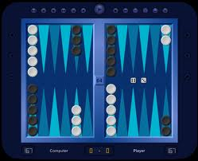
Reinforcement learning example
Backgammon
…
WIN!
…
LOSE!
Given sequences of moves and whether or not the player won at the end, learn to make good moves

Slide 35
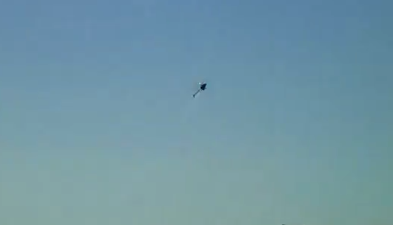
Reinforcement learning example
http://www.youtube.com/watch?v=VCdxqn0fcnE

Slide 36
Other learning variations
What data is available:
Supervised, unsupervised, reinforcement learning
semi-supervised, active learning, …
How are we getting the data:
online vs. offline learning
Type of model:
generative vs. discriminative
parametric vs. non-parametric

Slide 37
Representing examples
examples
What is an example?
How is it represented?

Slide 38
Features
examples
features
How our algorithms actually “view” the data
Features are the questions we can ask about the examples
f₁, f₂, f₃, …, f_{n}
f₁, f₂, f₃, …, f_{n}
f₁, f₂, f₃, …, f_{n}
f₁, f₂, f₃, …, f_{n}

Slide 39
Features
examples
features
How our algorithms actually “view” the data
Features are the questions we can ask about the examples
red, round, leaf, 3oz, …
green, round, no leaf, 4oz, …
yellow, curved, no leaf, 8oz, …
green, curved, no leaf, 7oz, …

Slide 40
Classification revisited
examples
label
red, round, leaf, 3oz, …
apple
learn
green, round, no leaf, 4oz, …
apple
model/
classifier
yellow, curved, no leaf, 8oz, …
banana
green, curved, no leaf, 7oz, …
banana
During learning/training/induction, learn a model of what distinguishes apples and bananas based on the features

Slide 41
Classification revisited
predict
Apple or banana?
model/
classifier
red, round, no leaf, 4oz, …
The model can then classify a new example based on the features

Slide 42
Classification revisited
predict
model/
classifier
Apple
red, round, no leaf, 4oz, …
Why?
The model can then classify a new example based on the features

Slide 43
Classification revisited
Training data
Test set
examples
label
red, round, leaf, 3oz, …
apple
?
green, round, no leaf, 4oz, …
apple
red, round, no leaf, 4oz, …
yellow, curved, no leaf, 4oz, …
banana
green, curved, no leaf, 5oz, …
banana

Slide 44
Classification revisited
Training data
Test set
examples
label
red, round, leaf, 3oz, …
apple
?
green, round, no leaf, 4oz, …
apple
red, round, no leaf, 4oz, …
yellow, curved, no leaf, 4oz, …
banana
Learning is about generalizing from the training data
green, curved, no leaf, 5oz, …
banana
What does this assume about the training and test set?

Slide 45
Past predicts future
Training data
Test set

Slide 46
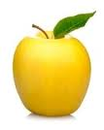
Past predicts future
Training data
Test set
Not always the case, but we’ll often assume it is!

Slide 47
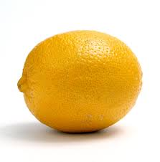
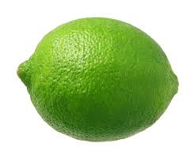
Past predicts future
Training data
Test set
Not always the case, but we’ll often assume it is!

Slide 48
More technically…
We are going to use the probabilistic model of learning
There is some probability distribution over example/label pairs called the data generating distribution
Both the training data and the test set are generated based on this distribution
What is a probability distribution?

Slide 49
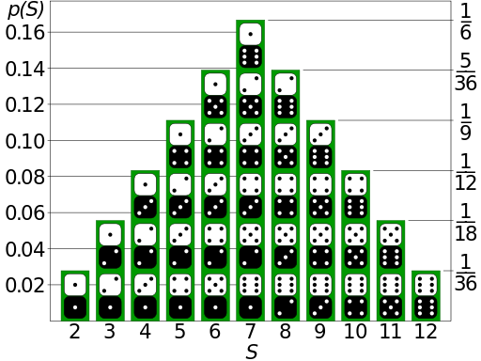
Probability distribution
Describes how likely (i.e. probable) certain events are

Slide 50
Probability distribution
Training data
High probability
Low probability
round apples
curved bananas
apples with leaves
…
curved apples
red bananas
yellow apples
…

Slide 51
data generating distribution
Training data
Test set
data generating distribution

Slide 52
data generating distribution
Training data
Test set
data generating distribution

Slide 53
data generating distribution
Training data
Test set
data generating distribution

