Slide 1
What is the internet?
http://www.youtube.com/watch?v=JUs7iG1mNjI

Slide 2
Natural language learning: EM
David Kauchak
CS159 – Spring 2011
some slides adapted from Dan Klein

Slide 3
Admin
My laptop
Assignment 2 grading
Assignment 3 out
  Due Friday at 6pm
  packages: submit code in package structure
    in code:
      nlp/parser/*.java
Read the book!

Slide 4
Parsing other languages
http://nlp.stanford.edu/software/lex-parser.shtml
  German
  Chinese
  Arabic
Most parsers can be retrained as long as you have a Treebank
  Czech
  Korean
    http://www.cis.upenn.edu/~xtag/koreantag/

Slide 5
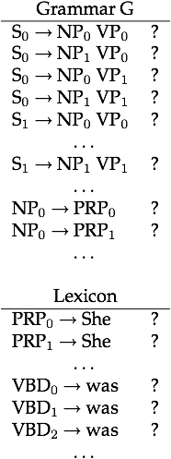
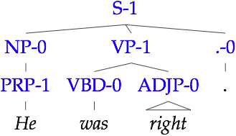
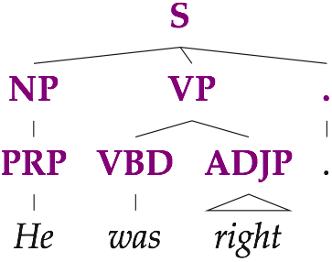
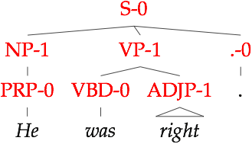

Learning good splits:
Latent Variable Grammars
...
Parse Tree
Sentence
Derivations
Parameters
Notes:
So, what are latent variable grammars? The idea is that we take our observed parse trees and augment them with latent variables at each node. Each observed category, like NP, is thereby split into a set of subcategories NP-0 through NP-k. This also creates a set of exponentially many derivations. We then learn distributions over the new subcategories and these derivations. The resulting grammars look like this, where we have now many rules for each of the original rules that we started with. For example ...
The learning process determines the exact set of rules, as well as the parameter values.

Slide 6
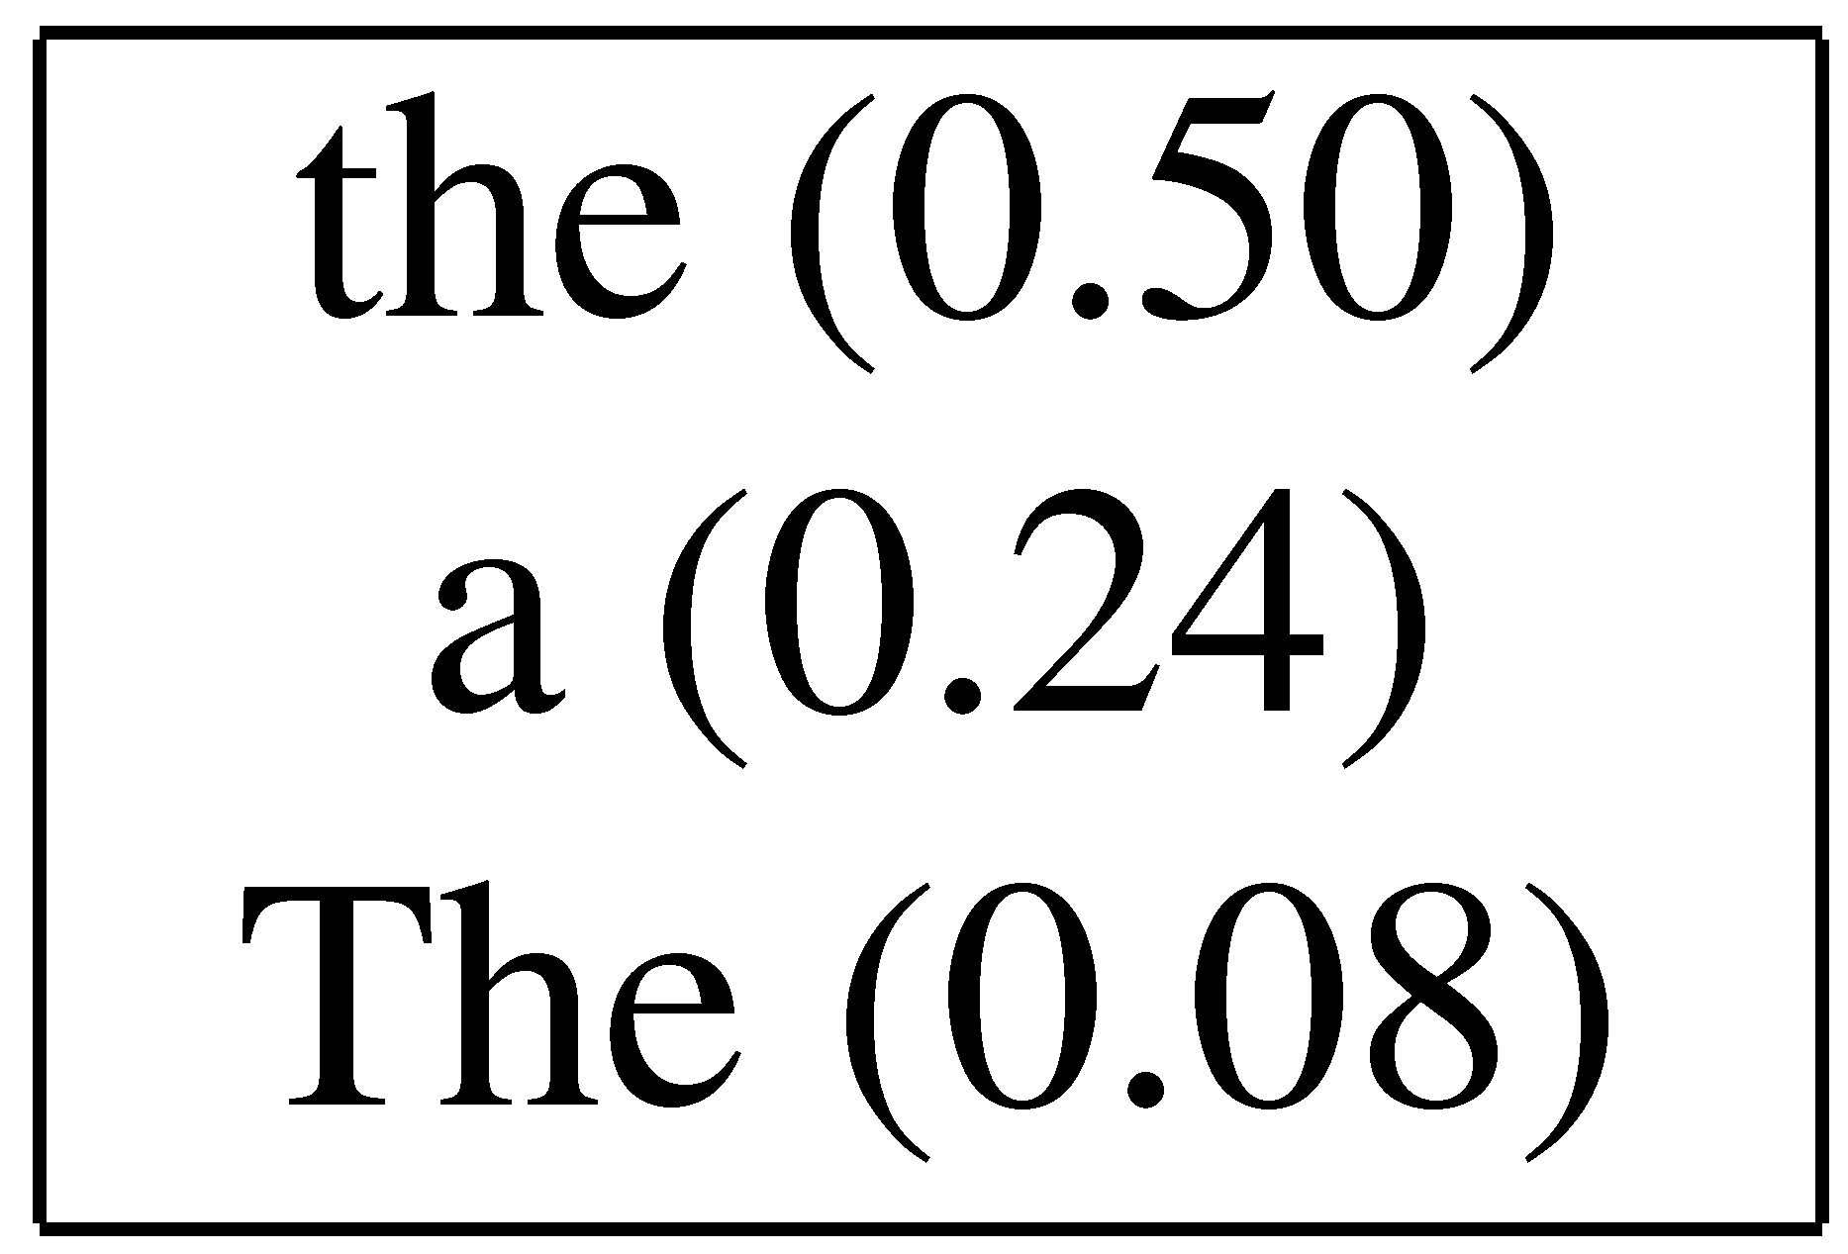
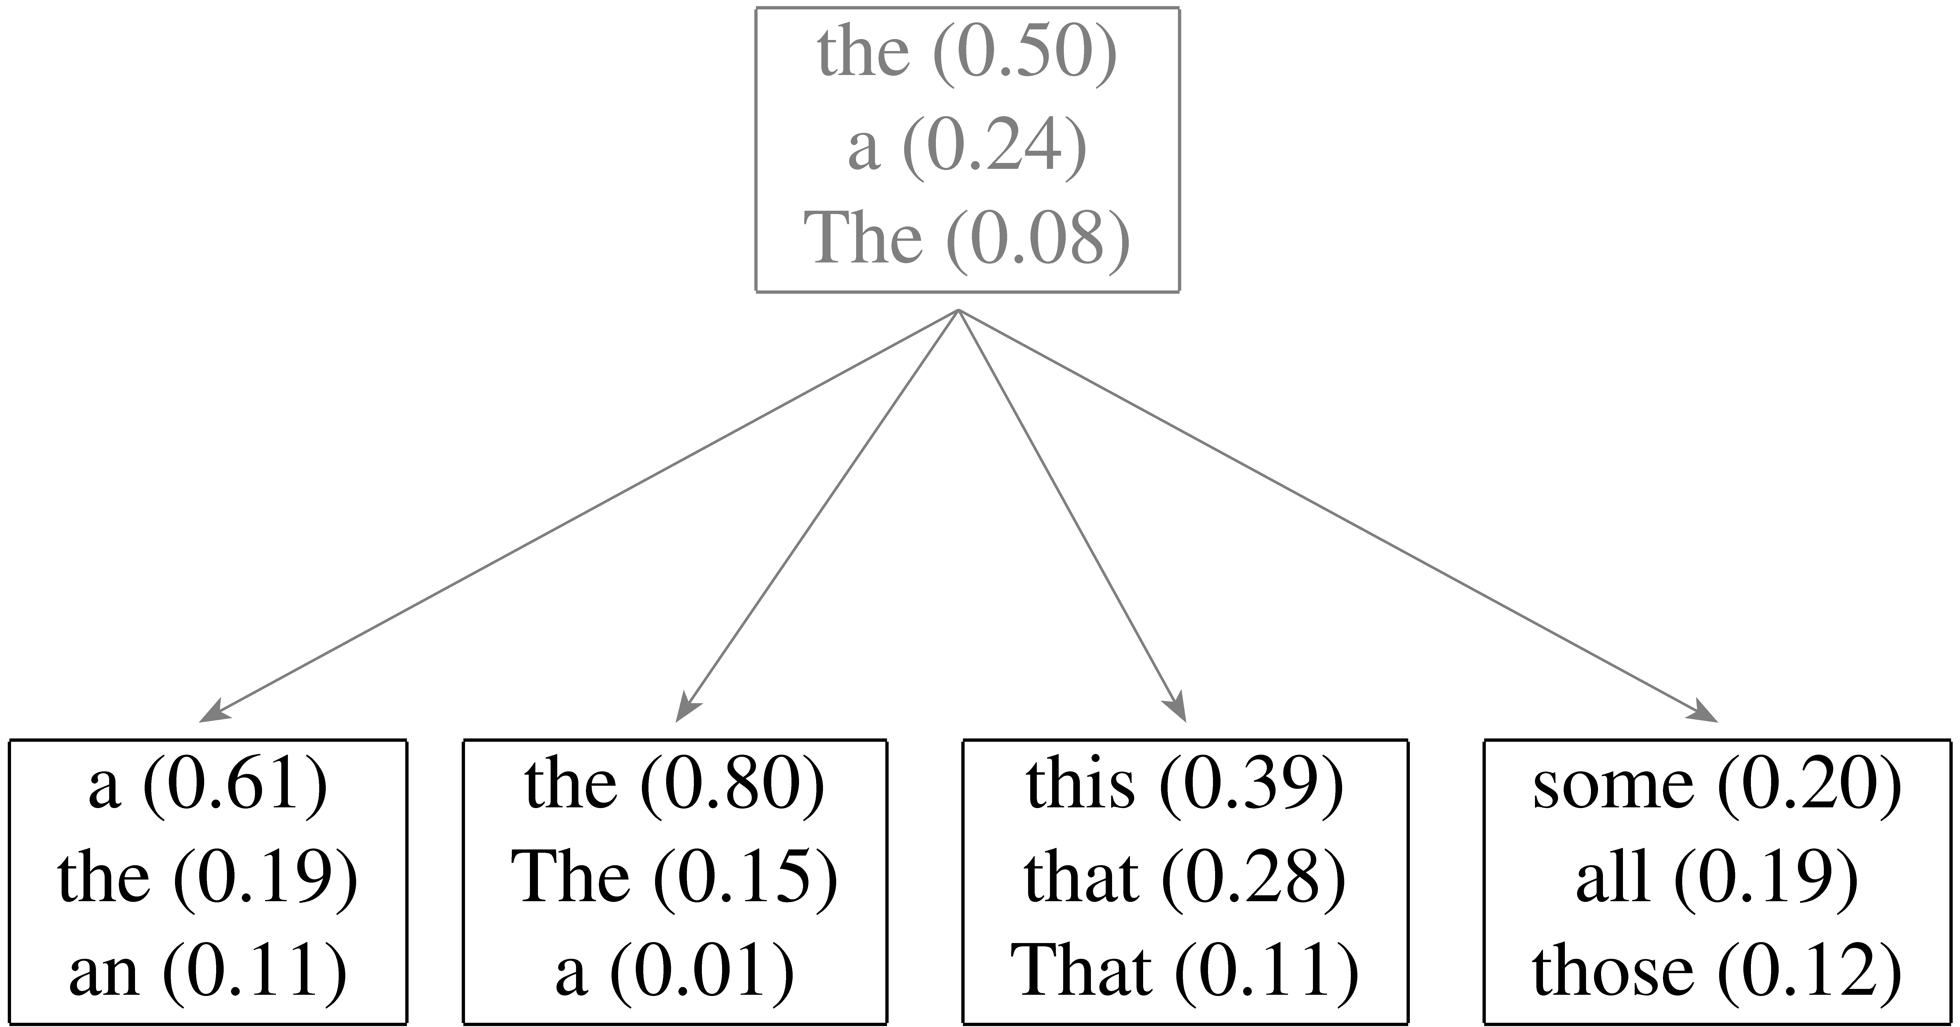
Refinement of the DT tag
DT
DT-1
DT-2
DT-3
DT-4

Slide 7
Learned Splits
Proper Nouns (NNP):
Personal pronouns (PRP):
NNP-14 | Oct. | Nov. | Sept.
NNP-12 | John | Robert | James
NNP-2 | J. | E. | L.
NNP-1 | Bush | Noriega | Peters
NNP-15 | New | San | Wall
NNP-3 | York | Francisco | Street
PRP-0 | It | He | I
PRP-1 | it | he | they
PRP-2 | it | them | him
Notes:
Before I finish, let me give you some interesting examples of what our grammars learn. These are intended to highlight some interesting observations, the full list of subcategories and more details are in the paper.
The subcategories sometimes capture syntactic and sometimes semantic difference. But very often they represent syntactico – semantic relations, which are similar to those found in distributional clustering results.
For example for the proper nouns the system learns a subcategory for months, first names, last names and initials. It also learns which words typically come first and second in multi-word units.
For personal pronouns there is a subcategory for accusative case and one for sentence initial and sentence medial nominative case.

Slide 8
Learned Splits
Relative adverbs (RBR):
Cardinal Numbers (CD):
RBR-0 | further | lower | higher
RBR-1 | more | less | More
RBR-2 | earlier | Earlier | later
CD-7 | one | two | Three
CD-4 | 1989 | 1990 | 1988
CD-11 | million | billion | trillion
CD-0 | 1 | 50 | 100
CD-3 | 1 | 30 | 31
CD-9 | 78 | 58 | 34
Notes:
Relative adverbs are divided into distance, degree and time.
For the cardinal numbers the system learns to distinguish between spelled out numbers, dates and others.

Slide 9
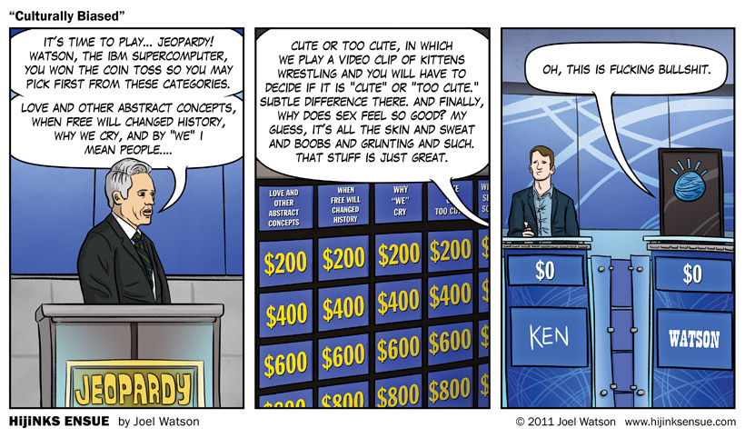
A step back: data
http://hijinksensue.com/2011/02/15/culturally-biased/

Slide 10
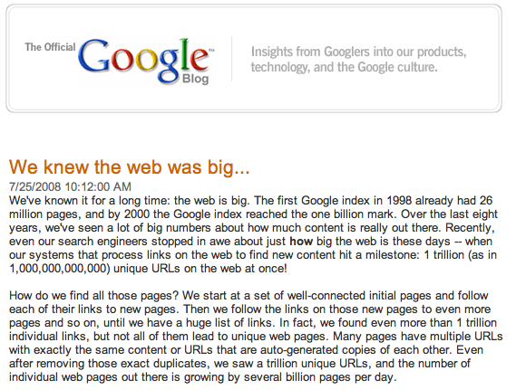
Why do we need computers for dealing with natural text?
Notes:
besides being a complex problem, there’s a lot of data! (which is a good thing and a bad thing)
some people may say… outsource it (India, the Philippines, etc.). And there are frameworks, like mechanical Turk
world population: ~7M
let’s say you had a simple task to perform on each web page that only took 10 seconds to do. If every single person in the world worked on this non-stop, they would have to work for 20 days straight.
what if it’s a task like translating the page or finding information that requires specialization?

Slide 11
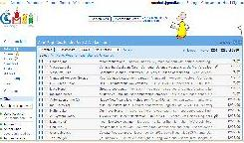

Web is just the start…
e-mail
27 million tweets a day
247 billion e-mails a day
corporate
databases
Blogs:
126 million different blogs
http://royal.pingdom.com/2010/01/22/internet-2009-in-numbers/
Notes:
- web pages are just the beginning…

Slide 12
Corpora examples
Linguistic Data Consortium
  http://www.ldc.upenn.edu/Catalog/byType.jsp
Dictionaries
  WordNet – 206K English words
  CELEX2 – 365K German words
Monolingual text
  Gigaword corpus
    4M documents (mostly news articles)
    1.7 trillion words
    11GB of data (4GB compressed)

Slide 13
Corpora examples
Monolingual text continued
  Enron e-mails
    517K e-mails
  Twitter
  Chatroom
  Many non-English resources
Parallel data
  ~10M sentences of Chinese-English and Arabic-English
  Europarl
    ~1.5M sentences English with 10 different languages

Slide 14
Corpora examples
Annotated
  Brown Corpus
    1M words with part of speech tag
  Penn Treebank
    1M words with full parse trees annotated
  Other Treebanks
    Treebank refers to a corpus annotated with trees (usually syntactic)
    Chinese: 51K sentences
    Arabic: 145K words
    many other languages…
    BLIPP: 300M words (automatically annotated)
Notes:
Many other data

Slide 15
Corpora examples
Many others…
  Spam and other text classification
  Google n-grams
    2006 (24GB compressed!)
    13M unigrams
    300M bigrams
    ~1B 3,4 and 5-grams
  Speech
  Video (with transcripts)

Slide 16
Problem
Labeled
Unlabeled
web
  Penn Treebank
    1M words with full parse trees annotated
1 trillion web pages
e-mail
☹
247 billion e-mails a day

Slide 17
Learning a grammar
Parsed sentences
Grammar
S → NP VP
S → VP
NP → Det A N
NP → NP PP
NP → PropN
A → ε
A → Adj A
PP → Prep NP
VP → V NP
VP → VP PP
0.9
0.1
0.5
0.3
0.2
0.6
0.4
1.0
0.7
0.3
Learning/
Training
English
…

Slide 18
Parsing other data sources
What if we wanted to parse sentences from the web?
web
1 trillion web pages

Slide 19
Idea 1
Penn Treebank
Penn Grammar
S → NP VP
S → VP
NP → Det A N
NP → NP PP
NP → PropN
A → ε
A → Adj A
PP → Prep NP
VP → V NP
VP → VP PP
0.9
0.1
0.5
0.3
0.2
0.6
0.4
1.0
0.7
0.3
Learning/
Training
English
…

Slide 20
Idea 1
Penn Grammar
S → NP VP
S → VP
NP → Det A N
NP → NP PP
NP → PropN
A → ε
A → Adj A
PP → Prep NP
VP → V NP
VP → VP PP
0.9
0.1
0.5
0.3
0.2
0.6
0.4
1.0
0.7
0.3
web
1 trillion web pages
English
How well will this work?

Slide 21
Parsing other data sources
What if we wanted to parse “sentences” from twitter?
27 million tweets a day

Slide 22
Idea 1
Penn Grammar
S → NP VP
S → VP
NP → Det A N
NP → NP PP
NP → PropN
A → ε
A → Adj A
PP → Prep NP
VP → V NP
VP → VP PP
0.9
0.1
0.5
0.3
0.2
0.6
0.4
1.0
0.7
0.3
27 million tweets a day
English
Probably not going to work very well
Ideas?

Slide 23
Idea 2
Pseudo-Twitter grammar
S → NP VP
S → VP
NP → Det A N
NP → NP PP
NP → PropN
A → ε
A → Adj A
PP → Prep NP
VP → V NP
VP → VP PP
0.9
0.1
0.5
0.3
0.2
0.6
0.4
1.0
0.7
0.3
Learning/
Training
English

Slide 24
Idea 2
Pseudo-Twitter grammer
S → NP VP
S → VP
NP → Det A N
NP → NP PP
NP → PropN
A → ε
A → Adj A
PP → Prep NP
VP → V NP
VP → VP PP
0.9
0.1
0.5
0.3
0.2
0.6
0.4
1.0
0.7
0.3
*
27 million tweets a day
English
Often, this improves the parsing performance

Slide 25
Idea 3
Pseudo-Twitter grammer
S → NP VP
S → VP
NP → Det A N
NP → NP PP
NP → PropN
A → ε
A → Adj A
PP → Prep NP
VP → V NP
VP → VP PP
0.9
0.1
0.5
0.3
0.2
0.6
0.4
1.0
0.7
0.3
Learning/
Training
*
English
27 million tweets a day

Slide 26
Idea 3: some things to think about
How many iterations should we do it for?
  When should we stop?
Will we always get better?
What does “get better” mean?

Slide 27
Idea 3: some things to think about
How many iterations should we do it for?
  We should keep iterating as long as we improve
Will we always get better?
  Not guaranteed for most measures
What does “get better” mean?
  Use our friend the development set
  Does it increase the likelihood of the training data

Slide 28
Idea 4
What if we don’t have any parsed data?
Penn Grammar
S → NP VP
S → VP
NP → Det A N
NP → NP PP
NP → PropN
A → ε
A → Adj A
PP → Prep NP
VP → V NP
VP → VP PP
0.9
0.1
0.5
0.3
0.2
0.6
0.4
1.0
0.7
0.3
27 million tweets a day
English

Slide 29
Idea 4
Randomly initialized grammar
S → NP VP
S → VP
NP → Det A N
NP → NP PP
NP → PropN
A → ε
A → Adj A
PP → Prep NP
VP → V NP
VP → VP PP
?
?
?
?
?
?
?
?
?
?
Pseudo-random
27 million tweets a day
English

Slide 30
Idea 4
Pseudo-Twitter grammar
S → NP VP
S → VP
NP → Det A N
NP → NP PP
NP → PropN
A → ε
A → Adj A
PP → Prep NP
VP → V NP
VP → VP PP
0.9
0.1
0.5
0.3
0.2
0.6
0.4
1.0
0.7
0.3
Pseudo-random
Learning/
Training
English

Slide 31
Idea 4
Pseudo-Twitter grammer
S → NP VP
S → VP
NP → Det A N
NP → NP PP
NP → PropN
A → ε
A → Adj A
PP → Prep NP
VP → V NP
VP → VP PP
0.9
0.1
0.5
0.3
0.2
0.6
0.4
1.0
0.7
0.3
Learning/
Training
*
English
27 million tweets a day

Slide 32
Idea 4
Viterbi approximation of EM
  Fast
  Works ok (but we can do better)
  Easy to get biased based on initial randomness
What information is the Viterbi approximation throwing away?
  We’re somewhat randomly picking the best parse
  We’re ignoring all other possible parses
  Real EM takes these into account

Slide 33
A digression
Why is this called Maximum Likelihood Estimation (MLE)?
Parsed sentences
Grammar
S → NP VP
S → VP
NP → Det A N
NP → NP PP
NP → PropN
A → ε
A → Adj A
PP → Prep NP
VP → V NP
VP → VP PP
0.9
0.1
0.5
0.3
0.2
0.6
0.4
1.0
0.7
0.3
Learning/
Training
English
…

Slide 34
MLE
Maximum likelihood estimation picks the values for the model parameters that maximize the likelihood of the training data
S → NP VP
S → VP
NP → Det A N
NP → NP PP
NP → PropN
A → ε
A → Adj A
PP → Prep NP
VP → V NP
VP → VP PP
0.9
0.1
0.5
0.3
0.2
0.6
0.4
1.0
0.7
0.3
parameter values
parameters
model (Θ)

Slide 35
MLE
Maximum likelihood estimation picks the values for the model parameters that maximize the likelihood of the training data
parameters
parameter values
S → NP VP
S → VP
NP → Det A N
NP → NP PP
NP → PropN
A → ε
A → Adj A
PP → Prep NP
VP → V NP
VP → VP PP
0.9
0.1
0.5
0.3
0.2
0.6
0.4
1.0
0.7
0.3
If this is what you want to optimize, you can do NO BETTER than MLE!
model (Θ)

Slide 36
MLE example
You flip a coin 100 times. 60 times you get heads.
What is the MLE for heads?
  p(head) = 0.60
What is the likelihood of the data under this model (each coin flip is a data point)?
log(0.60⁶⁰ * 0.40⁴⁰) = -67.3

Slide 37
MLE Example
Can we do any better?
p(heads) = 0.5
  log(0.50⁶⁰ * 0.50⁴⁰) =-69.3
p(heads) = 0.7
  log(0.70⁶⁰ * 0.30⁴⁰)=-69.5

Slide 38
Expectation Maximization (EM)
EM also tries to maximized the likelihood of the training data
  EM works without labeled training data, though!
However, because we don’t have labeled data, we cannot calculate the exact solution in closed form
Attempt to maximize training data
parameters
parameter values
EM
Training
S → NP VP
S → VP
NP → Det A N
NP → NP PP
NP → PropN
A → ε
A → Adj A
PP → Prep NP
VP → V NP
VP → VP PP
0.9
0.1
0.5
0.3
0.2
0.6
0.4
1.0
0.7
0.3
MLE
Training
model (Θ)

Slide 39
EM is a general framework
Create an initial model, θ’
  Arbitrarily, randomly, or with a small set of training examples
Use the model θ’ to obtain another model θ such that
  Σ_{i} log P_{θ}(data_{i}) > Σ_{i} log P_{θ’}(data_{i})
Let θ’ = θ and repeat the above step until reaching a local maximum
  Guaranteed to find a better model after each iteration
i.e. better models data
(increased log likelihood)
Where else have you seen EM?

Slide 40
EM shows up all over the place
Training HMMs (Baum-Welch algorithm)
Learning probabilities for Bayesian networks
EM-clustering
Learning word alignments for language translation
Learning Twitter friend network
Genetics
Finance
Anytime you have a model and unlabeled data!

Slide 41
E and M steps: creating a better model
Expectation: Given the current model, figure out the expected probabilities of the each example
What is the probability of each point belonging to each cluster?
p(x|θ_{c})
What is the probability of sentence being grammatical?
Maximization: Given the probabilities of each of the examples, estimate a new model, θ_{c}
Just like maximum likelihood estimation, except we use fractional counts instead of whole counts

Slide 42
EM clustering
We have some points in space
We would like to put them into some known number of groups (e.g. 2 groups/clusters)
Soft-clustering: rather than explicitly assigning a point to a group, we’ll probabilistically assign it
P(red) = 0.75
P(blue) = 0.25

Slide 43
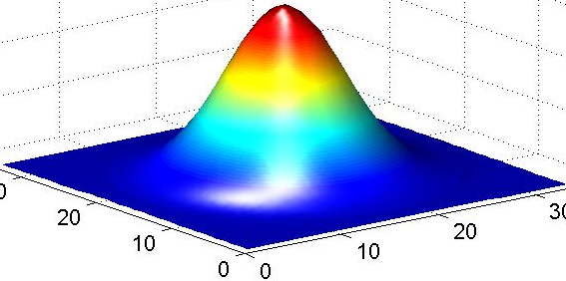
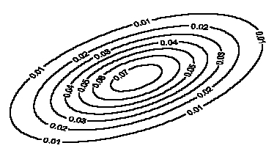
EM clustering
Model: mixture of Gaussians
Covariance determines
the shape of these contours
Fit these Gaussian densities to the data, one per cluster

Slide 44
E and M steps: creating a better model
Expectation: Given the current model, figure out the expected probabilities of the data points to each cluster
p(x|θ_{c})
What is the current probability of each point belonging to each cluster?
Maximization: Given the probabilistic assignment of all the points, estimate a new model, θ_{c}
Do MLE of the parameters (i.e. Gaussians), but use fractional counts based on probabilities (i.e. p(x | Θ_{c})

Slide 45
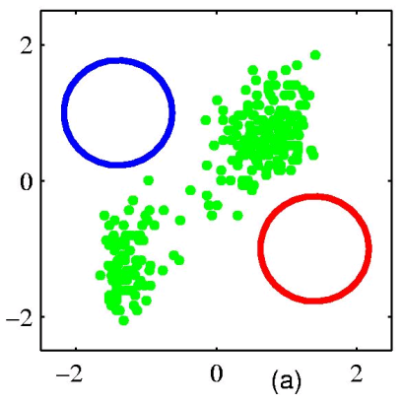
EM example
Figure from Chris Bishop

Slide 46
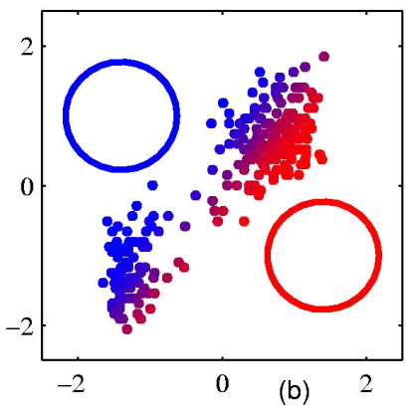
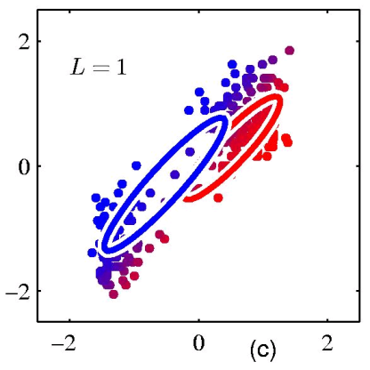
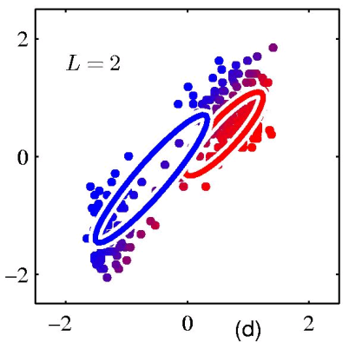
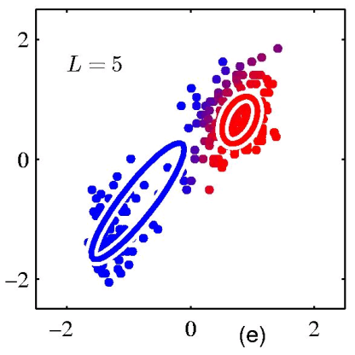
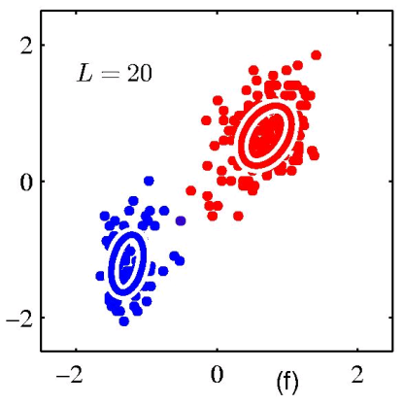
EM example
Figure from Chris Bishop

Slide 47
EM for parsing (Inside-Outside algorithm)
Expectation: Given the current model, figure out the expected probabilities of the each example
p(x|θ_{c})
What is the probability of sentence being grammatical?
Maximization: Given the probabilities of each of the examples, estimate a new model, θ_{c}
Just like maximum likelihood estimation, except we use fractional counts instead of whole counts

Slide 48
Expectation step
p(sentence)_{grammar}
p(time flies like an arrow)_{grammar} = ?
Note: This is the language modeling problem

Slide 49
Expectation step
p(time flies like an arrow)_{grammar} = ?
Most likely parse?
S
NP
time
VP
| S) = p(S → NP VP | S) * p(NP → time | NP)
p(
V
flies
PP
* p(VP → V PP | VP)
P
like
NP
* p(V → flies | V) * …
Det
an
N
arrow

Slide 50
Expectation step
p(time flies like an arrow)_{grammar} = ?
Sum over all the possible parses!
Often, we really want: p(time flies like an arrow | S)
S
S
NP
time
VP
| S)
NP
VP
| S) + …
p(
+ p(
N
time
V
like
NP
V
flies
PP
N
flies
P
like
NP
Det
an
N
arrow
Det
an
N
arrow

Slide 51
Expectation step
p(time flies like an arrow)_{grammar} = ?
Sum over all the possible parses!
Often, we really want: p(time flies like an arrow | S)
how can we calculate this sum?

Slide 52
Expectation step
p(time flies like an arrow)_{grammar} = ?
Sum over all the possible parses!
Often, we really want: p(time flies like an arrow | S)
CKY parsing except sum over possible parses instead of max

Slide 53
Probabilistic CKY Parser
Book the flight through Houston
S:.05*.5*
.000864
=.0000216
S :.01, VP:.1,
Verb:.5
Nominal:.03
Noun:.1
S:.05*.5*.054
=.00135
For any entry, sum over the possibilities!
None
VP:.5*.5*.054
=.0135
None
NP:.6*.6*
.0024
=.000864
S:.03*.0135*
.032
=.00001296
NP:.6*.6*.15
=.054
Det:.6
None
Nominal:.15
Noun:.5
Nominal:
.5*.15*.032
=.0024
None
Prep:.2
PP:1.0*.2*.16
=.032
S → VP PP 0.03
S → Verb NP 0.05
NP:.16
PropNoun:.8
Notes:
53

Slide 54
Maximization step
Calculate the probabilities of the grammar rules using partial counts
MLE
EM
?

Slide 55
Maximization step
Say we’re trying to figure out VP -> V PP
EM
MLE
S
NP
time
VP
V
flies
PP
P
like
NP
Det
an
N
arrow
fractional count based on the sentence and how likely the sentence is to be grammatical
count this as one occurrence

Slide 56
Maximization step
def. of conditional probability
conditional independence as specified by the PCFG

Slide 57
Maximization step
S
time
VP
V
PP
flies like an arrow

Slide 58
Inside & Outside Probabilities
S
“outside” the VP
NP
time
VP
α_{VP}(1,5) = p(time VP today | S)
VP
NP
today
The “outside” probabilities we can calculate using top-down approach (after we have the “inside” probabilities
V
flies
PP
P
like
NP
β_{VP}(1,5) = p(flies like an arrow | VP)
Det
an
N
arrow
The “inside” probabilities we can calculate using a CKY-style, bottom-up approach
“inside” the VP

Slide 59
EM grammar induction
The good:
  We learn a grammar
  At each step we’re guaranteed to increase (or keep the same) the likelihood of the training data
The bad
  Slow: O(m³n³), where m = sentence length and n = non-terminals in the grammar
  Lot’s of local maxima
  Often have to use more non-terminals in the grammar than are theoretically motivated (often ~3 times)
  Often non-terminals learned have no relation to traditional constituents

Slide 60
But…
If we bootstrap and start with a reasonable grammar, we can often obtain very interesting results
Penn Grammar
S → NP VP
S → VP
NP → Det A N
NP → NP PP
NP → PropN
A → ε
A → Adj A
PP → Prep NP
VP → V NP
VP → VP PP
0.9
0.1
0.5
0.3
0.2
0.6
0.4
1.0
0.7
0.3
English

Slide 61
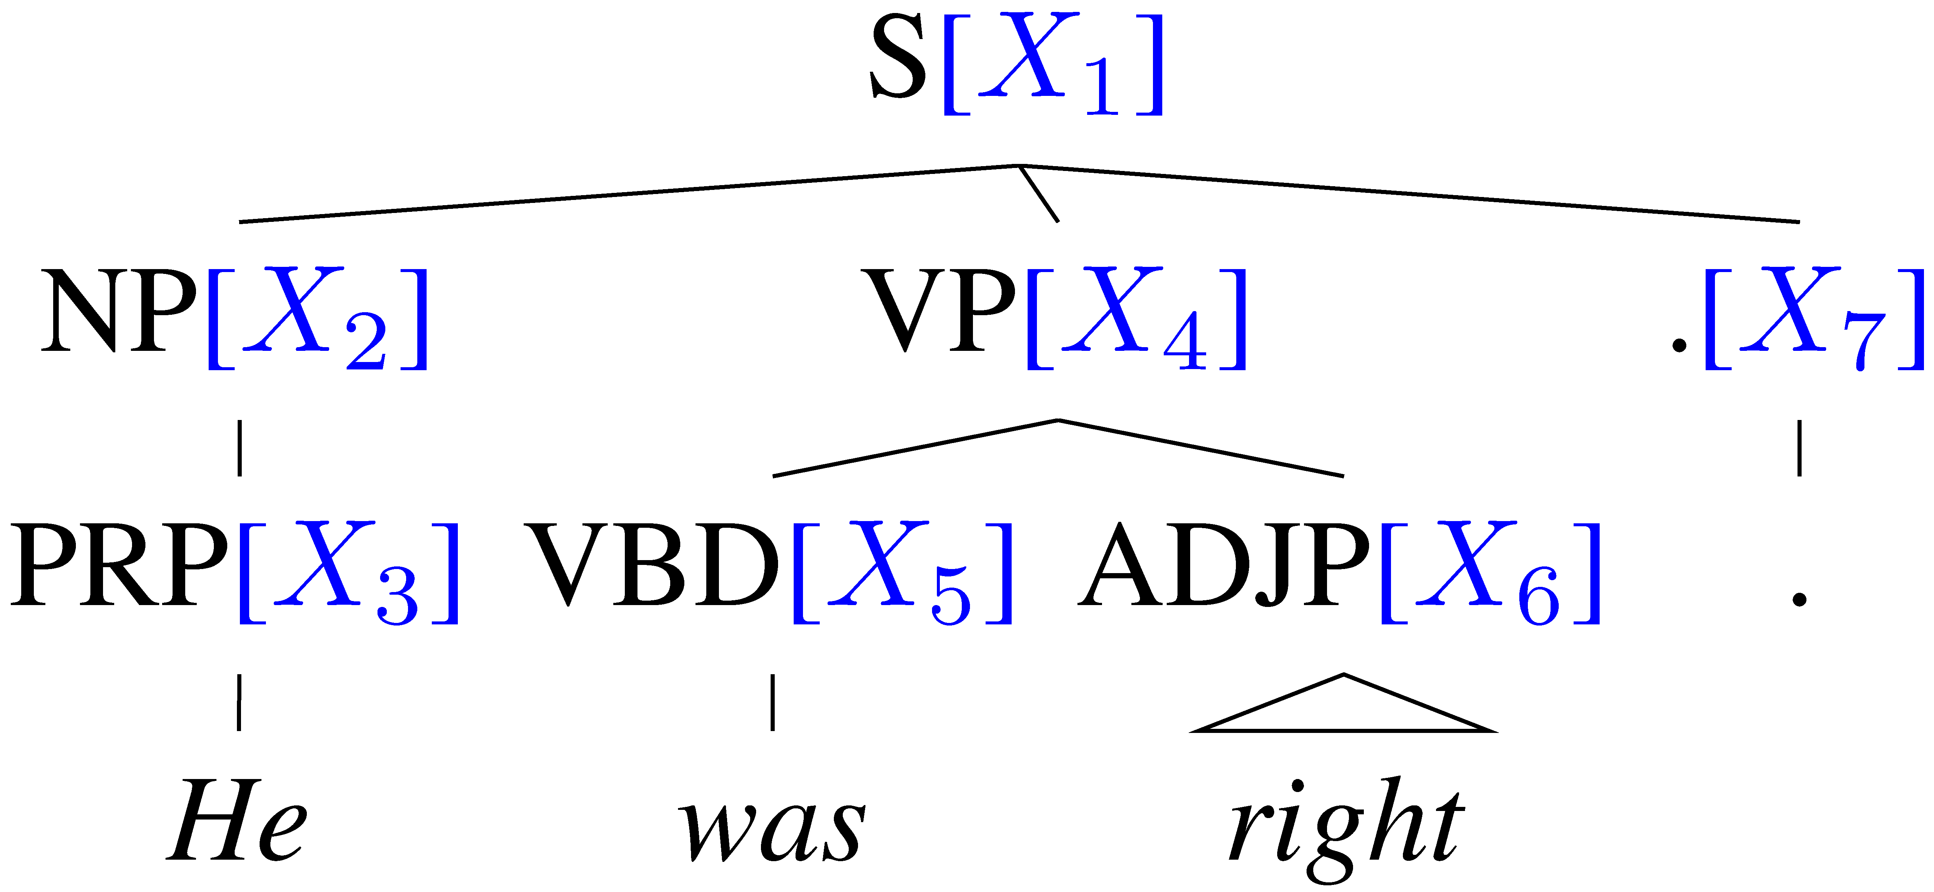
Learning Latent Annotations
Forward
EM algorithm:
  Brackets are known
  Base categories are known
  Only induce subcategories
X₁
X₂
X₄
X₇
X₃
X₅
X₆
.
He
was
right
Backward

Slide 62
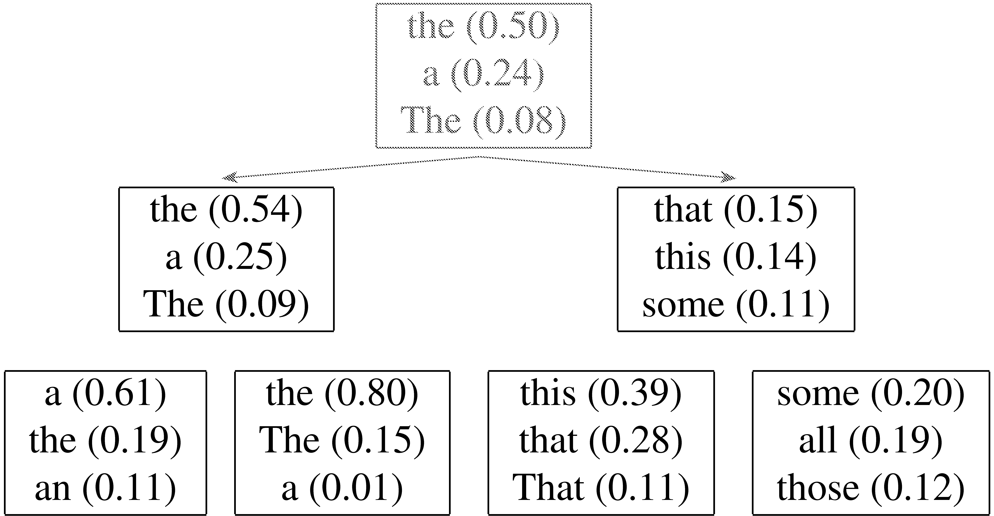
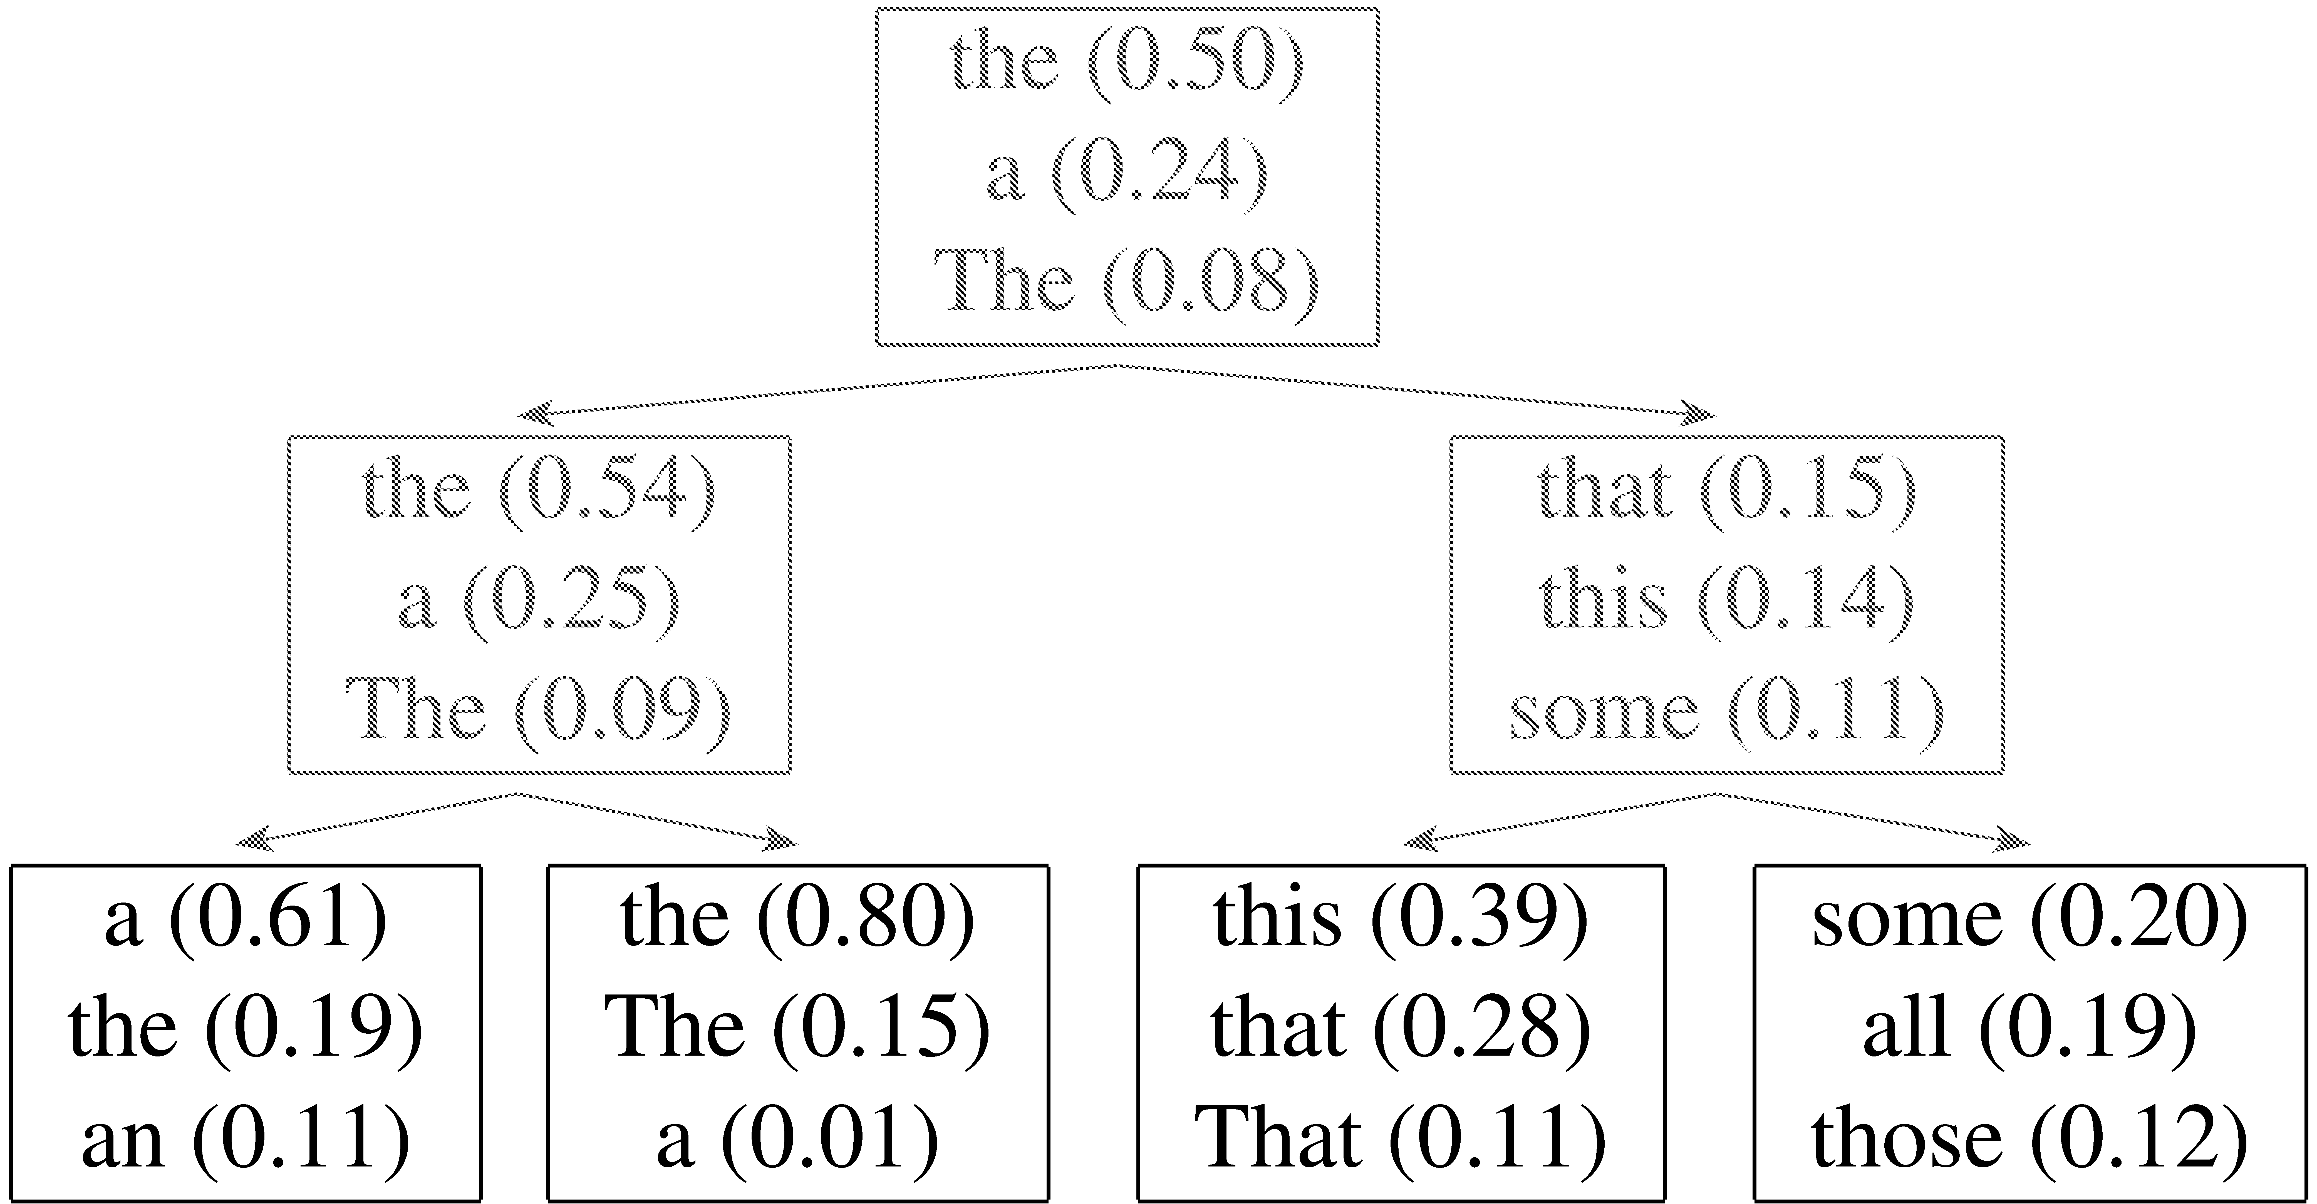
Hierarchical refinement

Slide 63
Hierarchical Estimation Results
Model | F1
Flat Training | 87.3
Hierarchical Training | 88.4
Notes:
As we had hoped the hierarchical training leads to better parameter estimates, which in turn results in a 1% improvement in parsing accuracy.

Slide 64
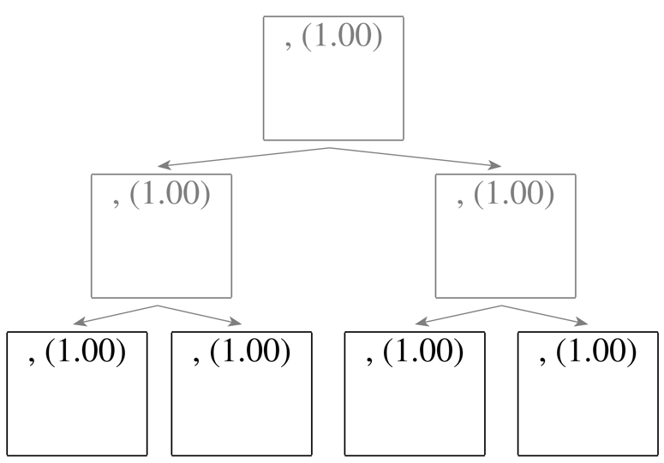
Refinement of the , tag
Splitting all categories equally is wasteful:
Notes:
This being said, there are still some things that are broken in our model. Let’s look at another category, e.g. the , tag. Whether we apply hierarchical training or not, the result will be the same. We are generating several subcategories that are exactly the same.

Slide 65
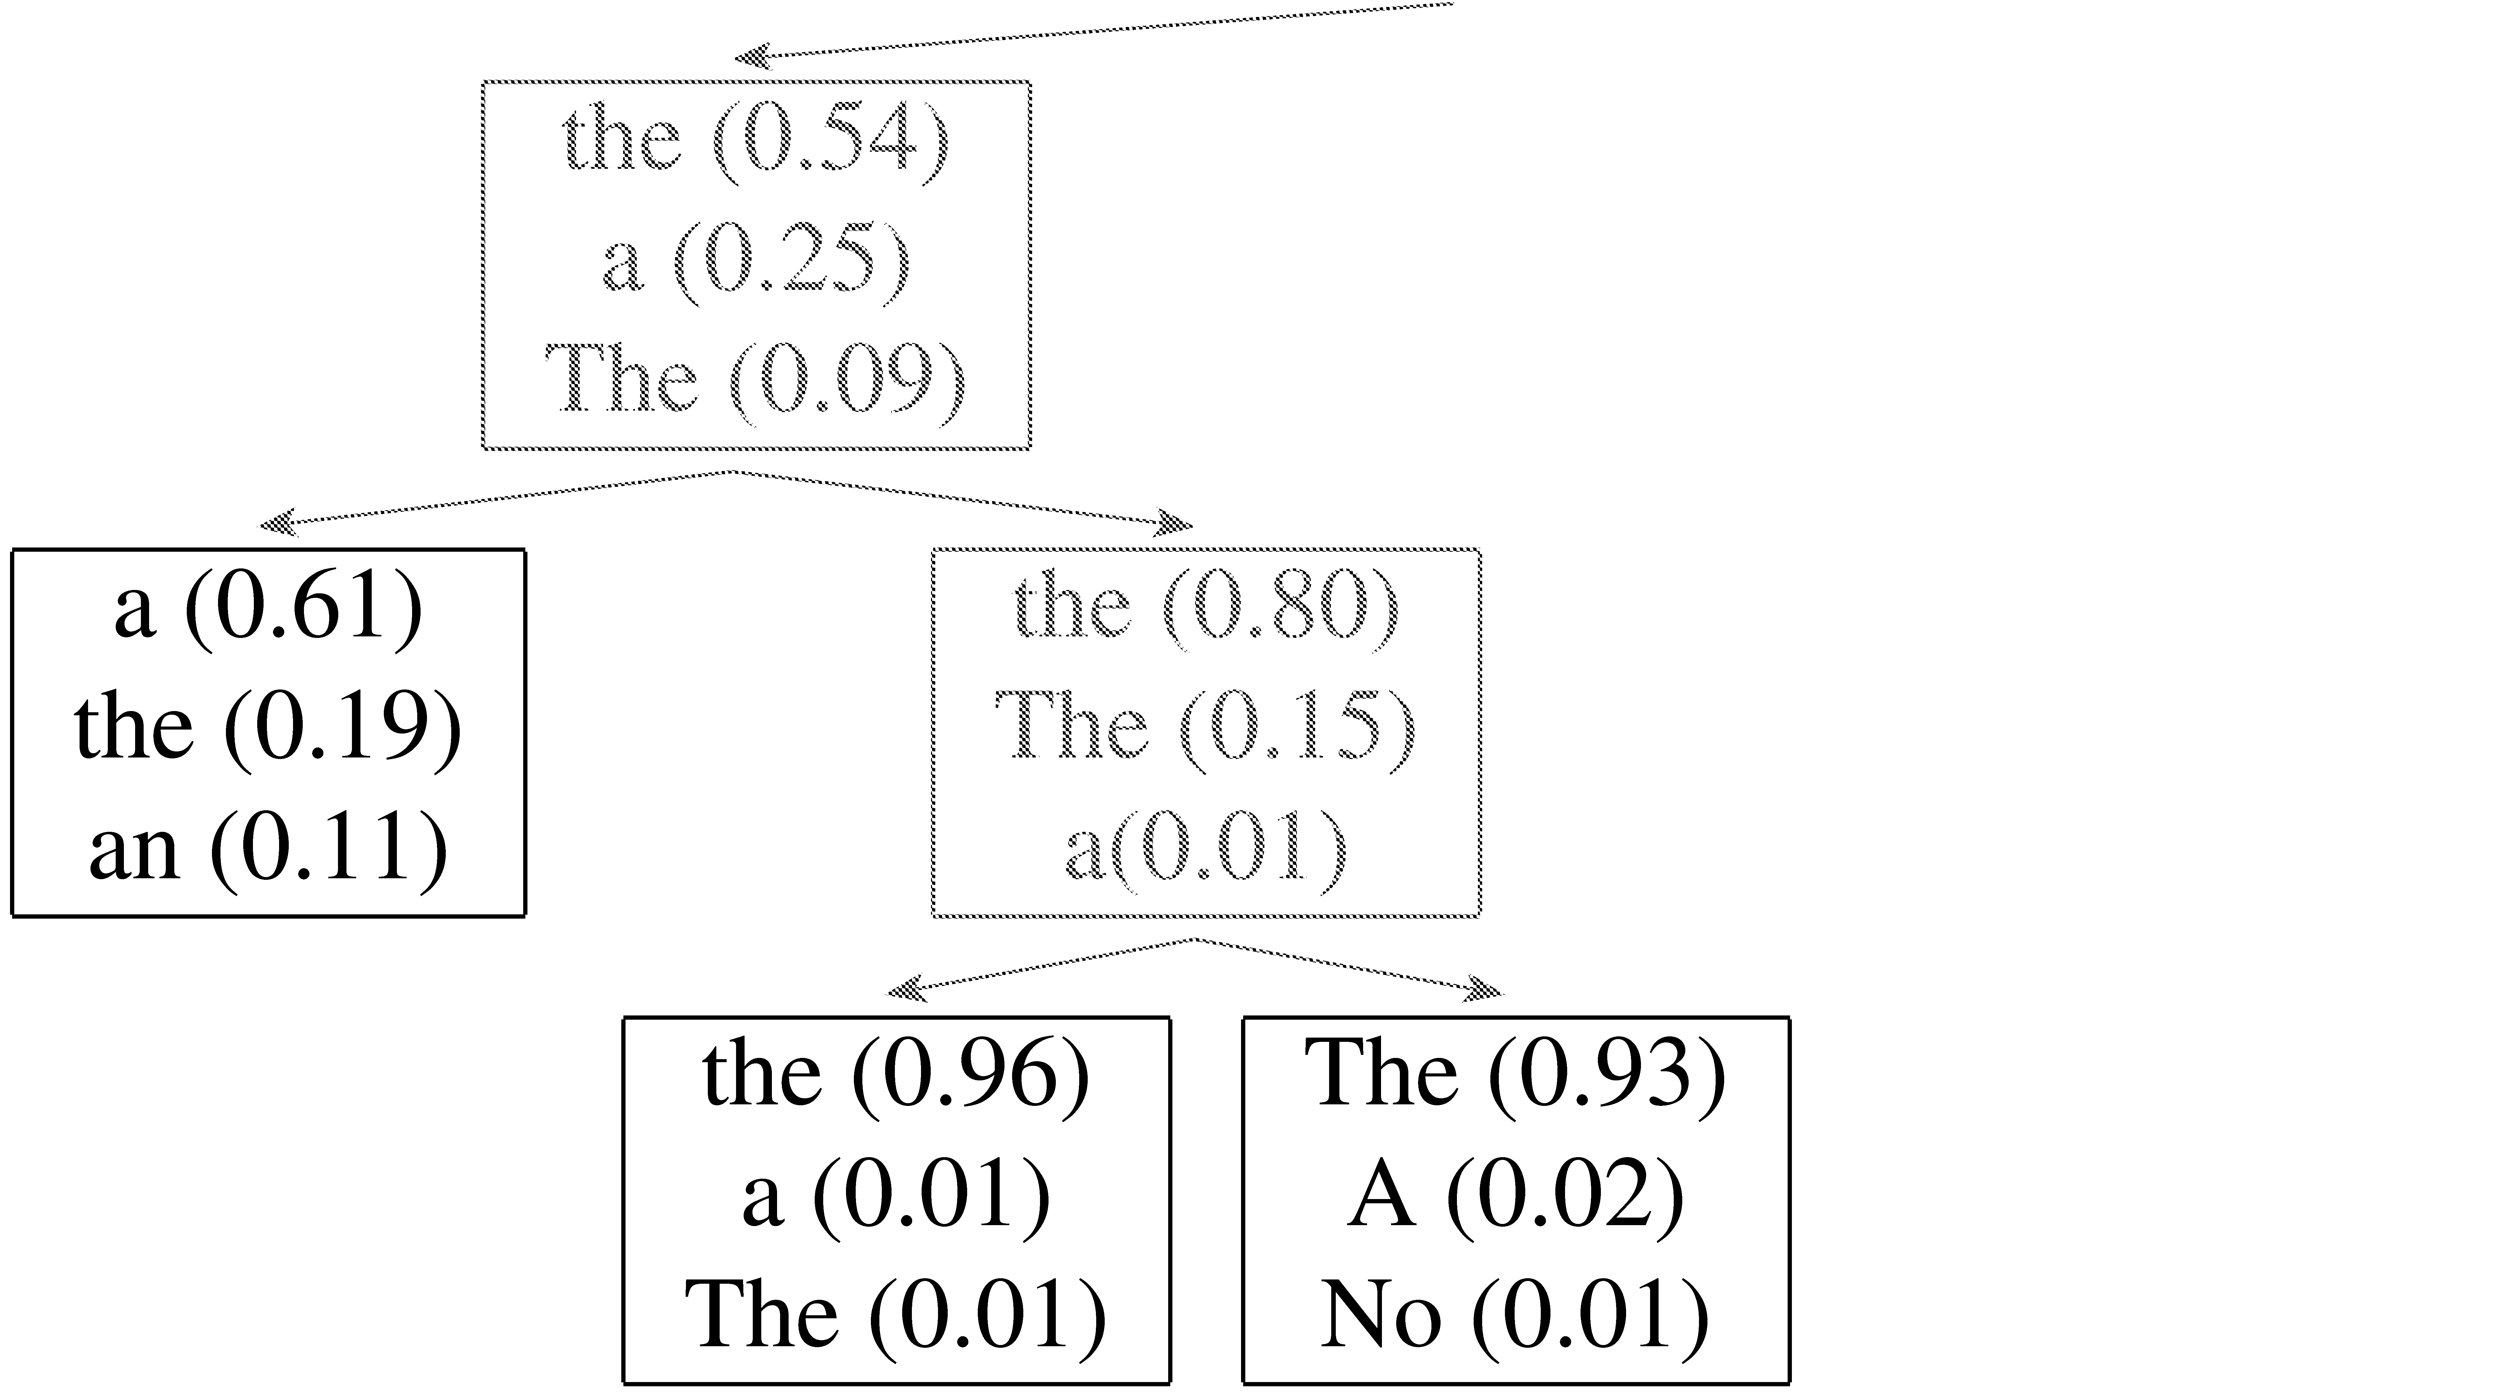
Adaptive Splitting
Want to split complex categories more
Idea: split everything, roll back splits which were least useful

Slide 66
Adaptive Splitting Results
Model | F1
Previous | 88.4
With 50% Merging | 89.5
Notes:
Here you can see how the grammar size has been dramatically reduced. The arrows connect models that have undergone the same number of split iterations and therefore have the same maximal number of subcategories. Because we have merged some of the subcategories back in, the blue model has far fewer total subcategories. The adaptive splitting allows us to do two more split iterations and further refine more complicated categories. This additional expressiveness gives us in turn another 1% improvement in parsing accuracy. We are now close to 90% with a grammar that has a total of barely more than 1000 subcategories. This grammar can allocate upto 64 subcategories, and here is where they get allocated.

Slide 67
Number of Phrasal Subcategories
Notes:
Here are the number of subcategories for each of the 25 phrasal categories. In general phrasal categories are split less heavily than lexical categories, a trend that one could have expected.

Slide 68
Number of Lexical Subcategories
Notes:
Or have little variance.

Slide 69
Final Results (Accuracy)
 |  | ≤ 40 words F1 | all F1
ENG | Charniak&Johnson ‘05 (generative) | 90.1 | 89.6
 | Split / Merge | 90.6 | 90.1
GER | Dubey ‘05 | 76.3 | -
 | Split / Merge | 80.8 | 80.1
CHN | Chiang et al. ‘02 | 80.0 | 76.6
 | Split / Merge | 86.3 | 83.4
Still higher numbers from reranking / self-training methods
Notes:
In terms of accuracy we are better than the generative component of the Brown parser, but still worse than the reranking parser. However, we could extract n-best lists and rerank them too, if we wanted… The nice thing about our approach is that we do not require any knowledge about the target language. We just need a treebank. We therefore trained some grammars for German and Chinese. We surpass the previous stae of the art by a huge margin there. Mainly because most work on parsing has been done on English and parsing techniques for other languages are still somewhat behind.

Slide 70
Finding Word Alignments
… la maison … la maison bleue … la fleur …
… the house … the blue house … the flower …
In machine translation, we train from pairs of translated sentences
Often useful to know how the words align in the sentences
Use EM!
  learn a model of P(french-word | english-word)

Slide 71
Finding Word Alignments
… la maison … la maison bleue … la fleur …
… the house … the blue house … the flower …
All word alignments equally likely
All P(french-word | english-word) equally likely

Slide 72
Finding Word Alignments
… la maison … la maison bleue … la fleur …
… the house … the blue house … the flower …
“la” and “the” observed to co-occur frequently,
so P(la | the) is increased.

Slide 73
Finding Word Alignments
… la maison … la maison bleue … la fleur …
… the house … the blue house … the flower …
“house” co-occurs with both “la” and “maison”, but
P(maison | house) can be raised without limit, to 1.0,
while P(la | house) is limited because of “the”
(pigeonhole principle)

Slide 74
Finding Word Alignments
… la maison … la maison bleue … la fleur …
… the house … the blue house … the flower …
settling down after another iteration

Slide 75
Finding Word Alignments
… la maison … la maison bleue … la fleur …
… the house … the blue house … the flower …
Inherent hidden structure revealed by EM training!
For details, see
- “A Statistical MT Tutorial Workbook” (Knight, 1999).
- 37 easy sections, final section promises a free beer.
- “The Mathematics of Statistical Machine Translation”
(Brown et al, 1993)
- Software: GIZA++

Slide 76
Statistical Machine Translation
… la maison … la maison bleue … la fleur …
… the house … the blue house … the flower …
P(maison | house ) = 0.411
P(maison | building) = 0.027
P(maison | manson) = 0.020
…
Estimating the model from training data

Slide 77
EM summary
EM is a popular technique in NLP
EM is useful when we have lots of unlabeled data
  we may have some labeled data
  or partially labeled data
Broad range of applications
Can be hard to get it right, though…

Slide 78
Discriminative Parse Reranking
Grammar
S → NP VP
S → VP
NP → Det A N
NP → NP PP
NP → PropN
A → ε
A → Adj A
PP → Prep NP
VP → V NP
VP → VP PP
0.9
0.1
0.5
0.3
0.2
0.6
0.4
1.0
0.7
0.3
best parse
CKY
English

Slide 79
Discriminative Parse Reranking
Grammar
best parse
2nd best parse
3rd best parse
4th best parse
5th best parse
….
S → NP VP
S → VP
NP → Det A N
NP → NP PP
NP → PropN
A → ε
A → Adj A
PP → Prep NP
VP → V NP
VP → VP PP
0.9
0.1
0.5
0.3
0.2
0.6
0.4
1.0
0.7
0.3
CKY
English
How could we do this?
How might this help us?

Slide 80
Parse Reranking
PCFG Parser
N-Best Parse Trees
sentence
Parse Tree
Feature
Extractor
Best Parse Tree
Discriminative
Parse Tree
Classifier
Parse Tree Descriptions

Slide 81
Sample Parse Tree Features
Probability of the parse from the PCFG.
The number of parallel conjuncts.
  “the bird in the tree and the squirrel on the ground”
  “the bird and the squirrel in the tree”
The degree to which the parse tree is right branching.
  English parses tend to be right branching (cf. parse of “Book the flight through Houston”)
Frequency of various tree fragments, i.e. specific combinations of 2 or 3 rules.

Slide 82
2-Stage Reranking Approach
Adapt the PCFG parser to produce an N-best list of the most probable parses in addition to the most-likely one.
Extract from each of these parses, a set of global features that help determine if it is a good parse tree.
Train a discriminative classifier (e.g. logistic regression) using the best parse in each N-best list as positive and others as negative.

Slide 83
Evaluation of Reranking
Reranking is limited by oracle accuracy, i.e. the accuracy that results when an omniscient oracle picks the best parse from the N-best list.
Typical current oracle accuracy is around F₁=97%
Reranking can generally improve test accuracy of current PCFG models a percentage point or two

Slide 84
Other Discriminative Parsing
There are also parsing models that move from generative PCFGs to a fully discriminative model, e.g. max margin parsing (Taskar et al., 2004).
There is also a recent model that efficiently reranks all of the parses in the complete (compactly-encoded) parse forest, avoiding the need to generate an N-best list (forest reranking, Huang, 2008).

Slide 85
Human Parsing
How do humans do it?
How might you try and figure it out computationally/experimentally?

Slide 86
Human parsing
Read these sentences
Which one was fastest/slowest?
  John put the dog in the pen with a lock.
  John carried the dog in the pen with a bone in the car.
  John liked the dog in the pen with a bone.

Slide 87
Human Parsing
Computational parsers can be used to predict human reading time as measured by tracking the time taken to read each word in a sentence.
Psycholinguistic studies show that words that are more probable given the preceding lexical and syntactic context are read faster.
  John put the dog in the pen with a lock.
  John carried the dog in the pen with a bone in the car.
  John liked the dog in the pen with a bone.
Modeling these effects requires an incremental statistical parser that incorporates one word at a time into a continuously growing parse tree.

Slide 88
Human Parsing
Computational parsers can be used to predict human reading time as measured by tracking the time taken to read each word in a sentence.
Psycholinguistic studies show that words that are more probable given the preceding lexical and syntactic context are read faster.
  John put the dog in the pen with a lock.
  John put the dog in the pen with a bone in the car.
  John liked the dog in the pen with a bone.
Modeling these effects requires an incremental statistical parser that incorporates one word at a time into a continuously growing parse tree.

Slide 89
Garden Path Sentences
People are confused by sentences that seem to have a particular syntactic structure but then suddenly violate this structure, so the listener is “lead down the garden path”.
  The horse raced past the barn fell.
    vs. The horse raced past the barn broke his leg.
  The complex houses married students.
  The old man the sea.
  While Anna dressed the baby spit up on the bed.
Incremental computational parsers can try to predict and explain the problems encountered parsing such sentences.

