Slide 1
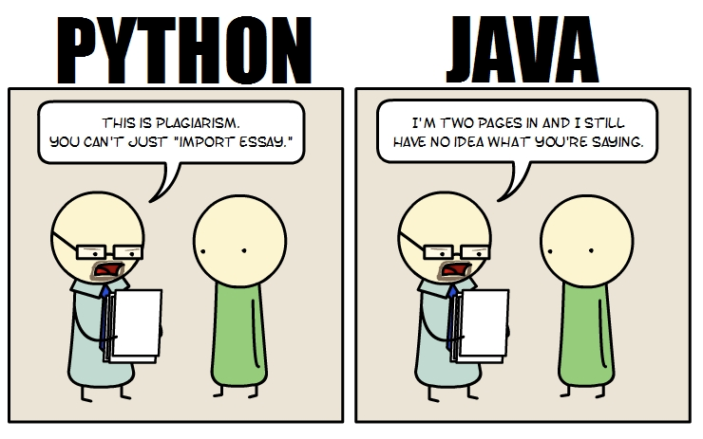
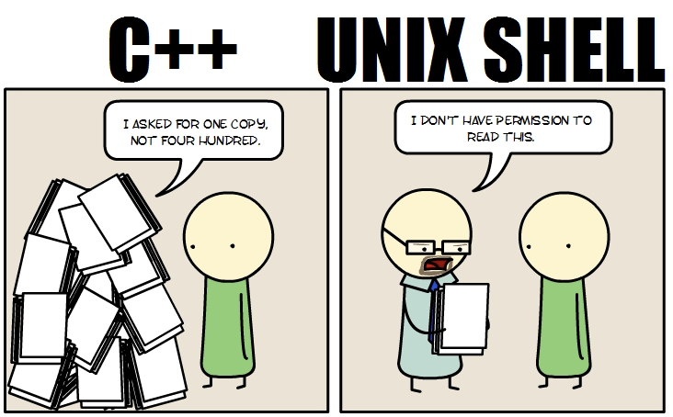
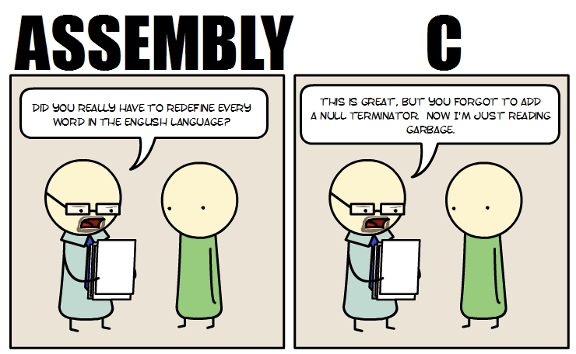
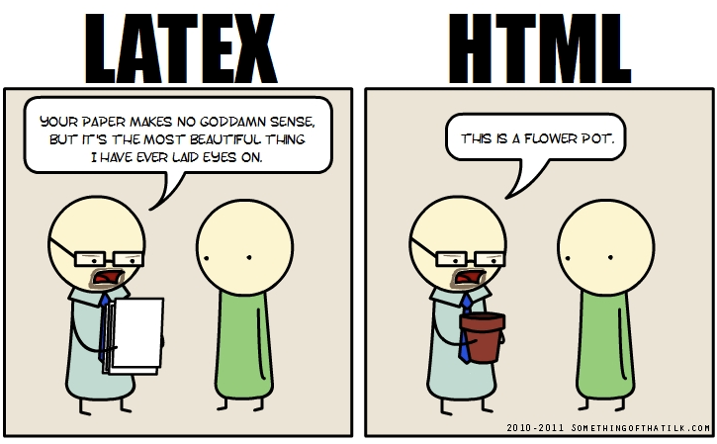
When You Write Your Essays in Programming Languages
http://www.somethingofthatilk.com/index.php?id=135

Slide 2
Question answering and Summarization
David Kauchak
CS159, Spring 2011

Slide 3
Admin?

Slide 4
Brin, 1998 Experiments
extraction patterns
extract from corpus
pairs
new pairs
Were only able to extract from a subset of the repository
Notes:
- Brin, 1998

Slide 5
Information retrieval
ranked documents
query
pomona college computer science
CORPUS

Slide 6
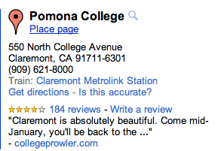
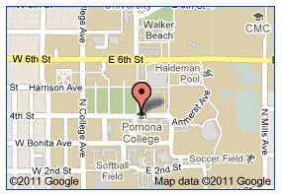
Question answering
answer
question
CORPUS
where is pomona college located?
resources

Slide 7
Question answering
Number of Documents: 979,000
Megabytes of Text: 3033
Document Sources: AP, WSJ, Financial Times, San Jose Mercury News,
LA Times, RBIS
Number of Questions: 682
Question Sources: Encarta log, Excite log
Sample questions:
How much folic acid should an expectant mother get daily?
Who invented the paper clip?
What university was Woodrow Wilson president of?
Where is Rider College located?
Name a film in which Jude law acted.
Where do lobsters like to live?

Slide 8
Other variants…
Mars Polar Lander- Where Are You?
(January 18, 2000) After more than a month of searching for a single sign from NASA’s Mars Polar Lander, mission controllers have lost hope of finding it. The Mars Polar Lander was on a mission to Mars to study its atmosphere and search for water, something that could help scientists determine whether life even existed on Mars. Polar Lander was to have touched down on December 3 for a 90-day mission. It was to land near Mars’ south pole. The lander was last heard from minutes before beginning its descent. The last effort to communicate with the three-legged lander ended with frustration at 8 a.m. Monday. “We didn’t see anything,” said Richard Cook, the spacecraft’s project manager at NASA’s Jest Propulsion laboratory. The failed mission to the Red Planet cost the American government more the $200 million dollars. Now, space agency scientists and engineers will try to find out what could have gone wrong. They do not want to make the same mistakes in the next mission.
  When did the mission controllers lost Hope of communication with the Lander?
  Who is the Polar Lander’s project manager?
  Where on Mars was the spacecraft supposed to touch down?
  What was the mission of the Mars Polar Lander?

Slide 9
Other variants…
Mars Polar Lander- Where Are You?
(January 18, 2000) After more than a month of searching for a single sign from NASA’s Mars Polar Lander, mission controllers have lost hope of finding it. The Mars Polar Lander was on a mission to Mars to study its atmosphere and search for water, something that could help scientists determine whether life even existed on Mars. Polar Lander was to have touched down on December 3 for a 90-day mission. It was to land near Mars’ south pole. The lander was last heard from minutes before beginning its descent. The last effort to communicate with the three-legged lander ended with frustration at 8 a.m. Monday. “We didn’t see anything,” said Richard Cook, the spacecraft’s project manager at NASA’s Jest Propulsion laboratory. The failed mission to the Red Planet cost the American government more the $200 million dollars. Now, space agency scientists and engineers will try to find out what could have gone wrong. They do not want to make the same mistakes in the next mission.
  When did the mission controllers lost Hope of communication with the Lander? (Answer: 8AM, Monday Jan. 17)
  Who is the Polar Lander’s project manager? (Answer: Richard Cook)
  Where on Mars was the spacecraft supposed to touch down? (Answer: near Mars’ south pole)
  What was the mission of the Mars Polar Lander? (Answer: to study Mars’ atmosphere and search for water)

Slide 10
Question answering
challenges? how is this different than IR?
answer
question
CORPUS
where is pomona college located?
resources

Slide 11
Challenges
Question: “When was Wendy’s founded?”

Slide 12
Challenges
Question: “When was Wendy’s founded?”
Passage candidate:
  “The renowned Murano glassmaking industry, on an island in the Venetian lagoon, has gone through several reincarnations since it was founded in 1291. Three exhibitions of 20th-century Murano glass are coming up in New York. By Wendy Moonan.”
Answer: 20th Century or 1291?

Slide 13
Challenges
Question: When was Microsoft established?

Slide 14
Challenges
Question: When was Microsoft established?
Microsoft tends to establish lots of things…
Microsoft plans to establish manufacturing partnerships in Brazil and Mexico in May.
Solution?

Slide 15
Challenges
Question: When was Microsoft established?
Microsoft tends to establish lots of things…
Microsoft plans to establish manufacturing partnerships in Brazil and Mexico in May.
Need to be able to detect sentences in which `Microsoft’ is object of `establish’ or close synonym.
Matching sentence:
Microsoft Corp was founded in the US in 1975, incorporated in 1981, and established in the UK in 1982.

Slide 16
Challenges
Question: What is the occupation of Bill Clinton’s wife?
  No documents contain these keywords plus the answer
Ideas?

Slide 17
Challenges
Question: What is the occupation of Bill Clinton’s wife?
  No documents contain these keywords plus the answer
One solution: decompose into two questions:
  Who is Bill Clinton’s wife? = X
  What is the occupation of X?
AI/planning/logic!

Slide 18
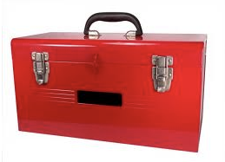
Question answering
How are we going to do it?
Information retrieval
text similarity
parsing
language modeling
machine learning
information extraction
POS tagging

Slide 19
QA basic framework
Question
Query
Docs
query
processing
Information
retrieval
Answer
processing
Answer
Corpus

Slide 20
Query processing
Question
Query
query
processing
Information
retrieval
Question
Why do we need query processing?
What types of things might we need to do?
Information
retrieval

Slide 21
Query processing
If we’re going to feed the question into an IR system, often need to reformulate the query
  Some things may already be done by the IR system
    remove stopwords
    remove question words
    query expansion:
      who is the president of the US?: US -> United States
  Formulate as a statement rather than a question:
When was the paper clip invented? | the paper clip was invented
what is the tallest building? | the tallest building is

Slide 22
Query processing
Analyze the query: what questions might we ask about the query that might help limit our set of answers?

Slide 23
Query processing
Analyze the query: what questions might we ask about the query that might help limit our set of answers?
What is the expected answer type?
 | Q-Type | A-Type
When did the Titanic sink ? | event-completion | time
Who was Darth Vader's son? | concept-completion | person-name
What is thalassemia ? | definition | definition

Slide 24
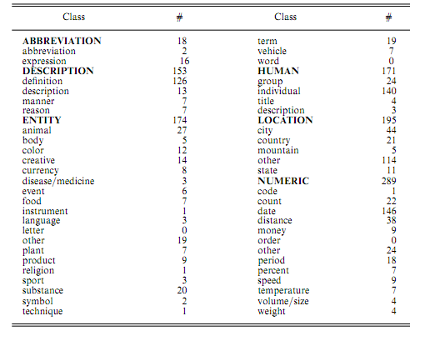
Answer type hierarchies

Slide 25
Question classification
 | Q-Type | A-Type
When did the Titanic sink ? | event-completion | time
Who was Darth Vader's son? | concept-completion | person-name
What is thalassemia ? | definition | definition
How can we identify this?

Slide 26
Question classification
 | Q-Type | A-Type
When did the Titanic sink ? | event-completion | time
Who was Darth Vader's son? | concept-completion | person-name
What is thalassemia ? | definition | definition
Hand-written rules
  WHO: person, organization, or country.
  WHERE: location (specific or general)
  WHEN: date on time period
  HOW MUCH: an amount
  HOW MANY: a number
  WHICH CITY: a city

Slide 27
Question classification
 | Q-Type | A-Type
When did the Titanic sink ? | event-completion | time
Who was Darth Vader's son? | concept-completion | person-name
What is thalassemia ? | definition | definition
Better: machine learning!
lots of clues
  What city is pomona college in?
  Where is pomona college located?
  What is the tallest building in the world?

Slide 28
QA basic framework
Question
Query
Docs
query
processing
Information
retrieval
Answer
processing
Answer
Corpus

Slide 29
Answer processing
problem?
What is the tallest building in the world?
The world's tallest structure is the 828 m (2,717 ft) tall Burj Khalifa in Dubai, United Arab Emirates. The building gained the official title of "Tallest Building in the World" at its opening on 4 January 2010. It is taller than any other man-made structure ever built.
The Council on Tall Buildings and Urban Habitat, an organization that certifies buildings as the "World’s Tallest", recognizes a building only if at least fifty percent of its height is made up of floor plates containing habitable floor area.[1] Structures that do not meet this criterion, such as the CN Tower, are defined as "towers".
There are dozens of radio and television broadcasting towers which measure over 600 meters (about 2,000 ft) in height, and only the tallest are recorded in publicly available information sources.

Slide 30
Answer processing
The world's tallest structure is the 828 m (2,717 ft) tall Burj Khalifa in Dubai, United Arab Emirates. The building gained the official title of "Tallest Building in the World" at its opening on 4 January 2010. It is taller than any other man-made structure ever built.
The Council on Tall Buildings and Urban Habitat, an organization that certifies buildings as the "World’s Tallest", recognizes a building only if at least fifty percent of its height is made up of floor plates containing habitable floor area.[1] Structures that do not meet this criterion, such as the CN Tower, are defined as "towers".
There are dozens of radio and television broadcasting towers which measure over 600 meters (about 2,000 ft) in height, and only the tallest are recorded in publicly available information sources.
Burj Khalifa
ideas?

Slide 31
NLP to the rescue!
Need more information than just the text
  named entity recognition/information extraction
  parsing
  relationships between entities
    Microsoft established vs. Microsoft was established
Pair this information with information we extracted from the query
  What are we looking for? A person? A date? …?

Slide 32
Extracting entities
President George Bush announced a new bill that would send $1.2 million dollars to Miami Florida for a new hurricane tracking system.
After applying a Named Entity Tagger, the text might look like this:
<Person=“President George Bush”> announced a new bill that would send <MONEY=$1.2 million dollars”> to <LOCATION=“Miami Florida:”> for a new hurricane tracking system.
Who announced the new bill?
Where will the money from the new bill go?
How much will be provided for the new bill?

Slide 33
Combining and normalizing evidence
Q: What year did the Titanic sink?
A: 1912
Supporting evidence:
It was the worst peacetime disaster involving a British ship since the Titanic sank on the 14th of April, 1912.
The Titanic sank after striking an iceberg in the North Atlantic on April 14th, 1912.
The Herald of Free Enterprise capsized off the Belgian port of Zeebrugge on March 6, 1987, in the worst peacetime disaster involving a British ship since the Titanic sank in 1912.

Slide 34
What happened?
Different formats for answer candidates detected, normalized and combined:
  `April 14th, 1912’
  `14th of April, 1912’
Supporting evidence detected and combined:
  `1912’ supports `April 14th, 1912’
Structure of date expressions understood and correct piece output:
  `1912’ rather than `April 14th, 1912’
Most frequent answer candidate found and output:
  `April 14th, 1912’ rather than something else.

Slide 35
NLP is expensive!
We need to run:
  sentence identifier
  tokenizer
  IE
  parsers
  …
These are expensive! (and there may be many documents)
Can we reduce this time?

Slide 36
QA actual framework
Question
Query
Docs
Answers
query
processing
Information
retrieval
Passage
retrieval
Answer
processing
Answer
Corpus
find relevant passages before doing NLP

Slide 37
Passage retrieval
IR Systems return the N most relevant documents
Passage retrieval systems then return the N most relevant passages
The answer processing is then only run on these passages

Slide 38
Evaluation
How can/should we evaluate the system?
Ideas:
  Accuracy
  Precision/Recall (often we allow it to say “No Answer”)
  Produce multiple answers and use IR like measures

Slide 39
Reciprocal ranking scheme
For the purposes of evaluating the systems, several answer candidates are often ranked by confidence.

Slide 40
Reciprocal ranking scheme
For the purposes of evaluating the systems, several answer candidates are often ranked by confidence.
Reciprocal Ranking Scheme: the score for a question is 1/R, where R is a rank of the first correct answer in the list.
Q: What is the capital of Utah? A1: Ogden A2: Salt Lake City A3: Provo A4: St. George A5: Salt Lake
RRS?

Slide 41
Reciprocal ranking scheme
For the purposes of evaluating the systems, several answer candidates are often ranked by confidence.
Reciprocal Ranking Scheme: the score for a question is 1/R, where R is a rank of the first correct answer in the list.
Q: What is the capital of Utah? A1: Ogden A2: Salt Lake City A3: Provo A4: St. George A5: Salt Lake
The score for the question Q would be ½.

Slide 42
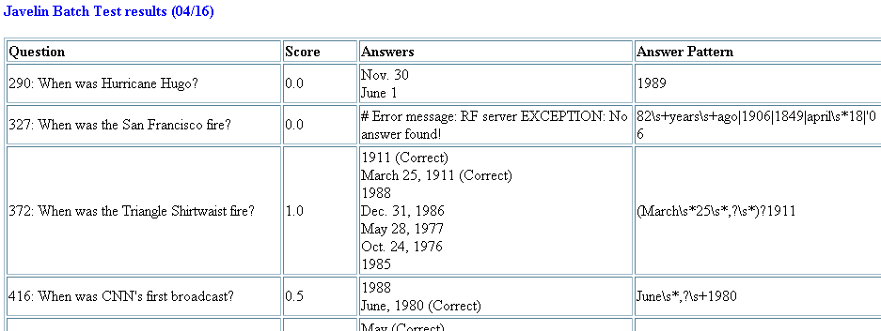
Sample Results

Slide 43
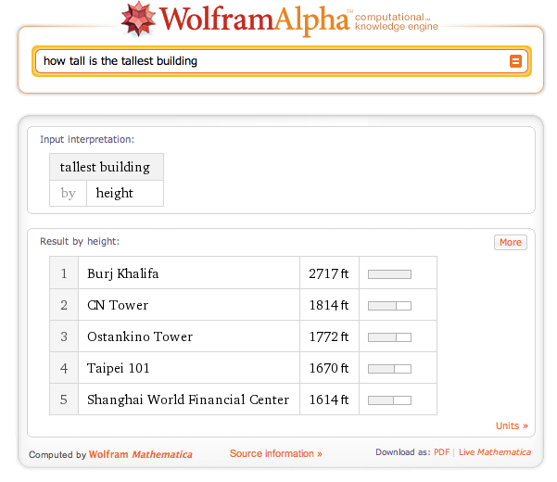
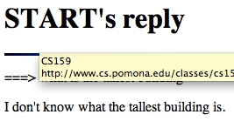
Does it work?

Slide 44
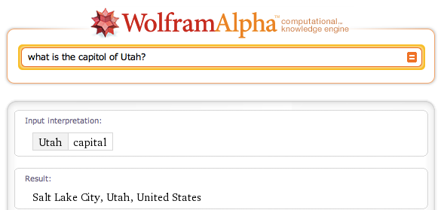
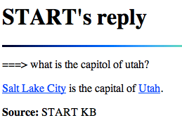
Does it work?

Slide 45
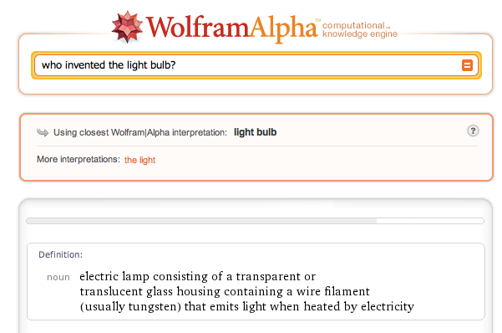
Does it work?

Slide 46
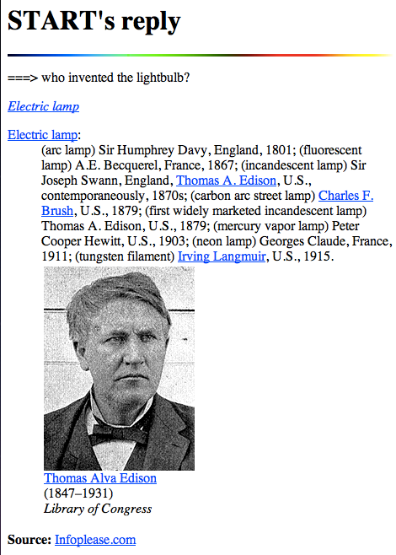
Does it work?

Slide 47
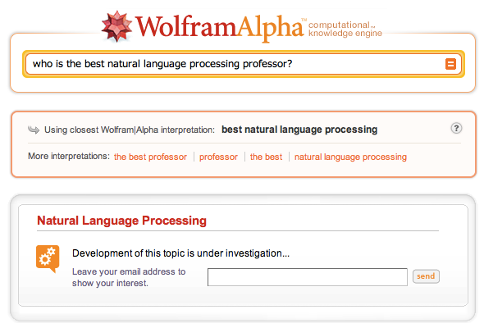
Does it work?

Slide 48
Does it work?
Where do lobsters like to live?
  on a Canadian airline
Where do hyenas live?
  in Saudi Arabia
  in the back of pick-up trucks
Where are zebras most likely found?
  near dumps
  in the dictionary
Why can't ostriches fly?
  Because of American economic sanctions
What’s the population of Maryland?
  three

Slide 49
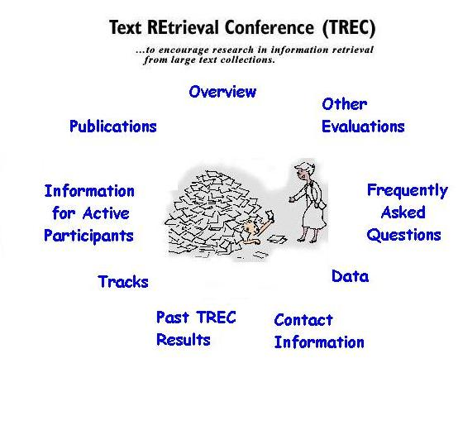

http://trec.nist.gov

Slide 50
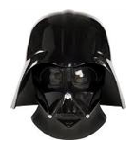


Summarization
Summarization approaches aim to produce a summarized version of a text document
summarizer
son of
summarizer

Slide 51
Summarization
Full-text
Summarization
Question Answer

Slide 52
Summarization
Applications?
Different types of summarization?

Slide 53
Genres
overview/summary/abstract
headlines
outlines
minutes
biographies
compression
simplification
sound bites
movie summaries
chronologies

Slide 54
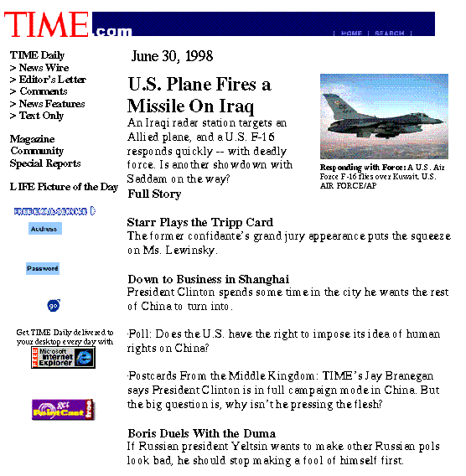
Headline news — informing

Slide 55
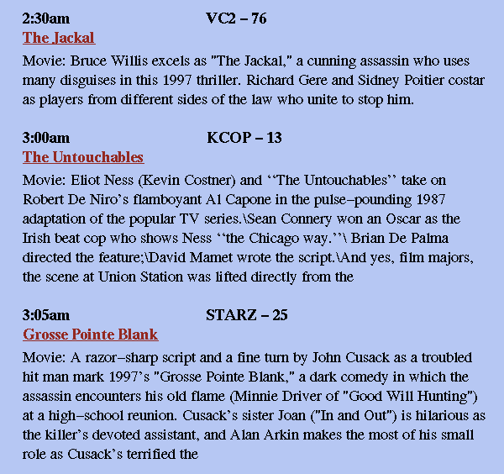
TV-GUIDES — decision making

Slide 56
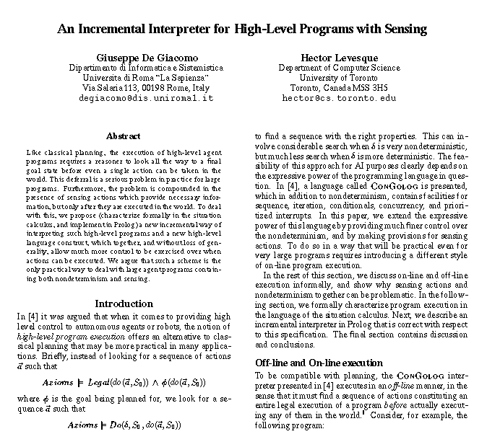
Abstracts of papers — time saving

Slide 57
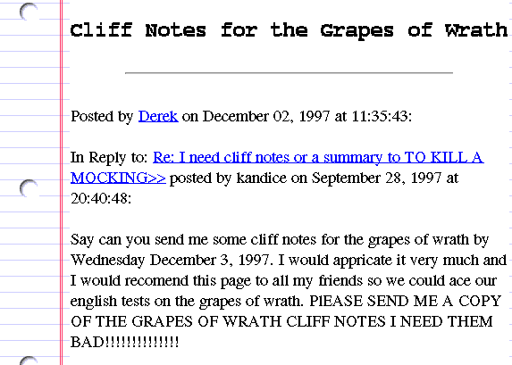
Cliff notes — Laziness support

Slide 58
Different dimensions of summarization
How much summarization
  quick categorization vs. content processing
  Background vs. just-the-news
Extract vs. abstract (how the summarization is generated
  lists fragments of text vs. re-phrases content coherently
Generic vs. query-oriented
Single-document vs. multi-document source
  ...based on one text vs. fuses together many texts.

Slide 59
Summarization
How are we going to do it?
Information retrieval
text similarity
language modeling
parsing
machine learning
information extraction
POS tagging
machine translation

Slide 60
Summarization
Three common steps:
  Content selection: what are the important concepts/clauses/sentences?
  Content ordering: how should this information be structured?
  Realization: concepts/sentences=> output

Slide 61
Three common steps: the basics
content selection
content ordering
realization

Slide 62
Content selection
content selection
General problem: identify important concepts
Common approximation: identify important sentences
How can we identify important sentences?

Slide 63
Identifying important sentences
Word-based
  Calculate the sentence as the average weight of the words in the sentence
    TF-IDF weighting
    likelihood ratio: likelihood of occurring in this document divided by the likelihood of occurring in the whole corpus
  pick the highest scoring sentences
Similarity-based
  pick sentences that are on average closer to the other sentences in the document
  might also discount for being generally similar to whole corpus

Slide 64
Identifying important sentences: supervised approach
Training data
Could we use this to learn a sentence importance measure?
What features might be useful?
Challenges?
Notes:
interesting features
-- position in the document
-- cue phrases (in summary, in conclusion)
-- word informativeness (from our unsupervised approach)
-- sentence length
challenges
-- our summaries might not be exact extracts: need to identify corresponding sentence(s) in the data

Slide 65
Summarization
Three common steps:
  Content selection: what are the important concepts/clauses/sentences?
  Content ordering: how should this information be structured?
Often, just put them in the same order they occur in the documents

Slide 66
Summarization
Three common steps:
  Content selection: what are the important concepts/clauses/sentences?
  Content ordering: how should this information be structured?
  Realization: concepts/sentences => output
challenges?

Slide 67
Realization (output)
Input: a bunch of sentences
output: summary
challenges
  reference resolution/naming (show some examples)
  fluidity
  repetition?

Slide 68
Multi-document approaches
In many domains, we have multiple documents on the same topic (e.g. news) and we’d like to summarize all the documents with one summary
How does this problem differ?

Slide 69
ARTICLE 18853: ALGIERS, May 20 (AFP)
ARTICLE 18854: ALGIERS, May 20 (UPI)
1. Eighteen decapitated bodies have been found in a mass grave in northern Algeria, press reports said Thursday, adding that two shepherds were murdered earlier this week.
2. Security forces found the mass grave on Wednesday at Chbika, near Djelfa, 275 kilometers (170 miles) south of the capital.
3. It contained the bodies of people killed last year during a wedding ceremony, according to Le Quotidien Liberte.
4. The victims included women, children and old men.
5. Most of them had been decapitated and their heads thrown on a road, reported the Es Sahafa.
6. Another mass grave containing the bodies of around 10 people was discovered recently near Algiers, in the Eucalyptus district.
7. The two shepherds were killed Monday evening by a group of nine armed Islamists near the Moulay Slissen forest.
8. After being injured in a hail of automatic weapons fire, the pair were finished off with machete blows before being decapitated, Le Quotidien d'Oran reported.
9. Seven people, six of them children, were killed and two injured Wednesday by armed Islamists near Medea, 120 kilometers (75 miles) south of Algiers, security forces said.
10. The same day a parcel bomb explosion injured 17 people in Algiers itself.
11. Since early March, violence linked to armed Islamists has claimed more than 500 lives, according to press tallies.
1. Algerian newspapers have reported that 18 decapitated bodies have been found by authorities in the south of the country.
2. Police found the ``decapitated bodies of women, children and old men,with their heads thrown on a road'' near the town of Jelfa, 275 kilometers (170 miles) south of the capital Algiers.
3. In another incident on Wednesday, seven people -- including six children -- were killed by terrorists, Algerian security forces said.
4. Extremist Muslim militants were responsible for the slaughter of the seven people in the province of Medea, 120 kilometers (74 miles) south of Algiers.
5. The killers also kidnapped three girls during the same attack, authorities said, and one of the girls was found wounded on a nearby road.
6. Meanwhile, the Algerian daily Le Matin today quoted Interior Minister Abdul Malik Silal as saying that ``terrorism has not been eradicated, but the movement of the terrorists has significantly declined.''
7. Algerian violence has claimed the lives of more than 70,000 people since the army cancelled the 1992 general elections that Islamic parties were likely to win.
8. Mainstream Islamic groups, most of which are banned in the country, insist their members are not responsible for the violence against civilians.
9. Some Muslim groups have blamed the army, while others accuse ``foreign elements conspiring against Algeria.’’

Slide 70
Evaluation?

Slide 71
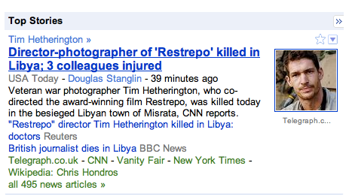
Google news

Slide 72
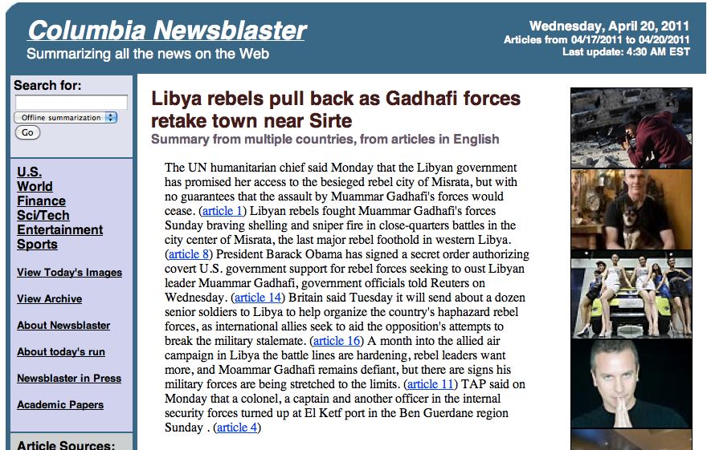
News blaster

Slide 73
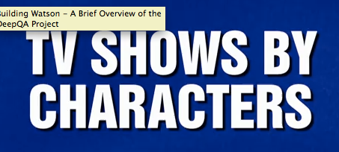
QA: Watson
http://www.youtube.com/watch?v=3G2H3DZ8rNc

