Slide 1
Probability
David Kauchak
CS159 – Spring 2011

Slide 2
Admin
Posted some links in Monday’s lecture for regular expressions
Logging in remotely
ssh to vpn.cs.pomona.edu (though don’t run anything here!) or project.cs.pomona.edu
use your Pomona CS login
ssh to one of the lab machines
cs227-33.cs.pomona.edu (cs227-43, cs227-44)
In regex terms: cs227-[1-4][1-4]\.cs\.pomona\.edu

Slide 3
Next Monday

Slide 4
Corpus statistics
www.nytimes.com 1/25/2011

Slide 5
Regular expression by language
grep
command-line tool for regular expressions (general regular expression print/parser)
returns all lines that match a regular expression
grep “@” twitter.posts
grep “http:” twiter.posts
can’t used metacharacters (\d, \w), use [] instead

Slide 6
Regular expression by language
sed
another command-line tool using that regexs to print and manipulate strings
very powerful, though we’ll just play with it
Most common is substitution:
sed “s/ is a / is not a/” twitter.posts
sed “s/ +/ /” twitter.posts
grep "#" twitter.posts | sed -E "s/#([a-zA-Z]+)/REF: \\1/g”
Use –E if you want to use character classes
\\1 references the first match (i.e. whatever is matched in
Can also do things like delete all that match, etc.

Slide 7
Basic Probability Theory: terminology
An experiment has a set of potential outcomes, e.g., throw a dice, “look at” another sentence
The sample space of an experiment is the set of all possible outcomes, e.g., {1, 2, 3, 4, 5, 6}
In NLP our sample spaces tend to be very large
All words, bigrams, 5-grams
All sentences of length 20 (given a finite vocabulary)
All sentences
All parse trees over a given sentence

Slide 8
Basic Probability Theory: terminology
An event is a subset of the sample space
Dice rolls
{2}
{3, 6}
even = {2, 4, 6}
odd = {1, 3, 5}
NLP
a particular word/part of speech occurring in a sentence
a particular topic discussed (politics, sports)
sentence with a parasitic gap
pick your favorite phenomena…

Slide 9
Events
We’re interested in probabilities of events
p({2})
p(even)
p(odd)
p(parasitic gap)
p(word)

Slide 10
Random variables
A random variable is a mapping from the sample space to a number (think events)
It represents all the possible values of something we want to measure in an experiment
For example, random variable, X, could be the number of heads for a coin
Really for notational convenience, since the event space can sometimes be irregular
space | HHH | HHT | HTH | HTT | THH | THT | TTH | TTT
X | 3 | 2 | 2 | 1 | 2 | 1 | 1 | 0

Slide 11
Random variables
We can then talk about the probability of the different values of a random variable
The definition of probabilities over all of the possible values of a random variable defines a probability distribution
space | HHH | HHT | HTH | HTT | THH | THT | TTH | TTT
X | 3 | 2 | 2 | 1 | 2 | 1 | 1 | 0
X | P(X)
3 | P(X=3) = 1/8
2 | P(X=2) = 3/8
1 | P(X=1) = 3/8
0 | P(X=0) = 1/8

Slide 12
Probability distribution
To be explicit
A probability distribution assigns probability values to all possible values of a random variable
These values must be >= 0 and <= 1
These values must sum to 1 for all possible values of the random variable
X | P(X)
3 | P(X=3) = 1/2
2 | P(X=2) = 1/2
1 | P(X=1) = 1/2
0 | P(X=0) = 1/2
X | P(X)
3 | P(X=3) = -1
2 | P(X=2) = 2
1 | P(X=1) = 0
0 | P(X=0) = 0

Slide 13
Unconditional/prior probability
Simplest form of probability is
P(X)
Prior probability: without any additional information, what is the probability
What is the probability of a heads?
What is the probability of a sentence containing a pronoun?
What is the probability of a sentence containing the word “banana”?
What is the probability of a document discussing politics?
…

Slide 14
Joint distributions
We can also talk about probability distributions over multiple variables
P(X,Y)
probability of X and Y
a distribution over the cross product of possible values
NLPPass | P(NLPPass)
true | 0.89
false | 0.11
NLPPass AND EngPass | P(NLPPass, EngPass)
true, true | .88
true, false | .01
false, true | .04
false, false | .07
EngPass | P(EngPass)
true | 0.92
false | 0.08

Slide 15
Joint distribution
Still a probability distribution
all values between 0 and 1, inclusive
all values sum to 1
All questions/probabilities of the two variables can be calculate from the joint distribution
NLPPass AND EngPass | P(NLPPass, EngPass)
true, true | .88
true, false | .01
false, true | .04
false, false | .07
What is P(ENGPass)?

Slide 16
Joint distribution
Still a probability distribution
all values between 0 and 1, inclusive
all values sum to 1
All questions/probabilities of the two variables can be calculate from the joint distribution
NLPPass AND EngPass | P(NLPPass, EngPass)
true, true | .88
true, false | .01
false, true | .04
false, false | .07
0.92
How did you figure that out?

Slide 17
Joint distribution
NLPPass AND EngPass | P(NLPPass, EngPass)
true, true | .88
true, false | .01
false, true | .04
false, false | .07

Slide 18
Conditional probability
As we learn more information, we can update our probability distribution
P(X|Y) models this (read “probability of X given Y”)
What is the probability of a heads given that both sides of the coin are heads?
What is the probability the document is about politics, given that it contains the word “Clinton”?
What is the probability of the word “banana” given that the sentence also contains the word “split”?
Notice that it is still a distribution over the values of X

Slide 19
Conditional probability
x
y
In terms of pior and joint distributions, what is the conditional probability distribution?

Slide 20
Conditional probability
Given that y has happened, what proportion of those events does x also happen
x
y

Slide 21
Conditional probability
Given that y has happened, what proportion of those events does x also happen
x
y
NLPPass AND EngPass | P(NLPPass, EngPass)
true, true | .88
true, false | .01
false, true | .04
false, false | .07
What is: p(NLPPass=true | EngPass=false)?

Slide 22
Conditional probability
NLPPass AND EngPass | P(NLPPass, EngPass)
true, true | .88
true, false | .01
false, true | .04
false, false | .07
What is: p(NLPPass=true | EngPass=false)?
= 0.125
Notice this is very different than p(NLPPass=true) = 0.89

Slide 23
A note about notation
When talking about a particular assignment, you should technically write p(X=x), etc.
However, when it’s clear , we’ll often shorten it
Also, we may also say P(X) or p(x) to generically mean any particular value, i.e. P(X=x)
= 0.125

Slide 24
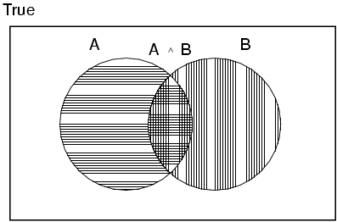
Properties of probabilities
P(A or B) = ?

Slide 25
Properties of probabilities
P(A or B) = P(A) + P(B) - P(A,B)

Slide 26
Properties of probabilities
P(¬E) = 1– P(E)
More generally:
Given events E = e₁, e₂, …, e_{n}
P(E1, E2) ≤ P(E1)

Slide 27
Chain rule (aka product rule)
We can view calculating the probability of X AND Y occurring as two steps:
Y occurs with some probability P(Y)
Then, X occurs, given that Y has occured
or you can just trust the math… ☺

Slide 28
Chain rule

Slide 29
Applications of the chain rule
We saw that we could calculate the individual prior probabilities using the joint distribution
What if we don’t have the joint distribution, but do have conditional probability information:
P(Y)
P(X|Y)

Slide 30
Bayes’ rule (theorem)

Slide 31
Bayes rule
Allows us to talk about P(Y|X) rather than P(X|Y)
Sometimes this can be more intuitive
Why?

Slide 32
Bayes rule
p(disease | symptoms)
For everyone who had those symptoms, how many had the disease?
p(symptoms|disease)
For everyone that had the disease, how many had this symptom?
p( linguistic phenomena | features )
For all examples that had those features, how many had that phenomena?
p(features | linguistic phenomena)
For all the examples with that phenomena, how many had this feature
p(cause | effect) vs. p(effect | cause)

Slide 33
Gaps
V
I just won’t put these away.
direct object
These, I just won’t put away.
filler
I just won’t put away.
gap

Slide 34
Gaps
What did you put away.
gap
The socks that I put away.
gap

Slide 35
Gaps
Whose socks did you fold and put away?
gap
gap
Whose socks did you fold ?
gap
Whose socks did you put away?
gap

Slide 36
Parasitic gaps
These I’ll put away without folding .
gap
gap
These I’ll put away.
gap
These without folding .
gap

Slide 37
Parasitic gap
These I’ll put away without folding .
gap
gap
1. Cannot exist by themselves (parasitic)
These I’ll put my pants away without folding .
gap
2. They’re optional
These I’ll put away without folding them.
gap

Slide 38
Parasitic gaps
http://literalminded.wordpress.com/2009/02/10/dougs-parasitic-gap/

Slide 39
Frequency of parasitic gaps
Parasitic gaps occur on average in 1/100,000 sentences
Problem:
Joe Linguist has developed a complicated set of regular expressions to try and identify parasitic gaps. If a sentence has a parasitic gap, it correctly identifies it 95% of the time. If it doesn’t, it will incorrectly say it does with probability 0.005. Suppose we run it on a sentence and the algorithm says it is a parasitic gap, what is the probability it actually is?

Slide 40
Prob of parasitic gaps
Joe Linguist has developed a complicated set of regular expressions to try and identify parasitic gaps. If a sentence has a parasitic gap, it correctly identifies it 95% of the time. If it doesn’t, it will incorrectly say it does with probability 0.005. Suppose we run it on a sentence and the algorithm says it is a parasitic gap, what is the probability it actually is?
G = gap
T = test positive
What question do we want to ask?

Slide 41
Prob of parasitic gaps
Joe Linguist has developed a complicated set of regular expressions to try and identify parasitic gaps. If a sentence has a parasitic gap, it correctly identifies it 95% of the time. If it doesn’t, it will incorrectly say it does with probability 0.005. Suppose we run it on a sentence and the algorithm says it is a parasitic gap, what is the probability it actually is?
G = gap
T = test positive

Slide 42
Prob of parasitic gaps
Joe Linguist has developed a complicated set of regular expressions to try and identify parasitic gaps. If a sentence has a parasitic gap, it correctly identifies it 95% of the time. If it doesn’t, it will incorrectly say it does with probability 0.005. Suppose we run it on a sentence and the algorithm says it is a parasitic gap, what is the probability it actually is?
G = gap
T = test positive

Slide 43
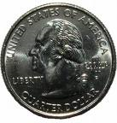
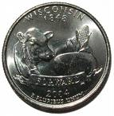
Obtaining probabilities
H
H
T
T
H
T
H
H
T
T
We’ve talked a lot about probabilities, but not where they come from
What is the probability of “the” occurring in a sentence?
What is the probability of “Pomona” occurring in a sentence?
What is the probability of "I think today is a good day to be me” as a sentence?

Slide 44
Obtaining probabilities
training data
estimate from actual data
P(…)

Slide 45
Estimating probabilities
What is the probability of “the” occurring in a sentence?
We don’t know!
We can estimate that based on data, though:
number of sentences with “the”
total number of sentences

Slide 46
Maximum likelihood estimation
Intuitive
Sets the probabilities so as to maximize the probability of the training data
Problems?
Amount of data
particularly problematic for rare events
Is our training data representative

Slide 47
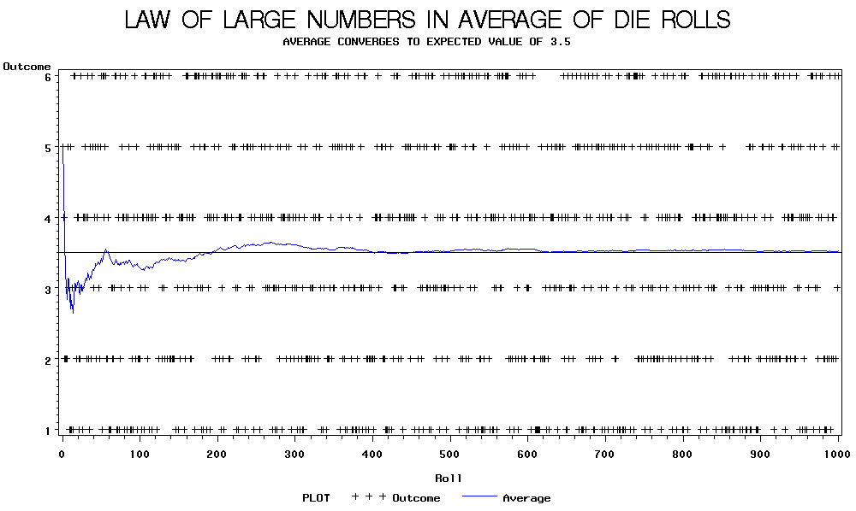

Slide 48
Back to parasitic gaps
Say the actual probability is 1/100,000
We don’t know this, though, so we’re estimating it from a small data set of 10K sentences
What is the probability that, by chance, we have a parasitic gap sentence in our sample?

Slide 49
Back to parasitic gaps
p(not_parasitic) = 0.99999
p(not_parasitic)¹⁰⁰⁰⁰ ≈ 0.905 is the probability of us NOT finding one
So, probability of us finding one is ~10%, in which case we would incorrectly assume that the probability is 1/10,000 (10 times too large)
Remember Zipf’s law from last time… NLP is all about rare events!

