Slide 1
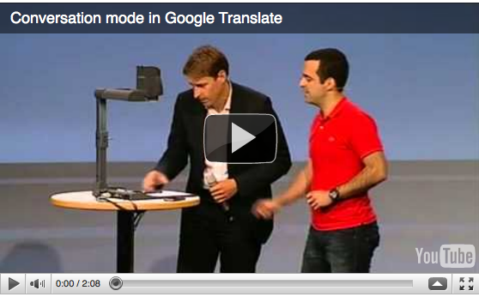
http://www.geekosystem.com/google-conversation/

Slide 2
NLP Linguistics 101
David Kauchak
CS159 – Spring 2011
some slides adapted from Ray Mooney

Slide 3
Admin
First quiz on Monday
first 30 minutes of class (show up on time!)
open book
Assignment 2
Assignment 3
you can assume one sentence per line (this isn’t exactly true, but it’s sufficient for this assignment)
to get the words, just split on whitespace
e-mail me if there are ambiguities/problems
Keep up with the reading

Slide 4
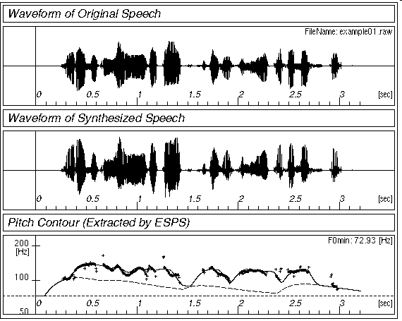
Simplified View of Linguistics
Phonology
/waddyasai/
Morphology
/waddyasai/ what did you say
say
Syntax
what did you say
obj
subj
say
you
what
Semantics
subj
obj
P[ λx. say(you, x) ]
you
what
Discourse
what did you say
what did you say

Slide 5
Morphology
What is morphology?
study of the internal structure of words
morph-ology word-s jump-ing
Why might this be useful for NLP?
generalization (runs, running, runner are related)
additional information (it’s plural, past tense, etc)
allows us to handle words we’ve never seen before
smoothing?

Slide 6
New words
AP newswire stories from Feb 1988 – Dec 30, 1988
300K unique words
New words seen on Dec 31
compounds: prenatal-care, publicly-funded, channel-switching, …
New words:
dumbbells, groveled, fuzzier, oxidized, ex-presidency, puppetry, boulderlike, over-emphasized, antiprejudice
Notes:
new technology:
- googled, googling
- tweeted

Slide 7
Morphology basics
Words are built up from morphemes
stems (base/main part of the word)
affixes
prefixes
precedes the stem
suffixes
follows the stem
infixes
inserted inside the stem
circumfixes
surrounds the stem
Examples?

Slide 8
Morpheme examples
prefix
circum- (circumnavigate)
dis- (dislike)
mis- (misunderstood)
com-, de-, dis-, in-, re-, post-, trans-, …
suffix
-able (movable)
-ance (resistance)
-ly (quickly)
-tion, -ness, -ate, -ful, …

Slide 9
Morpheme examples
infix
-fucking- (cinder-fucking-rella)
more common in other languages
circumfix
doesn’t happen in English

Slide 10
Agglutinative: Finnish
talo 'the-house’ kaup-pa 'the-shop'
talo-ni 'my house' kaup-pa-ni 'my shop'
talo-ssa 'in the-house' kaup-a-ssa 'in the-shop'
talo-ssa-ni 'in my house’ kaup-a-ssa-ni 'in my shop'
talo-i-ssa 'in the-houses’ kaup-o-i-ssa 'in the-shops'
talo-i-ssa-ni 'in my houses’ kaup-o-i-ssa-ni 'in my shops'

Slide 11
Stemming (baby lemmatization)
Reduce a word to the main morpheme
automate
automates automatic
automation
automat
run
runs
running
run

Slide 12
Stemming example
This is a poorly constructed example using the Porter stemmer.
This is a poorli construct example us the Porter stemmer.
http://maya.cs.depaul.edu/~classes/ds575/porter.html
(or you can download versions online)

Slide 13
Porter’s algorithm (1980)
Most common algorithm for stemming English
Results suggest it’s at least as good as other stemming options
Multiple sequential phases of reductions using rules, e.g.
sses → ss
ies → i
ational → ate
tional → tion
http://tartarus.org/~martin/PorterStemmer/

Slide 14
What is Syntax?
Study of structure of language
Examine the rules of how words interact and go together
Rules governing grammaticality
I will give you one perspective
no single correct theory of syntax
still an active field of research in linguistics
we will often use it as a tool/stepping stone for other applications

Slide 15
Structure in language
The man all the way home.
what are some examples of words that can/can’t go here?

Slide 16
Structure in language
The man all the way home.
why can’t some words go here?

Slide 17
Structure in language
The man flew all the way home.
Language is bound by a set of rules
It’s not clear exactly the form of these rules, however, people can generally recognize them
This is syntax!

Slide 18
Syntax != Semantics
Colorless green ideas sleep furiously.
Syntax is only concerned with how words interact from a grammatical standpoint, not semantically

Slide 19
Parts of speech
What are parts of speech (think 3rd grade)?

Slide 20
Parts of speech
Parts of speech are constructed by grouping words that function similarly:
- with respect to the words that can occur nearby
- and by their morphological properties
The man all the way home.
ran
forgave
ate
drove
drank
hid
learned
hurt
integrated
programmed
shot
shouted
sat
slept
understood
voted
washed
warned
walked
spoke
succeeded
survived
read
recorded

Slide 21
Parts of speech
What are the English parts of speech?
8 parts of speech?
Noun (person, place or thing)
Verb (actions and processes)
Adjective (modify nouns)
Adverb (modify verbs)
Preposition (on, in, by, to, with)
Determiners (a, an, the, what, which, that)
Conjunctions (and, but, or)
Particle (off, up)

Slide 22
English parts of speech
Brown corpus: 87 POS tags
Penn Treebank: ~45 POS tags
Derived from the Brown tagset
Most common in NLP
Many of the examples we’ll show us this one
British National Corpus (C5 tagset): 61 tags
C6 tagset: 148
C7 tagset: 146
C8 tagset: 171
Notes:
tag sets also include tags for punctuation

Slide 23
Brown tagset
http://www.comp.leeds.ac.uk/ccalas/tagsets/brown.html

Slide 24
English Parts of Speech
Noun (person, place or thing)
Singular (NN): dog, fork
Plural (NNS): dogs, forks
Proper (NNP, NNPS): John, Springfields
Personal pronoun (PRP): I, you, he, she, it
Wh-pronoun (WP): who, what
Verb (actions and processes)
Base, infinitive (VB): eat
Past tense (VBD): ate
Gerund (VBG): eating
Past participle (VBN): eaten
Non 3rd person singular present tense (VBP): eat
3rd person singular present tense: (VBZ): eats
Modal (MD): should, can
To (TO): to (to eat)

Slide 25
English Parts of Speech (cont.)
Adjective (modify nouns)
Basic (JJ): red, tall
Comparative (JJR): redder, taller
Superlative (JJS): reddest, tallest
Adverb (modify verbs)
Basic (RB): quickly
Comparative (RBR): quicker
Superlative (RBS): quickest
Preposition (IN): on, in, by, to, with
Determiner:
Basic (DT) a, an, the
WH-determiner (WDT): which, that
Coordinating Conjunction (CC): and, but, or,
Particle (RP): off (took off), up (put up)

Slide 26
Closed vs. Open Class
Closed class categories are composed of a small, fixed set of grammatical function words for a given language.
Pronouns, Prepositions, Modals, Determiners, Particles, Conjunctions
Open class categories have large number of words and new ones are easily invented.
Nouns (Googler, futon, iPad), Verbs (Google, futoning), Adjectives (geeky), Abverb (chompingly)

Slide 27
Part of speech tagging
Annotate each word in a sentence with a part-of-speech marker
Lowest level of syntactic analysis
John saw the saw and decided to take it to the table.
NNP VBD DT NN CC VBD TO VB PRP IN DT NN

Slide 28
Ambiguity in POS Tagging
I like candy.
Time flies like an arrow.
VBP
(verb, non-3rd person, singular, present)
IN
(preposition)
Does “like” play the same role (POS) in these sentences?

Slide 29
Ambiguity in POS Tagging
I bought it at the shop around the corner.
I never got around to getting the car.
The cost of a new Prius is around $25K.
IN
(preposition)
RP
(particle… on, off)
RB
(adverb)
Does “around” play the same role (POS) in these sentences?

Slide 30
Ambiguity in POS tagging
Like most language components, the challenge with POS tagging is ambiguity
Brown corpus analysis
11.5% of word types are ambiguous (this sounds promising)
40% of word appearance are ambiguous
Unfortunately, the ambiguous words tend to be the more frequently used words

Slide 31
How hard is it?
If I told you I had a POS tagger that achieved 90% would you be impressed?
Shouldn’t be… just picking the most frequent POS for a word gets you this
What about a POS tagger that achieves 93.7%?
Still probably shouldn’t be… only need to add a basic module for handling unknown words
What about a POS tagger that achieves 100%?
Should be suspicious… humans only achieve ~97%
Probably overfitting

Slide 32
POS Tagging Approaches
Rule-Based: Human crafted rules based on lexical and other linguistic knowledge
Learning-Based: Trained on human annotated corpora like the Penn Treebank
Statistical models: Hidden Markov Model (HMM), Maximum Entropy Markov Model (MEMM), Conditional Random Field (CRF), log-linear models, support vector machines
Rule learning: Transformation Based Learning (TBL)
The book discusses some of the more common approaches
Many publicly available:
http://nlp.stanford.edu/links/statnlp.html (list 15 different ones mostly publicly available!)
http://www.coli.uni-saarland.de/~thorsten/tnt/

Slide 33
Constituency
Parts of speech can be thought of as the lowest level of syntactic information
Groups words together into categories
likes to eat candy.
What can/can’t go here?

Slide 34
Constituency
likes to eat candy.
nouns
determiner nouns
Dave
Professor Kauchak
Dr. Suess
The man
The boy
The cat
determiner nouns +
pronouns
The man that I saw
The boy with the blue pants
The cat in the hat
He
She

Slide 35
Constituency
Words in languages tend to form into functional groups (parts of speech)
Groups of words (aka phrases) can also be grouped into functional groups
often some relation to parts of speech
though, more complex interactions
These phrase groups are called constituents

Slide 36
Common constituents
He likes to eat candy.
noun phrase
verb phrase
The man in the hat ran to the park.
noun phrase
verb phrase

Slide 37
Common constituents
The man in the hat ran to the park.
noun phrase
prepositional phrase
prepositional phrase
noun phrase
verb phrase

Slide 38
Common constituents
The man in the hat ran to the park.
noun phrase
prepositional phrase
noun phrase
noun phrase
prepositional phrase
verb phrase

Slide 39
Syntactic structure
Hierarchical: syntactic trees
S
NP
VP
PP
PP
non-terminals
NP
NP
NP
DT NN IN DT NN VBD IN DT NN
parts of speech
The man in the hat ran to the park.
terminals (words)

Slide 40
Syntactic structure
(S (NP (NP (DT the) (NN man)) (PP (IN in) (NP (DT the) (NN hat)))) (VP (VBD ran) (PP (TO to (NP (DT the) (NN park))))))
S
NP
VP
PP
PP
NP
NP
NP
DT NN IN DT NN VBD IN DT NN
The man in the hat ran to the park.

Slide 41
Syntactic structure
(S (NP (NP (DT the) (NN man)) (PP (IN in) (NP (DT the) (NN hat)))) (VP (VBD ran) (PP (TO to (NP (DT the) (NN park))))))
(S
(NP
(NP (DT the) (NN man))
(PP (IN in)
(NP (DT the) (NN hat))))
(VP (VBD ran)
(PP (TO to)
(NP (DT the) (NN park))))))

Slide 42
Syntactic structure
A number of related problems:
Given a sentence, can we determine the syntactic structure?
Can we determine if a sentence is grammatical?
Can we determine how likely a sentence is to be grammatical? to be an English sentence?
Can we generate candidate, grammatical sentences?

Slide 43
Grammars
What is a grammar (3rd grade again…)?

Slide 44
Grammars
Grammar is a set of structural rules that govern the composition of sentences, phrases and words
Lots of different kinds of grammars:
regular
context-free
context-sensitive
recursively enumerable
transformation grammars

Slide 45
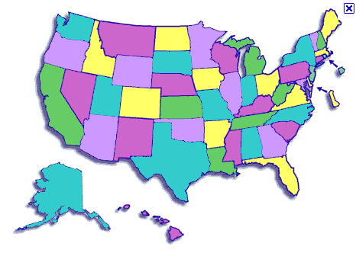
States
What is the capitol of this state?
Jefferson City (Missouri)

Slide 46
Context free grammar
How many people have heard of them?
Look like:
S → NP VP
left hand side
(single symbol)
right hand side
(one or more symbols)

Slide 47
Formally…
G = (NT,T,P,S)
V: finite set of nonterminal symbols
T: finite set of terminal symbols, V and T are disjoint
P: finite set of productions of the form
A → α, A ∈ V and α ∈ (T ∪ NT)*
S ∈ NT: start symbol

Slide 48
CFG: Example
Many possible CFGs for English, here is an example (fragment):
S → NP VP
VP → V NP
NP → DetP N | AdjP NP
AdjP → Adj | Adv AdjP
N → boy | girl
V → sees | likes
Adj → big | small
Adv → very
DetP → a | the

Slide 49
Grammar questions
Can we determine if a sentence is grammatical?
Given a sentence, can we determine the syntactic structure?
Can we determine how likely a sentence is to be grammatical? to be an English sentence?
Can we generate candidate, grammatical sentences?
Which of these can we answer with a CFG? How?

Slide 50
Grammar questions
Can we determine if a sentence is grammatical?
Is it accepted/recognized by the grammar
Applying rules right to left, do we get the start symbol?
Given a sentence, can we determine the syntactic structure?
Keep track of the rules applied…
Can we determine how likely a sentence is to be grammatical? to be an English sentence?
Not yet… no notion of “likelihood” (probability)
Can we generate candidate, grammatical sentences?
Start from the start symbol, randomly pick rules that apply (i.e. left hand side matches)

Slide 51
Derivations in a CFG
S → NP VP
VP → V NP
NP → DetP N | AdjP NP
AdjP → Adj | Adv AdjP
N → boy | girl
V → sees | likes
Adj → big | small
Adv → very
DetP → a | the
S

Slide 52
Derivations in a CFG
S → NP VP
VP → V NP
NP → DetP N | AdjP NP
AdjP → Adj | Adv AdjP
N → boy | girl
V → sees | likes
Adj → big | small
Adv → very
DetP → a | the
NP VP

Slide 53
Derivations in a CFG
S → NP VP
VP → V NP
NP → DetP N | AdjP NP
AdjP → Adj | Adv AdjP
N → boy | girl
V → sees | likes
Adj → big | small
Adv → very
DetP → a | the
DetP N VP

Slide 54
Derivations in a CFG
S → NP VP
VP → V NP
NP → DetP N | AdjP NP
AdjP → Adj | Adv AdjP
N → boy | girl
V → sees | likes
Adj → big | small
Adv → very
DetP → a | the
the boy VP

Slide 55
Derivations in a CFG
S → NP VP
VP → V NP
NP → DetP N | AdjP NP
AdjP → Adj | Adv AdjP
N → boy | girl
V → sees | likes
Adj → big | small
Adv → very
DetP → a | the
the boy likes NP

Slide 56
Derivations in a CFG
S → NP VP
VP → V NP
NP → DetP N | AdjP NP
AdjP → Adj | Adv AdjP
N → boy | girl
V → sees | likes
Adj → big | small
Adv → very
DetP → a | the
the boy likes a girl

Slide 57
Derivations in a CFG; Order of Derivation Irrelevant
S → NP VP
VP → V NP
NP → DetP N | AdjP NP
AdjP → Adj | Adv AdjP
N → boy | girl
V → sees | likes
Adj → big | small
Adv → very
DetP → a | the
DetP N VP
the boy VP
DetP N likes NP
the boy likes a girl

Slide 58
Derivations of CFGs
String rewriting system: we derive a string
But derivation history represented by phrase-structure tree
S
NP
VP
the boy likes a girl
DetP
N
V
NP
the
boy
likes
DetP
N
a
girl

Slide 59
Grammar Equivalence
Weak equivalence: grammars generate same set of strings
Grammar 1: NP → DetP N and DetP → a | the
Grammar 2: NP → a N | NP → the N
Strong equivalence: grammars have same set of derivation trees
With CFGs, possible only with useless rules
Grammar 2: NP → a N | NP → the N
Grammar 3: NP → a N | NP → the N, DetP → many

Slide 60
Normal Forms
There are weakly equivalent normal forms (Chomsky Normal Form, Greibach Normal Form)
A CFG is in Chomsky Normal Form (CNF) if all productions are of one of two forms:
A → BC with A, B, C nonterminals
A → a, with A a nonterminal and a a terminal
Every CFG has a weakly equivalent CFG in CNF

Slide 61
Parsing
Parsing is the field of NLP interested in automatically determining the syntactic structure of a sentence
parsing can be thought of as determining what sentences are “valid” English sentences
As a by product, we often can get the structure

Slide 62
Parsing
Given a CFG and a sentence, determine the possible parse tree(s)
I eat sushi with tuna
S -> NP VP
NP -> PRP
NP -> N PP
VP -> V NP
VP -> V NP PP
PP -> IN N
PRP -> I
V -> eat
N -> sushi
N -> tuna
IN -> with
What parse trees are possible for this sentence?
What if the grammar is much larger?

Slide 63
Parsing
S -> NP VP
NP -> PRP
NP -> N PP
VP -> V NP
VP -> V NP PP
PP -> IN N
PRP -> I
V -> eat
N -> sushi
N -> tuna
IN -> with
S
S
VP
VP
NP
NP
PP
NP
NP
PP
PRP
V
N
IN
N
PRP
V
N
IN
N
I eat sushi with tuna
I eat sushi with tuna
What is the difference between these parses?

Slide 64
Parsing
Given a CFG and a sentence, determine the possible parse tree(s)
I eat sushi with tuna
S -> NP VP
NP -> PRP
NP -> N PP
VP -> V NP
VP -> V NP PP
PP -> IN N
PRP -> I
V -> eat
N -> sushi
N -> tuna
IN -> with
approaches? algorithms?

Slide 65
Parsing
Top-down parsing
ends up doing a lot of repeated work
doesn’t take into account the words in the sentence until the end!
Bottom-up parsing
constrain based on the words
avoids repeated work (dynamic programming)
CKY parser

Slide 66
Article discussion
http://www.information-management.com/news/-10019543-1.html
How hard is this problem?
What are the challenges?
Are we leveraging any particular domain knowledge?
What other types of problem areas might this be useful for?
Is this a good problem to be working on?
What would be other “grand” NLP-like problems?

