Slide 1
MACHINE TRANSLATION Paper 1
Daniel Montalvo, Chrysanthia Cheung-Lau, Jonny Wang CS159 Spring 2011

Slide 2
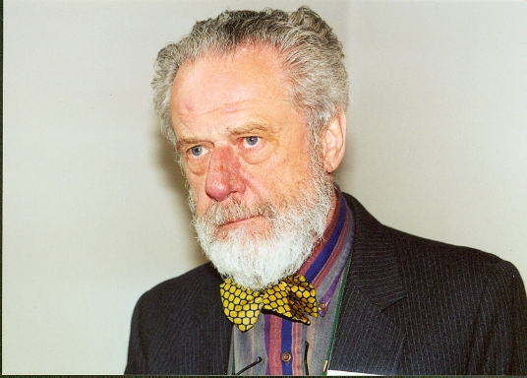
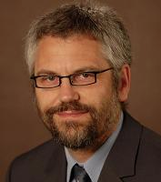
Paper
Intersecting multilingual data for faster and better statistical translations. Association for Computational Linguistics, June 2009.
Yu Chen Martin Kay Andreas Eisele

Slide 3
Introduction
Statistical Machine Translation (SMT):
Translation model
Broken
English
language model
Spanish (foreign)
English
model
translation model
language model

Slide 4
Statistical MT Overview
learned parameters
Bilingual data
model
monolingual data
Find the best translation given the foreign sentence and the model
English sentence
Translation
Foreign sentence

Slide 5
Problems
Noise from word/phrase alignment
Efficiency: time and space

Slide 6
Problems
Sie lieben ihre Kinder nicht
They love their children not
They don’t love their children
ihre Kinder nicht => a) their children are not b) their children
Language model =/= They love their children are not
Solution: remove b) from translation model

Slide 7
http://www.translationparty.com/#9144687
http://www.translationparty.com/#9144706
http://www.translationparty.com/#9144869
http://www.translationparty.com/#9144872
http://www.translationparty.com/#9144881

Slide 8
Solution: Triangulation
BRIDGE LANGUAGE
SOURCE LANGUAGE
TARGET LANGUAGE
Notes:
Mention prior work (union instead of intersection)

Slide 9
Triangulation
Look at source-target phrase pair (S,T)
S => X, T => X, S => T (keep)
S => X, T => Y, S =/> T (drop)
S => ?, T => ?, ??? (keep)

Slide 10
Experimental Design
Database: Europarl (1.3 million)
Divided by maximal sentence length
Spanish => English; bridges: French, Portuguese, Danish, German, Finnish
Models from Moses toolkit
Train, develop, test
Notes:
Expand “maximal sentence length” => EP 20, 40, 50

Slide 11
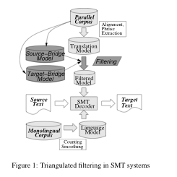

Slide 12
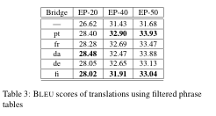
Results
Notes:
Mention robustness across bridge langauges

Slide 13
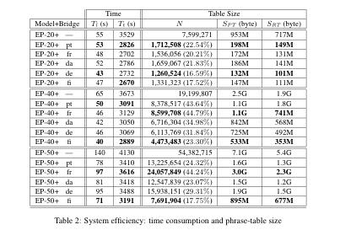

Slide 14
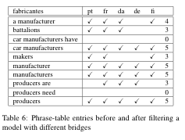
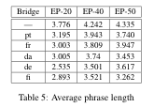
Phrase Length
"Long phrases suck” (Koehn, 2003)
Notes:
Point out how bad phrases are kept in NO bridge languages

Slide 15
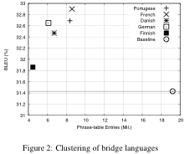
Notes:
Baseline sucks; clustering

Slide 16
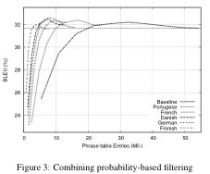
Further Research
Notes:
Gets better until a certain point; bridge curves increase faster

Slide 17
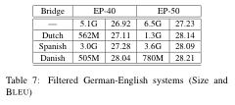
Further Research
German => English

Slide 18
Problems / Conclusion
Throwing away a lot of data (94%)
Picking a bridge language (sometimes)
Limitations of data set (Arabic? Chinese?)
Overall, great!

Slide 19
Thanks!

