Slide 1
Machine Learning
CS311
David Kauchak
Spring 2013
Some material borrowed from:
Sara Owsley Sood and others

Slide 2
Admin
Two talks this week
  Tuesday lunch
  Thursday lunch
Midterm exam posted later today
Assignment 4
  How’s it going?
  Due Friday at 6pm
No office hours on Friday

Slide 3
Classifiers so far
Naïve Bayes
k-nearest neighbors (k-NN)
Both fairly straightforward to understand and implement
How do they work?

Slide 4
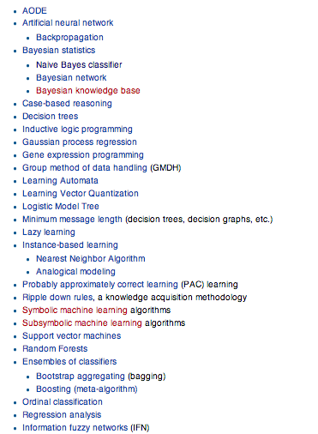
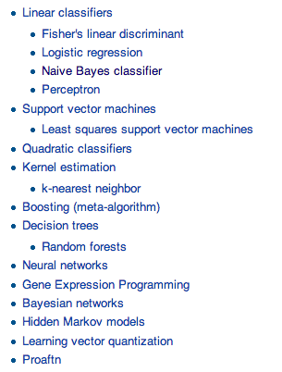
Many, many classifiers
http://en.wikipedia.org/wiki/Statistical_classification
http://en.wikipedia.org/wiki/List_of_machine_learning_algorithms

Slide 5
Many, many classifiers: what we will cover
Problem setup
  Training vs. testing
  Feature-based learning
  Evaluation
Introduction to a few models
Model comparison
  When to apply one vs the other (maybe…)
  How models differ
  Pros/cons

Slide 6
Many, many classifiers: what we won’t cover
Quite a few models
Won’t dive too much into the theoretical underpinnings
meta-learning (i.e. combining classifiers)
recommender systems aka collaborative filtering (but can be viewed as a classification problem)

Slide 7
Bias/Variance
Bias: How well does the model predict the training data?
  high bias – the model doesn’t do a good job of predicting the training data (high training set error)
  The model predictions are biased by the model
Variance: How sensitive to the training data is the learned model?
  high variance – changing the training data can drastically change the learned model

Slide 8
Bias/Variance
Another way to think about it is model complexity
Simple models
  may not model data well
  high bias
Complicated models
  may overfit to the training data
  high variance

Slide 9
Bias/variance trade-off
We want to fit a polynomial to this, which one should we use?

Slide 10
Bias/variance trade-off
Bias: How well does the model predict the training data?
  high bias – the model doesn’t do a good job of predicting the training data (high training set error)
  The model predictions are biased by the model
Variance: How sensitive to the training data is the learned model?
  high variance – changing the training data can drastically change the learned model
High variance OR high bias?

Slide 11
Bias/variance trade-off
Bias: How well does the model predict the training data?
  high bias – the model doesn’t do a good job of predicting the training data (high training set error)
  The model predictions are biased by the model
Variance: How sensitive to the training data is the learned model?
  high variance – changing the training data can drastically change the learned model
High bias

Slide 12
Bias/variance trade-off
Bias: How well does the model predict the training data?
  high bias – the model doesn’t do a good job of predicting the training data (high training set error)
  The model predictions are biased by the model
Variance: How sensitive to the training data is the learned model?
  high variance – changing the training data can drastically change the learned model
High variance OR high bias?

Slide 13
Bias/variance trade-off
Bias: How well does the model predict the training data?
  high bias – the model doesn’t do a good job of predicting the training data (high training set error)
  The model predictions are biased by the model
Variance: How sensitive to the training data is the learned model?
  high variance – changing the training data can drastically change the learned model
High variance

Slide 14
Bias/variance trade-off
Bias: How well does the model predict the training data?
  high bias – the model doesn’t do a good job of predicting the training data (high training set error)
  The model predictions are biased by the model
Variance: How sensitive to the training data is the learned model?
  high variance – changing the training data can drastically change the learned model
What do we want?

Slide 15
Bias/variance trade-off
Bias: How well does the model predict the training data?
  high bias – the model doesn’t do a good job of predicting the training data (high training set error)
  The model predictions are biased by the model
Variance: How sensitive to the training data is the learned model?
  high variance – changing the training data can drastically change the learned model
Compromise between bias and variance

Slide 16
k-NN vs. Naive Bayes
How do k-NN and NB sit on the variance/bias spectrum?
k-NN has high variance and low bias.
  more complicated model
  can model any boundary
  but very dependent on the training data
NB has low variance and high bias.
  Decision surface has to be linear (more on this later)
  Cannot model all data
  but, less variation based on the training data
Notes:
Bias/variance in terms of resulting classifier given randomly selected training set; why it is a tradeoff; when to choose low-bias method, when to choose low-variance method

Slide 17
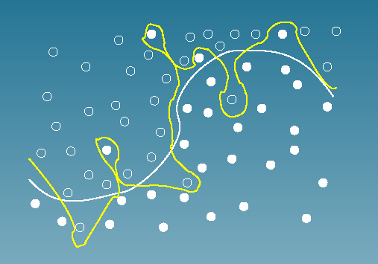
Bias vs. variance:
Choosing the correct model capacity
Which separating line should we use?

Slide 18
Playing tennis
You want to decide whether or not to play tennis today
  Outlook: Sunny, Overcast, Rain
  Humidity: High, normal
  Wind: Strong, weak
Tell me what you’re classifier should do?

Slide 19
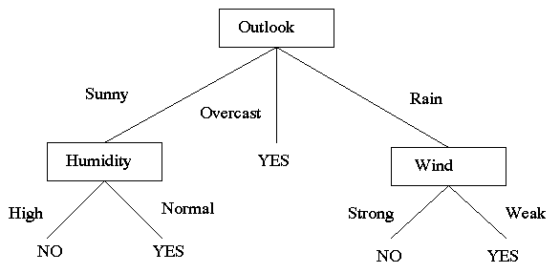
Decision tree is an intuitive way of representing a decision
Tree with internal nodes labeled by features
Branches are labeled by tests on that feature
  outlook = sunny
  x > 100
Leaves labeled with classes

Slide 20
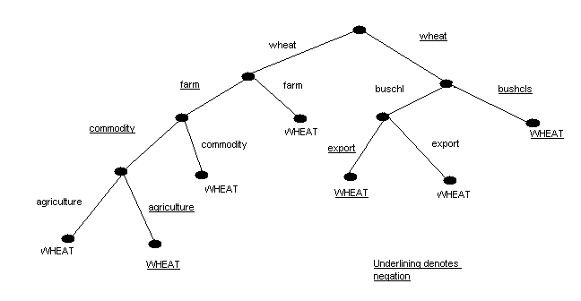
Another decision tree
Document classification: wheat or not wheat?

Slide 21
Another decision tree
Document: wheat, agriculture, buschl
Which category?

Slide 22
Decision tree learning
What does a decision node look like in the feature space?
y
Class 1
Class 2
Class 3
x

Slide 23
Decision tree learning
A node in the tree is threshold on that dimension
Test x
<
>
y
Class 1
Class 2
Class 3
x

Slide 24
Decision tree learning
Features are x and y
A node in the tree is threshold on that dimension
Class 1
Class 2
Class 3
How could we learn a tree from data?

Slide 25
Decision tree learning
Features are x and y
A node in the tree is threshold on that dimension
Test x
<
>
Class 1
Class 2
Class 3
How could we learn a tree from data?

Slide 26
Decision tree learning
Features are x and y
A node in the tree is threshold on that dimension
Test x
<
>
Class 1
Test y
<
>
Class 3
Class 2
How could we learn a tree from data?

Slide 27
Decision Tree Learning
Start at the top and work our way down
  Examine all of the features to see which feature best separates the data
  Split the data into subsets based on the feature test
  Test the remaining features to see which best separates the data in each subset
  Repeat this process in all branches until:

Slide 28
Decision Tree Learning
Start at the top and work our way down
  Examine all of the features to see which feature best separates the data
  Split the data into subsets based on the feature test
  Test the remaining features to see which best separates the data in each subset
  Repeat this process in all branches until:
    all examples in a subset are of the same type
    there are no examples left (or some small number left)
    there are no attributes left

Slide 29
Decision Tree Learning
Start at the top and work our way down
  Examine all of the features to see which feature best separates the data
  Split the data into subsets based on the feature test
  Test the remaining features to see which best separates the data in each subset
  Repeat this process in all branches until:
    all examples in a subset are of the same type
    there are no examples left
    there are no attributes left
Ideas?

Slide 30
KL-Divergence
Given two probability distributions P and Q
When is this large? small?

Slide 31
KL-Divergence
Given two probability distributions P and Q
When P = Q, D_{KL}(P||Q) = 0

Slide 32
KL-Divergence
Given two probability distributions P and Q
P(1) = 0.999
P(2) = 0.001
Q(1) = 0.001
Q(2) = 0.999
D_{KL}(P||Q) = 6.89
KL-divergence is a measure of the distance between two probability distributions (though it’s not a distance metric!)

Slide 33
Information Gain
What is this asking?
KL-divergence is a measure of the distance between two probability distributions (though it’s not a distance metric!

Slide 34
Information Gain
What is the distance from the probability of a class (i.e. the prior) and the probability of that class conditioned on f ?
What information do we gain about the class decision, given the feature f ?
Use information gain to decide the most informative feature to split on

Slide 35
Decision tree learning
Features are x and y
A node in the tree is threshold on that dimension
Class 1
Class 2
What would be the learned tree?

Slide 36
Decision tree learning
Features are x and y
A node in the tree is threshold on that dimension
Class 1
Class 2
Do you think this is right?

Slide 37
Overfitting
Decision trees: high-variance or high-bias?
Bias: How well does the model predict the training data?
  high bias – the model doesn’t do a good job of predicting the training data (high training set error)
  The model predictions are biased by the model
Variance: How sensitive to the training data is the learned model?
  high variance – changing the training data can drastically change the learned model

Slide 38
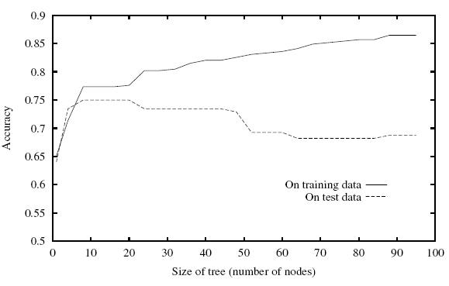
Overfitting
Decision trees can have a high variance
The model can be too complicated and overfit to the training data
Ideas?

Slide 39
Pruning
Ideas?
WHEAT

Slide 40
Pruning
Measure accuracy on a hold-out set (i.e. not used for training)
  Stop splitting when when accuracy decreases
  Prune tree from the bottom up, replacing split nodes with majority label, while accuracy doesn’t decrease
Other ways look at complexity of the model with respect to characteristics of the training data
  Don’t split if information gain gets below a certain threshold
  Don’t split if number of examples is below some threshold
  Don’t split if tree depth goes beyond a certain depth
  …

Slide 41
Decision trees: good and bad
Good
  Very human friendly
    easy to understand
    people can modify
  fairly quick to train
Bad
  overfitting/pruning can be tricky
  greedy approach: if you make a split you’re stuck with it
  performance is ok, but can do better

Slide 42
Midterm
Open book
  still only 2 hours, so don’t rely on it too much
Anything we’ve talked about in class or read about is fair game
Written questions are a good place to start

Slide 43
Review
Intro to AI
  what is AI
  goals
  challenges
  problem areas

Slide 44
Review
Uninformed search
  reasoning through search
  agent paradigm (sensors, actuators, environment, etc.)
  setting up problems as search
    state space (starting state, next state function, goal state)
    actions
    costs
  problem characteristics
    observability
    determinism
    known/unknown state space
  techniques
    BFS
    DFS
    uniform cost search
    depth limited search
    Iterative deepening

Slide 45
Review
Uninformed search cont.
  things to know about search algorithms
    time
    space
    completeness
    optimality
    when to use them
  graph search vs. tree search
Informed search
  heuristic function
    admissibility
    combining functions
    dominance
  methods
    greedy best-first search
    A*

Slide 46
Review
Adversarial search
  game playing through search
    ply
    depth
    branching factor
    state space sizes
    optimal play
  game characteristics
    observability
    # of players
    discrete vs. continuous
    real-time vs. turn-based
    determinism

Slide 47
Review
Adversarial search cont
  minimax algorithm
  alpha-beta pruning
    optimality, etc.
  evalution functions (heuristics)
    horizon effect
  improvements
    transposition table
    history/end-game tables
  dealing with chance/non-determinism
    expected minimax
  dealing with partially observable games

Slide 48
Review
Local search
  when to use/what types of problems
  general formulation
  hill-climbing
    greedy
    random restarts
    randomness
    simulated annealing
    local beam search
  genetic algorithms

Slide 49
Review
Basic probability
  why probability (vs. say logic)?
  vocabulary
    experiment
    sample
    event
    random variable
    probability distribution
  unconditional/prior probability
  joint distribution
  conditional probability
  Bayes rule
  estimating probabilities

Slide 50
Review
Machine learning (up through last Thursday)
  Bayesian classification
    problem formulation, argmax, etc.
    NB model
  k-nearest neighbor
  training, testing, evaluation
  bias vs. variance
  model characteristics

