Slide 1
CS41B machine
David Kauchak
CS 52 – Spring 2016

Slide 2
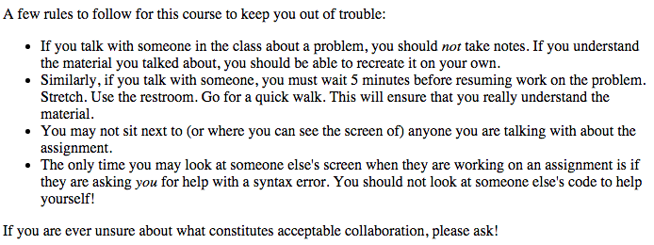
Admin
Assignment 3
  due Monday at 11:59pm
Academic honesty

Slide 3
Admin
Midterm next Thursday in-class (2/18)
  Comprehensive ☺
  Closed books, notes, computers, etc.
  Except, may bring up to 2 pages of notes
  Practice problems posted
    Also some practice problems in the Intro SML reading
  Midterm review sessions (will announce on piazza soon)

Slide 4
Midterm topics
SML
recursion
math

Slide 5
Midterm topics
Basic syntax
SML built-in types
Defining function
  pattern matching
Function type signatures
Recursion!
map
exceptions
Defining datatypes
addition, subtraction, multiplication manually and on list digits
Numbers in different bases
Binary number representation (first part of today’s lecture)
NOT CS41B material

Slide 6
Binary number revisited
What number does 1001 represent in binary?
Depends!
Is it a signed number or unsigned?
If signed, what convention are we using?

Slide 7
Twos complement
For a number with n digits high order bit represents -2^{n-1}
unsigned
2³
2²
2¹
2⁰
signed
(twos complement)
-2³
2²
2¹
2⁰

Slide 8
Twos complement
What number is it?
1
0
0
1
unsigned
9
2³
2²
2¹
2⁰
1
0
0
1
signed
(twos complement)
-7
-2³
2²
2¹
2⁰

Slide 9
Twos complement
What number is it?
1
1
1
1
unsigned
15
2³
2²
2¹
2⁰
1
1
1
1
signed
(twos complement)
-1
-2³
2²
2¹
2⁰

Slide 10
Twos complement
What number is it?
1
1
0
0
unsigned
12
2³
2²
2¹
2⁰
1
1
0
0
signed
(twos complement)
-4
-2³
2²
2¹
2⁰

Slide 11
Twos complement
How many numbers can we represent with each approach using 4 bits?
16 (2⁴) numbers, 0000, 0001, …., 1111
Doesn’t matter the representation!
unsigned
2³
2²
2¹
2⁰
signed
(twos complement)
-2³
2²
2¹
2⁰

Slide 12
Twos complement
How many numbers can we represent with each approach using 32 bits?
2³² ≈ 4 billion numbers
unsigned
2³
2²
2¹
2⁰
signed
(twos complement)
-2³
2²
2¹
2⁰

Slide 13
Twos complement
What is the range of numbers we can represent for each approach with 4 bits?
unsigned: 0, 1, … 15
signed: -8, -7, …, 7
unsigned
2³
2²
2¹
2⁰
signed
(twos complement)
-2³
2²
2¹
2⁰

Slide 14
binary representation | unsigned
0000 | 0
0001 | 1
0010 | ?
0011
0100
0101
0110
0111
1000
1001
1010
1011
1100
1101
1110
1111

Slide 15
binary representation | unsigned | twos complement
0000 | 0 | ?
0001 | 1
0010 | 2
0011 | 3
0100 | 4
0101 | 5
0110 | 6
0111 | 7
1000 | 8
1001 | 9
1010 | 10
1011 | 11
1100 | 12
1101 | 13
1110 | 14
1111 | 15

Slide 16
binary representation | unsigned | twos complement
0000 | 0 | 0
0001 | 1 | 1
0010 | 2 | 2
0011 | 3 | 3
0100 | 4 | 4
0101 | 5 | 5
0110 | 6 | 6
0111 | 7 | 7
1000 | 8 | ?
1001 | 9
1010 | 10
1011 | 11
1100 | 12
1101 | 13
1110 | 14
1111 | 15

Slide 17
binary representation | unsigned | twos complement
0000 | 0 | 0
0001 | 1 | 1
0010 | 2 | 2
0011 | 3 | 3
0100 | 4 | 4
0101 | 5 | 5
0110 | 6 | 6
0111 | 7 | 7
1000 | 8 | -8
1001 | 9 | ?
1010 | 10
1011 | 11
1100 | 12
1101 | 13
1110 | 14
1111 | 15

Slide 18
binary representation | unsigned | twos complement
0000 | 0 | 0
0001 | 1 | 1
0010 | 2 | 2
0011 | 3 | 3
0100 | 4 | 4
0101 | 5 | 5
0110 | 6 | 6
0111 | 7 | 7
1000 | 8 | -8
1001 | 9 | -7
1010 | 10 | -6
1011 | 11 | -5
1100 | 12 | -4
1101 | 13 | -3
1110 | 14 | -2
1111 | 15 | -1

Slide 19
binary representation | unsigned | twos complement
0000 | 0 | 0
0001 | 1 | 1
0010 | 2 | 2
0011 | 3 | 3
0100 | 4 | 4
0101 | 5 | 5
0110 | 6 | 6
0111 | 7 | 7
1000 | 8 | -8
1001 | 9 | -7
1010 | 10 | -6
1011 | 11 | -5
1100 | 12 | -4
1101 | 13 | -3
1110 | 14 | -2
1111 | 15 | -1
How can you tell if a number is negative?

Slide 20
binary representation | unsigned | twos complement
0000 | 0 | 0
0001 | 1 | 1
0010 | 2 | 2
0011 | 3 | 3
0100 | 4 | 4
0101 | 5 | 5
0110 | 6 | 6
0111 | 7 | 7
1000 | 8 | -8
1001 | 9 | -7
1010 | 10 | -6
1011 | 11 | -5
1100 | 12 | -4
1101 | 13 | -3
1110 | 14 | -2
1111 | 15 | -1
High order bit!

Slide 21
A two’s complement trick
You can also calculate the value of a negative number represented as twos complement as follows:
  Flip all of the bits (0 → 1 and 1→ 0)
  Add 1
  Resulting number is the magnitude of the original negative number
flip the bits
add 1
1101
0010
0011
-3

Slide 22
A two’s complement trick
You can also calculate the value of a negative number represented as twos complement as follows:
  Flip all of the bits (0 → 1 and 1→ 0)
  Add 1
  Resulting number is the magnitude of the original negative number
flip the bits
add 1
1110
0001
0010
-2

Slide 23
Addition with twos complement numbers
0001
0101
+
?

Slide 24
Addition with twos complement numbers
1
0001
0101
+
0110

Slide 25
Addition with twos complement numbers
0110
0101
+
?

Slide 26
Addition with twos complement numbers
1
0110
0101
+
1011?

Slide 27
Addition with twos complement numbers
1
0110
0101
6
+
5
1011?
11
Overflow! We cannot represent this number (it’s too large)

Slide 28
Addition with twos complement numbers
0110
1101
+
?

Slide 29
Addition with twos complement numbers
1
1
0110
1101
+
0011

Slide 30
Addition with twos complement numbers
1
1
0110
1101
6
ignore the last carry
+
-3
0011
3

Slide 31
Subtraction
Ideas?

Slide 32
Subtraction
Negate the 2nd number (flip the bits and add 1)
Add them!

Slide 33
Hexadecimal numbers
Hexadecimal = base 16
What will be the digits?

Slide 34
Hexadecimal numbers
Hexadecimal = base 16
Digits
0
1
2
…
9
a (10)
b (11)
c (12)
d (13)
e (14)
f (15)
What number is 1ad?

Slide 35
Hexadecimal numbers
Hexadecimal = base 16
Digits
0
1
2
…
9
a (10)
b (11)
c (12)
d (13)
e (14)
f (15)
a d = 256+10*16+13=
= 429
16²
16¹
16⁰

Slide 36
Hexadecimal numbers
Hexadecimal = base 16
Digits
0
1
2
…
9
a (10)
b (11)
c (12)
d (13)
e (14)
f (15)
Hexadecimal is common in CS.
Why?

Slide 37
Hexadecimal numbers
Hexadecimal = base 16
Digits
0
1
2
…
9
a (10)
b (11)
c (12)
d (13)
e (14)
f (15)
Hexadecimal is common in CS.
4 bits = 1 hexadecimal digit
What is the following number in hex?
0110 1101 0101 0001

Slide 38
Hexadecimal numbers
Hexadecimal = base 16
Digits
0
1
2
…
9
a (10)
b (11)
c (12)
d (13)
e (14)
f (15)
Hexadecimal is common in CS.
4 bits = 1 hexadecimal digit
What is the following number in hex?
0110 1101 0101 0001
6
d
5
1

Slide 39
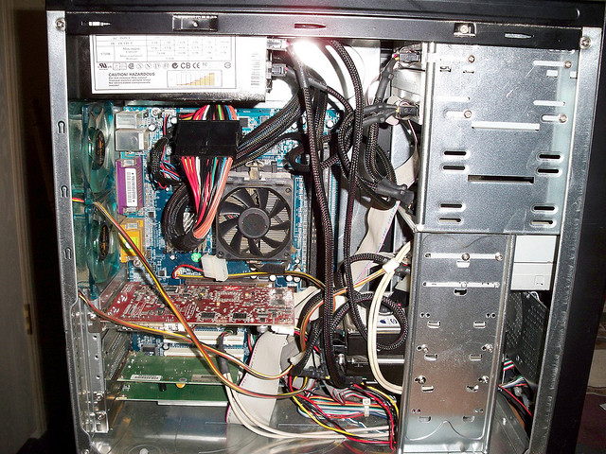
Computer internals

Slide 40
Computer internals simplified
CPU
RAM
What does it stand for?
What does it do?
What does it stand for?
What does it do?

Slide 41
Computer internals simplified
CPU
RAM
(Central Processing Unit,
aka “the processor”)
(Random Access Memory,
aka “memory” or “main memory”)
Does all the work!
Temporary storage

Slide 42
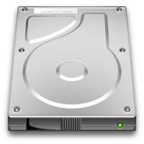
Computer internals simplified
“the computer”
hard drive
CPU
RAM
Why do we need a hard drive?

Slide 43
Computer internals simplified
“the computer”
hard drive
CPU
RAM
Persistent memory
RAM only stores data while it has power

Slide 44

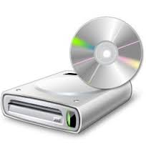


Computer simplified
“the computer”
hard drive
CPU
RAM
network
media drive
input devices
display

Slide 45
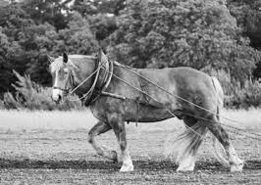
Inside the CPU
CPU
processor
processor: does the work
registers: local, fast memory slots
…
registers
Why all these levels of memory?

Slide 46
Memory speed
operation | access time | times slower than register access | for comparison…
register | 0.3 ns | 1 | 1 s
RAM | 120 ns | 400 | 6 min
Hard disk | 1ms | ~million | 1 month
google.com | 0.4s | ~billion | 30 years

Slide 47
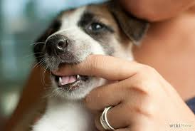
Memory
RAM
010101111000101000010010 …
What is a byte?
?

Slide 48
Memory
RAM
01010111 10001010 00010010 …
byte = 8 bits
byte is abbreviated as B
My laptop has 16GB (gigabytes) of memory. How many bits is that?

Slide 49
Memory sizes
 | bits
byte | 8
kilobyte (KB) | 2^10 bytes = ~8,000
megabyte (MB) | 2^20 =~ 8 million
gigabyte (GB) | 2^30 = ~8 billion
My laptop has 16GB (gigabytes) of memory. How many bits is that?

Slide 50
Memory sizes
 | bits
byte | 8
kilobyte (KB) | 2^10 bytes = ~8,000
megabyte (MB) | 2^20 =~ 8 million
gigabyte (GB) | 2^30 = ~8 billion
~128 billion bits!

Slide 51
Memory
address
0
1
2
3
…
01010111
10001010
00010010
01011010
…
RAM
Memory is byte addressable

Slide 52
Memory
address
0
1
2
3
…
01010111
10001010
00010010
01011010
…
RAM
Memory is organized into “words”, which is the most common functional unit

Slide 53
Memory
address
32-bit words
0
4
8
...
10101011 10001010 00010010 01011010
11001011 00001110 01010010 01010110
10111011 10010010 00000000 01110100
…
RAM
Most modern computers use 32-bit (4 byte) or 64-bit (8 byte) words

Slide 54
Memory in the CS41B Machine
address
16-bit words
0
2
4
...
10101011 10001010
00010010 01011010
11001011 00001110
…
RAM
We’ll use 16-bit words for our model (the CS41B machine)

Slide 55
CS41B machine
CPU
instruction counter
(location in memory of the next
instruction in memory)
processor
ic
r0
holds the value 0 (read only)
r1
general purpose
read/write
r2
registers
r3

Slide 56
CS41B instructions
CPU
processor
What types of operations might we want to do (think really basic)?
registers

Slide 57
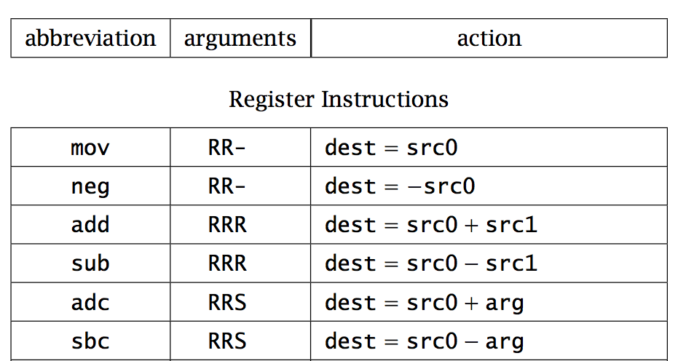

Slide 58
operation name
(always three characters)

Slide 59
operation arguments
R = register (e.g. r0)
S = signed number (byte)

Slide 60
operation function
dest = first register
src0 = second register
src1 = third register
arg = number/argument

Slide 61
add r1 r2 r3
What does this do?

Slide 62
add r1 r2 r3
r1 = r2 + r3
Add contents of registers r2 and r3 and store the result in r1

Slide 63
adc r2 r1 10
What does this do?

Slide 64
adc r2 r1 10
r2 = r1 + 10
Add 10 to the contents of register r1 and store in r2

Slide 65
adc r1 r0 8
neg r2 r1
sub r2 r1 r2
What number is in r2?

Slide 66
adc r1 r0 8
neg r2 r1
sub r2 r1 r2
r1 = 8
r2 = -8, r1 = 8
r2 = 16

