Slide 1
backpropagation
David Kauchak
CS159 – Fall 2019

Slide 2
Admin
Assignment 5

Slide 3
Neural network
inputs
Individual perceptrons/neurons
Notes:
- often we view a slice of them

Slide 4
Neural network
some inputs are provided/entered
inputs
Notes:
- often we view a slice of them

Slide 5
Neural network
inputs
each perceptron computes and calculates an answer
Notes:
- often we view a slice of them

Slide 6
Neural network
inputs
those answers become inputs for the next level
Notes:
- often we view a slice of them

Slide 7
Neural network
inputs
finally get the answer after all levels compute
Notes:
- often we view a slice of them

Slide 8
A neuron/perceptron
Input x₁
Weight w₁
Weight w₂
Input x₂
Output y
activation function
Input x₃
Weight w₃
Weight w₄
Input x₄

Slide 9
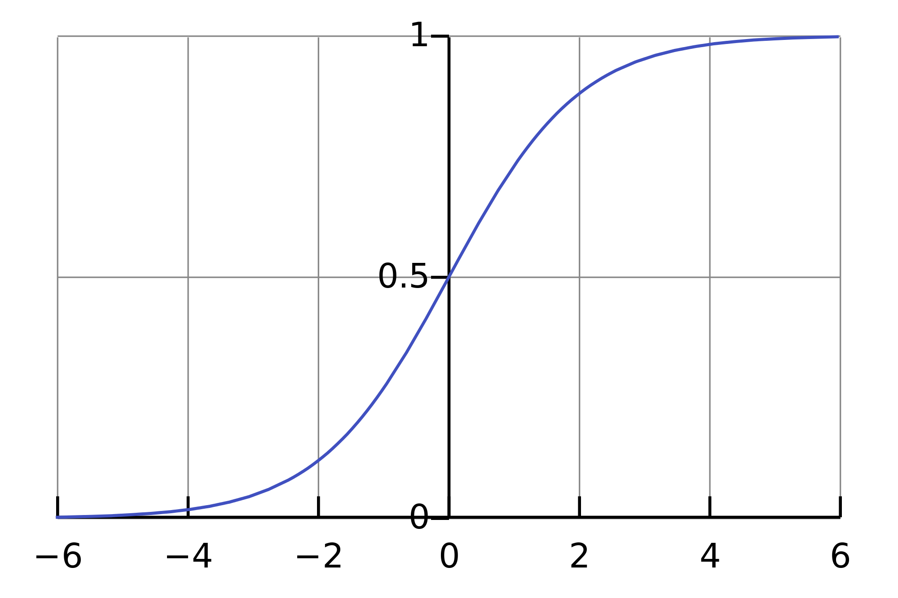
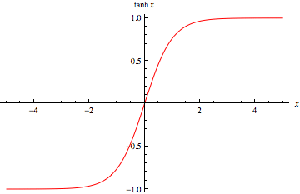
Activation functions
hard threshold:
sigmoid
tanh x
$$g\left(in\right)= \left\{\begin{matrix}1 & if in≥T \\ 0 & otherwise\end{matrix}\right.$$

Slide 10
Training
?
Input x₁
?
?
Output = x₁ xor x₂
T=?
?
?
?
T=?
Input x₂
x₁ | x₂ | x₁ xor x₂
0 | 0 | 0
0 | 1 | 1
1 | 0 | 1
1 | 1 | 0
T=?
How do we learn the weights?

Slide 11
Learning in multilayer networks
Challenge: for multilayer networks, we don’t know what the expected output/error is for the internal nodes!
how do we learn these weights?
w
w
w
w
w
w
w
w
w
expected output?
w
w
w
perceptron/ linear model
neural network

Slide 12
Backpropagation: intuition
Gradient descent method for learning weights by optimizing a loss function
calculate output of all nodes
calculate the weights for the output layer based on the error
“backpropagate” errors through hidden layers

Slide 13
Backpropagation: intuition
We can calculate the actual error here

Slide 14
Backpropagation: intuition
Key idea: propagate the error back to this layer

Slide 15
Backpropagation: intuition
w₂
w₁
w₃
error
error for node is ~ w_{i} * error

Slide 16
Backpropagation: intuition
w₅
w₄
w₆
~w₃ * error
Calculate as normal, but weight the error

Slide 17
Backpropagation: the details
Gradient descent method for learning weights by optimizing a loss function
calculate output of all nodes
calculate the updates directly for the output layer
“backpropagate” errors through hidden layers
squared error

Slide 18
Backpropagation: the details
Notation:
m: features/inputs
d: hidden nodes
hj: output from hidden nodes
x₁
h₁
out
…
…
x_{m}
h_{d}
How many weights?

Slide 19
Backpropagation: the details
Notation:
m: features/inputs
d: hidden nodes
hj: output from hidden nodes
x₁
h₁
v₁
out
…
…
v_{d}
x_{m}
h_{d}
d weights: denote v_{k}

Slide 20
Backpropagation: the details
Notation:
m: features/inputs
d: hidden nodes
hj: output from hidden nodes
x₁
h₁
v₁
out
…
…
v_{d}
x_{m}
h_{d}
How many weights?

Slide 21
Backpropagation: the details
Notation:
m: features/inputs
d: hidden nodes
h_{k}: output from hidden nodes
w₁₁
x₁
w₂₁
h₁
w₃₁
v₁
out
…
…
v_{d}
x_{m}
w_{dm}
h_{d}
d * m: denote w_{kj}
first index = hidden node
second index = feature
w₂₃: weight from input 3 to hidden node 2
w₄: all the m weights associated with hidden node 4

Slide 22
Backpropagation: the details
Gradient descent method for learning weights by optimizing a loss function
calculate output of all nodes
calculate the updates directly for the output layer
“backpropagate” errors through hidden layers

Slide 23
Finding the minimum
You’re blindfolded, but you can see out of the bottom of the blindfold to the ground right by your feet. I drop you off somewhere and tell you that you’re in a convex shaped valley and escape is at the bottom/minimum. How do you get out?

Slide 24
Finding the minimum
loss
w
How do we do this for a function?

Slide 25
One approach: gradient descent
Partial derivatives give us the slope (i.e. direction to move) in that dimension
loss
w

Slide 26
One approach: gradient descent
Partial derivatives give us the slope (i.e. direction to move) in that dimension
Approach:
pick a starting point (w)
repeat:
move a small amount towards decreasing loss (using the derivative)
loss
w

Slide 27
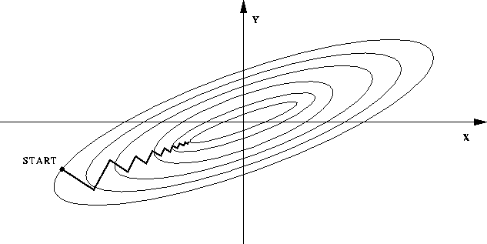
One approach: gradient descent
Partial derivatives give us the slope (i.e. direction to move) in that dimension
Approach:
pick a starting point (w)
repeat:
pick a dimension
move a small amount in that dimension towards decreasing loss (using the derivative)

Slide 28
Output layer weights
h₁
v₁
out
…
v_{d}
h_{d}
how far from correct and which direction
size and direction of the feature associated with this weight
slope of the activation function where input is at

Slide 29
Output layer weights
h₁
v₁
out
…
v_{d}
h_{d}
how far from correct and which direction
?

Slide 30
Output layer weights
h₁
v₁
out
…
v_{d}
h_{d}
how far from correct and which direction
prediction < label:
increase the weight
prediction > label:
decrease the weight
bigger difference = bigger change

Slide 31
Output layer weights
h₁
v₁
out
…
v_{d}
h_{d}
slope of the activation function where input is at
smaller step
bigger step
smaller step

Slide 32
Output layer weights
h₁
v₁
out
…
v_{d}
h_{d}
size and direction of the feature associated with this weight

Slide 33
Backpropagation: the details
Gradient descent method for learning weights by optimizing a loss function
calculate output of all nodes
calculate the updates directly for the output layer
“backpropagate” errors through hidden layers

Slide 34
Backpropagation: hidden layer
output layer
hidden layer
error
output activation slope
input
error
output activation slope
input
w₁₁
x₁
w₂₁
h₁
w₃₁
v₁
out
…
…
v_{d}
x_{m}
w_{dm}
weight from hidden layer to output layer
slope of wx
h_{d}

Slide 35
There’s a bit of math to show this, but it’s mostly just calculus…

Slide 36
Learning rate
Output layer update:
Hidden layer update:
Adjust how large the updates we’ll make (a parameter to the learning approach – like lambda for n-gram models)
Often will start larger and then get smaller

Slide 37
Backpropagation implementation
for some number of iterations:
randomly shuffle training data
for each example:
Compute all outputs going forward
Calculate new weights and modified errors at output layer
Recursively calculate new weights and modified errors on hidden layers based on recursive relationship
Update model with new weights
Notes:
- Make sure to calculate all of the outputs and modified errors *before* updating any of the model weights

Slide 38
Many variations
Momentum: include a factor in the weight update to keep moving in the direction of the previous update
Mini-batch:
Compromise between online and batch
Avoids noisiness of updates from online while making more educated weight updates
Simulated annealing:
With some probability make a random weight update
Reduce this probability over time
…

Slide 39
Challenges of neural networks?
Picking network configuration
Can be slow to train for large networks and large amounts of data
Loss functions (including squared error) are generally not convex with respect to the parameter space

