Slide 1
Introduction to
Statistical Machine Translation
David Kauchak
CS159 – Fall 2014
Some slides adapted from
Philipp Koehn
Kevin Knight
Dan Klein
School of Informatics
University of Edinburgh
USC/Information Sciences Institute
USC/Computer Science Department
Computer Science Department
UC Berkeley

Slide 2
Admin
Assignment 5
Normal office hours on Friday

Slide 3





Language translation
Yo quiero Taco Bell

Slide 4
MT Systems
Where have you seen machine translation systems?

Slide 5
Machine Translation
美国关岛国际机场及其办公室均接获一名自称沙地阿拉伯富商拉登等发出的电子邮件，威胁将会向机场等公众地方发动生化袭击後，关岛经保持高度戒备。
The U.S. island of Guam is maintaining a high state of alert after the Guam airport and its offices both received an e-mail from someone calling himself the Saudi Arabian Osama bin Laden and threatening a biological/chemical attack against public places such as the airport .
A good test for natural language processing.
Requires capabilities in both interpretation and generation.

Slide 6
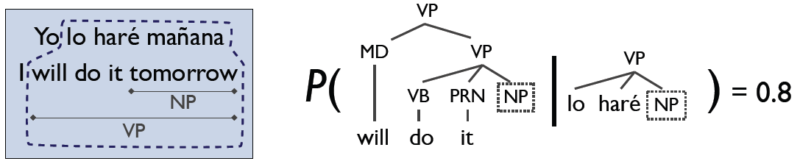
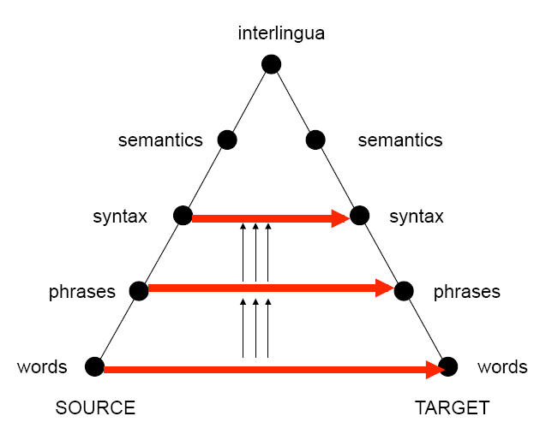
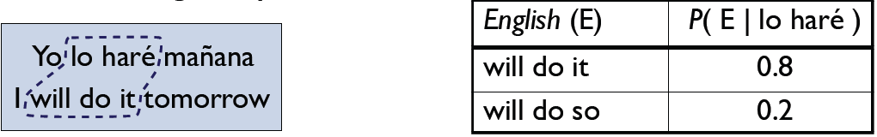
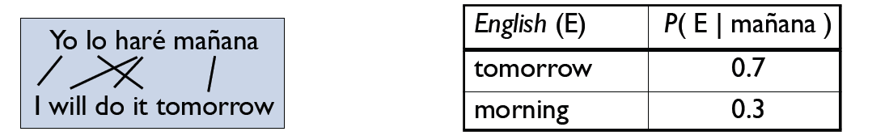
Levels of Transfer

Slide 7
World-Level MT: Examples
la politique de la haine . (Foreign Original)
politics of hate . (Reference Translation)
the policy of the hatred . (IBM4+N-grams+Stack)
nous avons signé le protocole . (Foreign Original)
we did sign the memorandum of agreement . (Reference Translation)
we have signed the protocol . (IBM4+N-grams+Stack)
où était le plan solide ? (Foreign Original)
but where was the solid plan ? (Reference Translation)
where was the economic base ? (IBM4+N-grams+Stack)

Slide 8
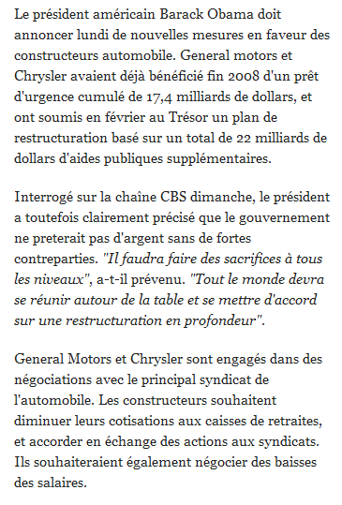
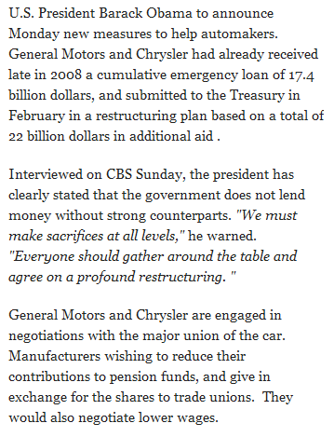
Phrasal / Syntactic MT: Examples

Slide 9

Data-Driven Machine Translation
Hmm, every time he sees
“banco”, he either types
“bank” or “bench” … but if
he sees “banco de…”,
he always types “bank”,
never “bench”…
Man, this is so boring.
Translated documents

Slide 10
Welcome to the Chinese Room
Chinese texts with
English translations
New
Chinese
Document
English
Translation
You can teach yourself to translate Chinese
using only bilingual data (without grammar books,
dictionaries, any people to answer your questions…)

Slide 11
Centauri/Arcturan [Knight, 1997]
Your assignment, translate this to Arcturan: farok crrrok hihok yorok clok kantok ok-yurp
1a. ok-voon ororok sprok .
1b. at-voon bichat dat .
7a. lalok farok ororok lalok sprok izok enemok .
7b. wat jjat bichat wat dat vat eneat .
2a. ok-drubel ok-voon anok plok sprok .
2b. at-drubel at-voon pippat rrat dat .
8a. lalok brok anok plok nok .
8b. iat lat pippat rrat nnat .
3a. erok sprok izok hihok ghirok .
3b. totat dat arrat vat hilat .
9a. wiwok nok izok kantok ok-yurp .
9b. totat nnat quat oloat at-yurp .
4a. ok-voon anok drok brok jok .
4b. at-voon krat pippat sat lat .
10a. lalok mok nok yorok ghirok clok .
10b. wat nnat gat mat bat hilat .
5a. wiwok farok izok stok .
5b. totat jjat quat cat .
11a. lalok nok crrrok hihok yorok zanzanok .
11b. wat nnat arrat mat zanzanat .
6a. lalok sprok izok jok stok .
6b. wat dat krat quat cat .
12a. lalok rarok nok izok hihok mok .
12b. wat nnat forat arrat vat gat .

Slide 12
Centauri/Arcturan [Knight, 1997]
Your assignment, translate this to Arcturan: farok crrrok hihok yorok clok kantok ok-yurp
1a. ok-voon ororok sprok .
1b. at-voon bichat dat .
7a. lalok farok ororok lalok sprok izok enemok .
7b. wat jjat bichat wat dat vat eneat .
2a. ok-drubel ok-voon anok plok sprok .
2b. at-drubel at-voon pippat rrat dat .
8a. lalok brok anok plok nok .
8b. iat lat pippat rrat nnat .
3a. erok sprok izok hihok ghirok .
3b. totat dat arrat vat hilat .
9a. wiwok nok izok kantok ok-yurp .
9b. totat nnat quat oloat at-yurp .
4a. ok-voon anok drok brok jok .
4b. at-voon krat pippat sat lat .
10a. lalok mok nok yorok ghirok clok .
10b. wat nnat gat mat bat hilat .
5a. wiwok farok izok stok .
5b. totat jjat quat cat .
11a. lalok nok crrrok hihok yorok zanzanok .
11b. wat nnat arrat mat zanzanat .
6a. lalok sprok izok jok stok .
6b. wat dat krat quat cat .
12a. lalok rarok nok izok hihok mok .
12b. wat nnat forat arrat vat gat .

Slide 13
Centauri/Arcturan [Knight, 1997]
Your assignment, translate this to Arcturan: farok crrrok hihok yorok clok kantok ok-yurp
1a. ok-voon ororok sprok .
1b. at-voon bichat dat .
7a. lalok farok ororok lalok sprok izok enemok .
7b. wat jjat bichat wat dat vat eneat .
2a. ok-drubel ok-voon anok plok sprok .
2b. at-drubel at-voon pippat rrat dat .
8a. lalok brok anok plok nok .
8b. iat lat pippat rrat nnat .
3a. erok sprok izok hihok ghirok .
3b. totat dat arrat vat hilat .
9a. wiwok nok izok kantok ok-yurp .
9b. totat nnat quat oloat at-yurp .
4a. ok-voon anok drok brok jok .
4b. at-voon krat pippat sat lat .
10a. lalok mok nok yorok ghirok clok .
10b. wat nnat gat mat bat hilat .
5a. wiwok farok izok stok .
5b. totat jjat quat cat .
11a. lalok nok crrrok hihok yorok zanzanok .
11b. wat nnat arrat mat zanzanat .
6a. lalok sprok izok jok stok .
6b. wat dat krat quat cat .
12a. lalok rarok nok izok hihok mok .
12b. wat nnat forat arrat vat gat .

Slide 14
Centauri/Arcturan [Knight, 1997]
Your assignment, translate this to Arcturan: farok crrrok hihok yorok clok kantok ok-yurp
1a. ok-voon ororok sprok .
1b. at-voon bichat dat .
7a. lalok farok ororok lalok sprok izok enemok .
7b. wat jjat bichat wat dat vat eneat .
2a. ok-drubel ok-voon anok plok sprok .
2b. at-drubel at-voon pippat rrat dat .
8a. lalok brok anok plok nok .
8b. iat lat pippat rrat nnat .
3a. erok sprok izok hihok ghirok .
3b. totat dat arrat vat hilat .
9a. wiwok nok izok kantok ok-yurp .
9b. totat nnat quat oloat at-yurp .
4a. ok-voon anok drok brok jok .
4b. at-voon krat pippat sat lat .
10a. lalok mok nok yorok ghirok clok .
10b. wat nnat gat mat bat hilat .
5a. wiwok farok izok stok .
5b. totat jjat quat cat .
11a. lalok nok crrrok hihok yorok zanzanok .
11b. wat nnat arrat mat zanzanat .
???
6a. lalok sprok izok jok stok .
6b. wat dat krat quat cat .
12a. lalok rarok nok izok hihok mok .
12b. wat nnat forat arrat vat gat .

Slide 15
Centauri/Arcturan [Knight, 1997]
Your assignment, translate this to Arcturan: farok crrrok hihok yorok clok kantok ok-yurp
1a. ok-voon ororok sprok .
1b. at-voon bichat dat .
7a. lalok farok ororok lalok sprok izok enemok .
7b. wat jjat bichat wat dat vat eneat .
2a. ok-drubel ok-voon anok plok sprok .
2b. at-drubel at-voon pippat rrat dat .
8a. lalok brok anok plok nok .
8b. iat lat pippat rrat nnat .
3a. erok sprok izok hihok ghirok .
3b. totat dat arrat vat hilat .
9a. wiwok nok izok kantok ok-yurp .
9b. totat nnat quat oloat at-yurp .
4a. ok-voon anok drok brok jok .
4b. at-voon krat pippat sat lat .
10a. lalok mok nok yorok ghirok clok .
10b. wat nnat gat mat bat hilat .
5a. wiwok farok izok stok .
5b. totat jjat quat cat .
11a. lalok nok crrrok hihok yorok zanzanok .
11b. wat nnat arrat mat zanzanat .
6a. lalok sprok izok jok stok .
6b. wat dat krat quat cat .
12a. lalok rarok nok izok hihok mok .
12b. wat nnat forat arrat vat gat .

Slide 16
Centauri/Arcturan [Knight, 1997]
Your assignment, translate this to Arcturan: farok crrrok hihok yorok clok kantok ok-yurp
1a. ok-voon ororok sprok .
1b. at-voon bichat dat .
7a. lalok farok ororok lalok sprok izok enemok .
7b. wat jjat bichat wat dat vat eneat .
2a. ok-drubel ok-voon anok plok sprok .
2b. at-drubel at-voon pippat rrat dat .
8a. lalok brok anok plok nok .
8b. iat lat pippat rrat nnat .
3a. erok sprok izok hihok ghirok .
3b. totat dat arrat vat hilat .
9a. wiwok nok izok kantok ok-yurp .
9b. totat nnat quat oloat at-yurp .
4a. ok-voon anok drok brok jok .
4b. at-voon krat pippat sat lat .
10a. lalok mok nok yorok ghirok clok .
10b. wat nnat gat mat bat hilat .
5a. wiwok farok izok stok .
5b. totat jjat quat cat .
11a. lalok nok crrrok hihok yorok zanzanok .
11b. wat nnat arrat mat zanzanat .
6a. lalok sprok izok jok stok .
6b. wat dat krat quat cat .
12a. lalok rarok nok izok hihok mok .
12b. wat nnat forat arrat vat gat .

Slide 17
Centauri/Arcturan [Knight, 1997]
Your assignment, translate this to Arcturan: farok crrrok hihok yorok clok kantok ok-yurp
1a. ok-voon ororok sprok .
1b. at-voon bichat dat .
7a. lalok farok ororok lalok sprok izok enemok .
7b. wat jjat bichat wat dat vat eneat .
2a. ok-drubel ok-voon anok plok sprok .
2b. at-drubel at-voon pippat rrat dat .
8a. lalok brok anok plok nok .
8b. iat lat pippat rrat nnat .
3a. erok sprok izok hihok ghirok .
3b. totat dat arrat vat hilat .
9a. wiwok nok izok kantok ok-yurp .
9b. totat nnat quat oloat at-yurp .
4a. ok-voon anok drok brok jok .
4b. at-voon krat pippat sat lat .
10a. lalok mok nok yorok ghirok clok .
10b. wat nnat gat mat bat hilat .
5a. wiwok farok izok stok .
5b. totat jjat quat cat .
11a. lalok nok crrrok hihok yorok zanzanok .
11b. wat nnat arrat mat zanzanat .
6a. lalok sprok izok jok stok .
6b. wat dat krat quat cat .
12a. lalok rarok nok izok hihok mok .
12b. wat nnat forat arrat vat gat .

Slide 18
Centauri/Arcturan [Knight, 1997]
Your assignment, translate this to Arcturan: farok crrrok hihok yorok clok kantok ok-yurp
1a. ok-voon ororok sprok .
1b. at-voon bichat dat .
7a. lalok farok ororok lalok sprok izok enemok .
7b. wat jjat bichat wat dat vat eneat .
2a. ok-drubel ok-voon anok plok sprok .
2b. at-drubel at-voon pippat rrat dat .
8a. lalok brok anok plok nok .
8b. iat lat pippat rrat nnat .
3a. erok sprok izok hihok ghirok .
3b. totat dat arrat vat hilat .
9a. wiwok nok izok kantok ok-yurp .
9b. totat nnat quat oloat at-yurp .
4a. ok-voon anok drok brok jok .
4b. at-voon krat pippat sat lat .
10a. lalok mok nok yorok ghirok clok .
10b. wat nnat gat mat bat hilat .
???
5a. wiwok farok izok stok .
5b. totat jjat quat cat .
11a. lalok nok crrrok hihok yorok zanzanok .
11b. wat nnat arrat mat zanzanat .
6a. lalok sprok izok jok stok .
6b. wat dat krat quat cat .
12a. lalok rarok nok izok hihok mok .
12b. wat nnat forat arrat vat gat .

Slide 19
Centauri/Arcturan [Knight, 1997]
Your assignment, translate this to Arcturan: farok crrrok hihok yorok clok kantok ok-yurp
1a. ok-voon ororok sprok .
1b. at-voon bichat dat .
7a. lalok farok ororok lalok sprok izok enemok .
7b. wat jjat bichat wat dat vat eneat .
2a. ok-drubel ok-voon anok plok sprok .
2b. at-drubel at-voon pippat rrat dat .
8a. lalok brok anok plok nok .
8b. iat lat pippat rrat nnat .
3a. erok sprok izok hihok ghirok .
3b. totat dat arrat vat hilat .
9a. wiwok nok izok kantok ok-yurp .
9b. totat nnat quat oloat at-yurp .
4a. ok-voon anok drok brok jok .
4b. at-voon krat pippat sat lat .
10a. lalok mok nok yorok ghirok clok .
10b. wat nnat gat mat bat hilat .
5a. wiwok farok izok stok .
5b. totat jjat quat cat .
11a. lalok nok crrrok hihok yorok zanzanok .
11b. wat nnat arrat mat zanzanat .
6a. lalok sprok izok jok stok .
6b. wat dat krat quat cat .
12a. lalok rarok nok izok hihok mok .
12b. wat nnat forat arrat vat gat .

Slide 20
Centauri/Arcturan [Knight, 1997]
Your assignment, translate this to Arcturan: farok crrrok hihok yorok clok kantok ok-yurp
1a. ok-voon ororok sprok .
1b. at-voon bichat dat .
7a. lalok farok ororok lalok sprok izok enemok .
7b. wat jjat bichat wat dat vat eneat .
2a. ok-drubel ok-voon anok plok sprok .
2b. at-drubel at-voon pippat rrat dat .
8a. lalok brok anok plok nok .
8b. iat lat pippat rrat nnat .
3a. erok sprok izok hihok ghirok .
3b. totat dat arrat vat hilat .
9a. wiwok nok izok kantok ok-yurp .
9b. totat nnat quat oloat at-yurp .
4a. ok-voon anok drok brok jok .
4b. at-voon krat pippat sat lat .
10a. lalok mok nok yorok ghirok clok .
10b. wat nnat gat mat bat hilat .
process of
elimination
5a. wiwok farok izok stok .
5b. totat jjat quat cat .
11a. lalok nok crrrok hihok yorok zanzanok .
11b. wat nnat arrat mat zanzanat .
6a. lalok sprok izok jok stok .
6b. wat dat krat quat cat .
12a. lalok rarok nok izok hihok mok .
12b. wat nnat forat arrat vat gat .

Slide 21
Centauri/Arcturan [Knight, 1997]
Your assignment, translate this to Arcturan: farok crrrok hihok yorok clok kantok ok-yurp
1a. ok-voon ororok sprok .
1b. at-voon bichat dat .
7a. lalok farok ororok lalok sprok izok enemok .
7b. wat jjat bichat wat dat vat eneat .
2a. ok-drubel ok-voon anok plok sprok .
2b. at-drubel at-voon pippat rrat dat .
8a. lalok brok anok plok nok .
8b. iat lat pippat rrat nnat .
3a. erok sprok izok hihok ghirok .
3b. totat dat arrat vat hilat .
9a. wiwok nok izok kantok ok-yurp .
9b. totat nnat quat oloat at-yurp .
4a. ok-voon anok drok brok jok .
4b. at-voon krat pippat sat lat .
10a. lalok mok nok yorok ghirok clok .
10b. wat nnat gat mat bat hilat .
5a. wiwok farok izok stok .
5b. totat jjat quat cat .
11a. lalok nok crrrok hihok yorok zanzanok .
11b. wat nnat arrat mat zanzanat .
cognate?
6a. lalok sprok izok jok stok .
6b. wat dat krat quat cat .
12a. lalok rarok nok izok hihok mok .
12b. wat nnat forat arrat vat gat .

Slide 22
Centauri/Arcturan [Knight, 1997]
Your assignment, put these words in order: { jjat, arrat, mat, bat, oloat, at-yurp }
1a. ok-voon ororok sprok .
1b. at-voon bichat dat .
7a. lalok farok ororok lalok sprok izok enemok .
7b. wat jjat bichat wat dat vat eneat .
2a. ok-drubel ok-voon anok plok sprok .
2b. at-drubel at-voon pippat rrat dat .
8a. lalok brok anok plok nok .
8b. iat lat pippat rrat nnat .
3a. erok sprok izok hihok ghirok .
3b. totat dat arrat vat hilat .
9a. wiwok nok izok kantok ok-yurp .
9b. totat nnat quat oloat at-yurp .
4a. ok-voon anok drok brok jok .
4b. at-voon krat pippat sat lat .
10a. lalok mok nok yorok ghirok clok .
10b. wat nnat gat mat bat hilat .
5a. wiwok farok izok stok .
5b. totat jjat quat cat .
11a. lalok nok crrrok hihok yorok zanzanok .
11b. wat nnat arrat mat zanzanat .
zero
fertility
6a. lalok sprok izok jok stok .
6b. wat dat krat quat cat .
12a. lalok rarok nok izok hihok mok .
12b. wat nnat forat arrat vat gat .

Slide 23
It’s Really Spanish/English
Clients do not sell pharmaceuticals in Europe => Clientes no venden medicinas en Europa
1a. Garcia and associates .
1b. Garcia y asociados .
7a. the clients and the associates are enemies .
7b. los clients y los asociados son enemigos .
2a. Carlos Garcia has three associates .
2b. Carlos Garcia tiene tres asociados .
8a. the company has three groups .
8b. la empresa tiene tres grupos .
3a. his associates are not strong .
3b. sus asociados no son fuertes .
9a. its groups are in Europe .
9b. sus grupos estan en Europa .
4a. Garcia has a company also .
4b. Garcia tambien tiene una empresa .
10a. the modern groups sell strong pharmaceuticals .
10b. los grupos modernos venden medicinas fuertes .
5a. its clients are angry .
5b. sus clientes estan enfadados .
11a. the groups do not sell zenzanine .
11b. los grupos no venden zanzanina .
6a. the associates are also angry .
6b. los asociados tambien estan enfadados .
12a. the small groups are not modern .
12b. los grupos pequenos no son modernos .

Slide 24
Data available
Many languages
  Europarl corpus has all European languages
    http://www.statmt.org/europarl/
    From a few hundred thousand sentences to a few million
  French/English from French parliamentary proceedings
  Lots of Chinese/English and Arabic/English from government projects/interests
    Chinese-English: Hundreds of millions if sentence pairs)
    Arabic-English: ~One hundred million sentence pairs
  Smaller corpora in many, many other languages
Lots of monolingual data available in many languages
Even less data with multiple translations available
Available in limited domains
  most data is either news or government proceedings
  some other domains recently, like blogs

Slide 25
Statistical MT Overview
training
learn parameters
Bilingual data
model
monolingual data
Find the best
translation given the foreign sentence and the model (aka “decoding”)
Translation
Foreign sentence
English
sentence

Slide 26
Statistical MT
We will model the translation process probabilistically
Given a foreign sentence to translate, for any possible English sentence, we want to know the probability that the sentence is a translation of the foreign sentence
If we can find the most probable English sentence, we’re done
p(english sentence | foreign sentence)

Slide 27
Translation
Probabilistic model:
p(English | Foreign)
What is the translation problem then?
Notes:
general idea started with information theory and Shannon in the 40s
used in the early 90s by IBM team for machine translation
- started to become a prevalent model for text-to-text approaches in the late 1990s

Slide 28
Noisy channel model
Bayes’ rule
probability of the foreign sentence
language model: what are likely English word sequences?
translation model: how does the translation process happen? probability of the translated English sentence given the foreign sentence

Slide 29
Noisy channel model
Bayes’ rule
probability of the foreign sentence
why?
language model: what are likely English word sequences?
translation model: how does the translation process happen? probability of the translated English sentence given the foreign sentence

Slide 30
Noisy channel model
Bayes’ rule
probability of the foreign sentence
why?
this is a constant for any given f

Slide 31
Noisy channel model
model
translation model
language model
how do English sentences get translated to foreign?
what do English sentences look like?

Slide 32
Translation model
The models define probabilities over inputs
Morgen fliege ich nach Kanada zur Konferenz
Tomorrow I will fly to the conference in Canada
What is the probability that the English sentence is a translation of the foreign sentence?

Slide 33
Translation model
The models define probabilities over inputs
Morgen
fliege
ich
nach Kanada
zur Konferenz
Tomorrow
I
will fly
to the conference
In Canada
What is the probability of a foreign word being translated as a particular English word?
What is the probability of a foreign foreign phrase being translated as a particular English phrase?
What is the probability of a word/phrase changing ordering?
What is the probability of a foreign word/phrase disappearing?
What is the probability of a English word/phrase appearing?

Slide 34
Translation model
The models define probabilities over inputs
p( Morgen fliege ich nach Kanada zur Konferenz |
Tomorrow I will fly to the conference in Canada )
= 0.1
p( Morgen fliege ich nach Kanada zur Konferenz |
I like peanut butter and jelly )
= 0.0001

Slide 35
Language model
The models define probabilities over inputs
Tomorrow I will fly to the conference in Canada

Slide 36
What is a probability distribution?
A probability distribution defines the probability over a space of possible inputs
For the language model, what is the space of possible inputs?
  A language model describes the probability over ALL possible combinations of English words
For the translation model, what is the space of possible inputs?
  ALL possible combinations of foreign words with ALL possible combinations of English words

Slide 37
One way to think about it…
Translation
model
Broken
English
language
model
Spanish
(foreign)
English
What hunger have I,
Hungry I am so,
I am so hungry,
Have I that hunger …
Que hambre tengo yo
I am so hungry

Slide 38
Statistical MT Overview
training
learned parameters
“nice” fragment aligned data
Bilingual data
Translation model
preprocessing
monolingual data
Language model
Decoder
(what English sentence is most probable given foreign sentence with learned models)
Translation
Foreign sentence

Slide 39
Basic Model, Revisited
argmax P(e | f) =
e
argmax P(e) x P(f | e) / P(f) =
e
argmax P(e) x P(f | e)
e

Slide 40
Basic Model, Revisited
argmax P(e | f) =
e
argmax P(e) x P(f | e) / P(f) =
e
argmax P(e)^{2.4} x P(f | e) … works better!
e

Slide 41
Basic Model, Revisited
argmax P(e | f) =
e
argmax P(e) x P(f | e) / P(f)
e
argmax P(e)^{2.4} x P(f | e) x length(e)^{1.1}
e
Rewards longer hypotheses, since
these are unfairly punished by P(e)

Slide 42
Basic Model, Revisited
argmax P(e)^{2.4} x P(f | e) x length(e)^{1.1} x KS ^{3.7} …
e
Lots of knowledge sources vote on any given hypothesis.
“Knowledge source” = “feature function” = “score component”.
A feature function simply scores a hypothesis with a real value.
(May be binary, as in “e has a verb”).

Slide 43
Problems for Statistical MT
Preprocessing
  How do we get aligned bilingual text?
  Tokenization
  Segmentation (document, sentence, word)
Language modeling
  Given an English string e, assigns P(e) by formula
Translation modeling
  Given a pair of strings <f,e>, assigns P(f | e) by formula
Decoding
  Given a language model, a translation model, and a new sentence f … find translation e maximizing P(e) * P(f | e)
Parameter optimization
  Given a model with multiple feature functions, how are they related? What are the optimal parameters?
Evaluation
  How well is a system doing? How can we compare two systems?

Slide 44
Translation Model
Want: probabilistic model gives us how likely one sentence is to be a translation of another, i.e p(foreign | english)
Mary did not slap the green witch
Maria no dió una botefada a la bruja verde
Can we just model this directly, i.e. p(foreign | english) ?
How would we estimate these probabilities, e.g.
p( “Maria …” | “Mary …”)?

Slide 45
Translation Model
Want: probabilistic model gives us how likely one sentence is to be a translation of another, i.e p(foreign | english)
Mary did not slap the green witch
Maria no dió una botefada a la bruja verde
count(“Mary…” aligned-to “Maria…”)
p( “Maria…” | “Mary…” ) =
count( “Mary…”)
Not enough data for most sentences!

Slide 46
Translation Model
Key: break up process into smaller steps
Mary did not slap the green witch
sufficient statistics for smaller steps
Maria no dió una botefada a la bruja verde

Slide 47
What kind of Translation Model?
Mary did not slap the green witch
Word-level models
Phrasal models
Syntactic models
Semantic models
Maria no dió una botefada a la bruja verde

Slide 48
IBM Word-level models
Mary did not slap the green witch
Word-level model
Maria no dió una botefada a la bruja verde
Generative story: description of how the translation happens
1. Each English word gets translated as 0 or more Foreign words
2. Some additional foreign words get inserted
3. Foreign words then get shuffled

Slide 49
IBM Word-level models
Mary did not slap the green witch
Word-level model
Maria no dió una botefada a la bruja verde
Each foreign word is aligned to exactly one English word.
Key idea: decompose p( foreign | english ) into word translation probabilities of the form p( foreign_word | english_word )
IBM described 5 different levels of models with increasing complexity (and decreasing independence assumptions)

Slide 50
Some notation
English sentence with length |E|
Foreign sentence with length |F|
Mary did not slap the green witch
Maria no dió una botefada a la bruja verde
Translation model:

Slide 51
Word models: IBM Model 1
Mary did not slap the green witch
p(verde | green)
Maria no dió una botefada a la bruja verde
Each foreign word is aligned to exactly one English word
This is the ONLY thing we model!
Does the model handle foreign words that are not aligned, e.g. “a”?

Slide 52
Word models: IBM Model 1
NULL
Mary did not slap the green witch
p(verde | green)
Maria no dió una botefada a la bruja verde
Each foreign word is aligned to exactly one English word
This is the ONLY thing we model!
Include a “NULL” English word and align to this to account for deletion

Slide 53
Word models: IBM Model 1
generative story -> probabilistic model
  Key idea: introduce “hidden variables” to model the word alignment
one variable for each foreign word
a_{i} corresponds to the ith foreign word
each a_{i} can take a value 0…|E|

Slide 54
Alignment variables
Mary did not slap the green witch
Maria no dió una botefada a la bruja verde
a₁ | 1
a₂ | 3
a₃ | 4
a₄ | 4
a₅ | 4
a₆ | 0
a₇ | 5
a₈ | 7
a₉ | 6

Slide 55
Alignment variables
And the program has been implemented
Alignment?
Le programme a ete mis en application

Slide 56
Alignment variables
And the program has been implemented
Le programme a ete mis en application
a₁ | ?
a₂ | ?
a₃ | ?
a₄ | ?
a₅ | ?
a₆ | ?
a₇ | ?

Slide 57
Alignment variables
And the program has been implemented
Le programme a ete mis en application
a₁ | 2
a₂ | 3
a₃ | 4
a₄ | 5
a₅ | 6
a₆ | 6
a₇ | 6

Slide 58
Probabilistic model
?
=
NO!
How do we get rid of variables?

Slide 59
Joint distribution
NLPPass, EngPass | P(NLPPass, EngPass)
true, true | .88
true, false | .01
false, true | .04
false, false | .07
What is P(ENGPass)?

Slide 60
Joint distribution
0.92
NLPPass, EngPass | P(NLPPass, EngPass)
true, true | .88
true, false | .01
false, true | .04
false, false | .07
How did you figure that out?

Slide 61
Joint distribution
Called “marginalization”, aka summing over a variable
NLPPass, EngPass | P(NLPPass, EngPass)
true, true | .88
true, false | .01
false, true | .04
false, false | .07

Slide 62
Probabilistic model
Sum over all possible values, i.e. marginalize out the alignment variables

Slide 63
Independence assumptions
IBM Model 1:
What independence assumptions are we making?
What information is lost?

Slide 64
And the program has been implemented
Le programme a ete mis en application
Are the probabilities any different under model 1?
And the program has been implemented
application en programme Le mis ete a

Slide 65
And the program has been implemented
Le programme a ete mis en application
No. Model 1 ignores word order!
And the program has been implemented
application en programme Le mis ete a

Slide 66
IBM Model 2
NULL
Mary did not slap the green witch
p(la|the)
Maria no dió una botefada a la verde bruja
p(i aligned-to a_{i})
Maria no dió una botefada a la bruja verde
Models word movement by position, e.g.
Words don’t tend to move too much
Words at the beginning move less than words at the end

Slide 67
IBM Model 3
NULL
Mary did not slap the green witch
p(3|slap)
Mary not slap slap slap the green witch
p(la|the)
Maria no dió una botefada a la verde bruja
p(i aligned-to a_{i})
Maria no dió una botefada a la bruja verde
Incorporates “fertility”: how likely a particular English word is to produce multiple foreign words

Slide 68
Word-level models
Problems/concerns?
  Multiple English words for one French word
    IBM models can do one-to-many (fertility) but not many-to-one
  Phrasal Translation
    “real estate”, “note that”, “interest in”
  Syntactic Transformations
    Verb at the beginning in Arabic
    Translation model penalizes any proposed re-ordering
    Language model not strong enough to force the verb to move to the right place
Notes:
Why word-level models, then?

Slide 69
Benefits of word-level model
Rarely used in practice for modern MT systems
Why talk about them?
Mary did not slap the green witch
Maria no dió una botefada a la bruja verde
Two key side effects of training a word-level model:
  Word-level alignment
  p(f | e): translation dictionary
Notes:
- though a few groups still have successful IBM 4-5 systems

Slide 70
Training a word-level model
Where do these come from?
Have to learn them!
The old man is happy. He has fished many times.
His wife talks to him.
The sharks await.
…
El viejo está feliz porque ha pescado muchos veces.
Su mujer habla con él.
Los tiburones esperan.
…

